Slide 1
Rahab: A Faith Not Held Back by Fear
June 15

Slide 2
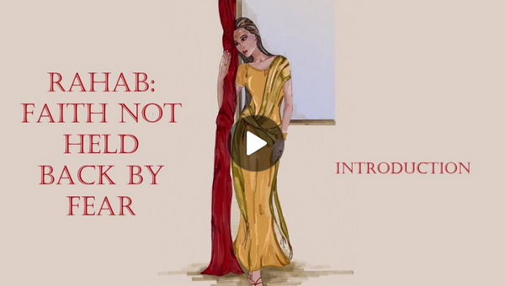
Video Introduction
View Video

Slide 3
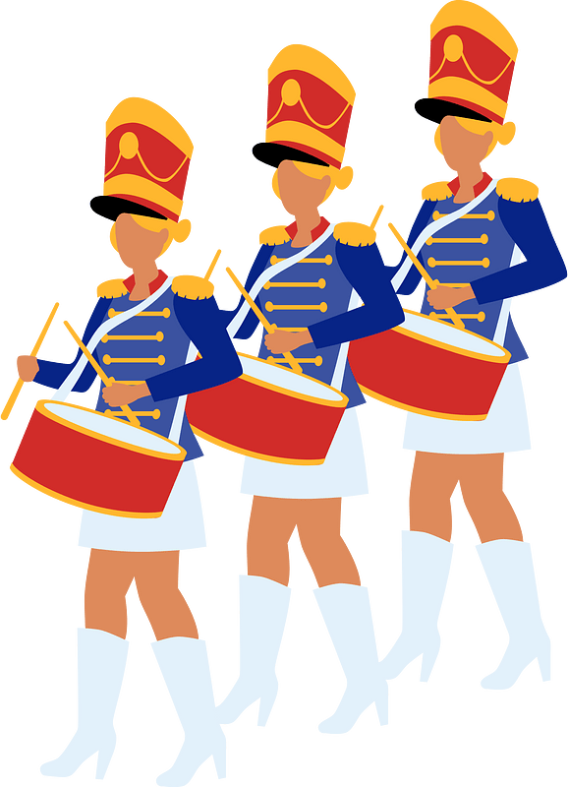
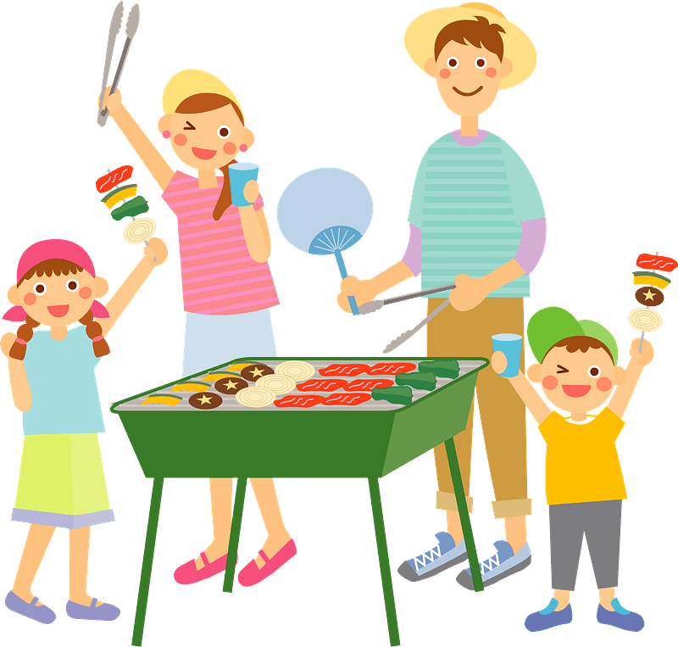
Think about it …
What is your fondest memory of celebrating Independence Day?
Consider the fact that for America’s founding fathers, it may have been a day clouded with fear.
The overcame that fear to establish our nation.
Today we look at how faith acts when others are paralyzed by fear.

Slide 4
Listen for intrigue
Joshua 2:1-4 (NIV) Then Joshua son of Nun secretly sent two spies from Shittim. "Go, look over the land," he said, "especially Jericho." So they went and entered the house of a prostitute named Rahab and stayed there. 2 The king of Jericho was told, "Look! Some of the

Slide 5
Listen for intrigue
Israelites have come here tonight to spy out the land." 3 So the king of Jericho sent this message to Rahab: "Bring out the men who came to you and entered your house, because they have come to spy out the whole land." 4 But the woman had taken the two men and hidden them..

Slide 6
Faith Says, “Always Do Right”
What action did Joshua take as further preparation for leading the Israelites across the Jordan into Canaan?
Why might the two spies have chosen to go to Rahab’s house, a known place of prostitution?
How do you imagine the spies felt about sneaking into Canaan, even though it was an important role?

Slide 7
Faith Says, “Always Do Right”
When have you ever been scared or nervous about doing something that you knew was right?
What actions did Rahab take to protect the Israelite spies?

Slide 8
Faith Says, “Always Do Right”
Why was such action potentially risky for her; therefore an act of courage?
How do we navigate the tension between obeying our elected leaders and obeying God?

Slide 9
Listen for fear expressed.
Joshua 2:8-14 (NIV) Before the spies lay down for the night, she went up on the roof 9 and said to them, "I know that the LORD has given this land to you and that a great fear of you has fallen on us, so that all who live in this country are melting in fear because of you. 10 We have heard how the LORD dried up the water of

Slide 10
Listen for fear expressed.
the Red Sea for you when you came out of Egypt, and what you did to Sihon and Og, the two kings of the Amorites east of the Jordan, whom you completely destroyed. 11 When we heard of it, our hearts melted and everyone's courage failed because of you, for the LORD your God is God in heaven above and on the

Slide 11
Listen for fear expressed.
earth below. 12 Now then, please swear to me by the LORD that you will show kindness to my family, because I have shown kindness to you. Give me a sure sign 13 that you will spare the lives of my father and mother, my brothers and sisters, and all who belong to them, and that you will save us from death."

Slide 12
Faith in the Face of Fear
What words and phrases did Rahab use to describe the feelings of the people of Jericho?
What reports of awesome events had proceeded the Israelites?
What is the significance of her use of God’s name, LORD, or Jehovah in her descriptions?

Slide 13
Faith in the Face of Fear
How would you explain the phrase “fear of God” to someone who isn’t a Christ-follower?
Consider the statement, Fear of God fuels faith into action. What do you think that means?

Slide 14
Listen for a promise fulfilled.
Joshua 6:22-25 (NIV) Joshua said to the two men who had spied out the land, "Go into the prostitute's house and bring her out and all who belong to her, in accordance with your oath to her." 23 So the young men who had done the spying went in and brought out Rahab, her father and

Slide 15
Listen for a promise fulfilled.
mother and brothers and all who belonged to her. They brought out her entire family and put them in a place outside the camp of Israel. 24 Then they burned the whole city and everything in it, but they put the silver and gold and the articles of bronze and iron into

Slide 16
Listen for a promise fulfilled.
the treasury of the LORD's house. 25 But Joshua spared Rahab the prostitute, with her family and all who belonged to her, because she hid the men Joshua had sent as spies to Jericho--and she lives among the Israelites to this day.

Slide 17
Our Faith Benefits Others
What assignment did Joshua give to the two former spies when the city of Jericho fell?
Who else benefited from her acting by faith?

Slide 18
Our Faith Benefits Others
What do we learn about the mercy, love and grace God in this story about Rahab?
Mercy | Love and Grace

Slide 19
Our Faith Benefits Others
We note that Rahab’s faith affected not just her, but her whole family. What does this suggest about the “ripple effect” of one’s personal faith?
What does Rahab’s story say about God’s willingness to use unlikely people for His purposes?

Slide 20
Application
Imagine.
Your faith may be new but imagine having a strong faith like Rahab.
Think of one thing in your life that would be different if you had stronger faith.
What could you accomplish?

Slide 21
Application
Plan.
Faith demands action. Your life may not be in danger like Rahab’s, but each small step of faith will prepare you to take more giant steps as your faith grows.
What can you do today that will make progress toward the one thing you considered above? Make a plan.

Slide 22
Application
Share.
As your faith grows and you take bigger and bigger steps, people will notice.
What will their reaction be regarding your growing faith?
It will impact your family, friends, and even the world.
Choose someone with whom you can share your faith journey.
Pray for this person before sharing your faith.

Slide 23
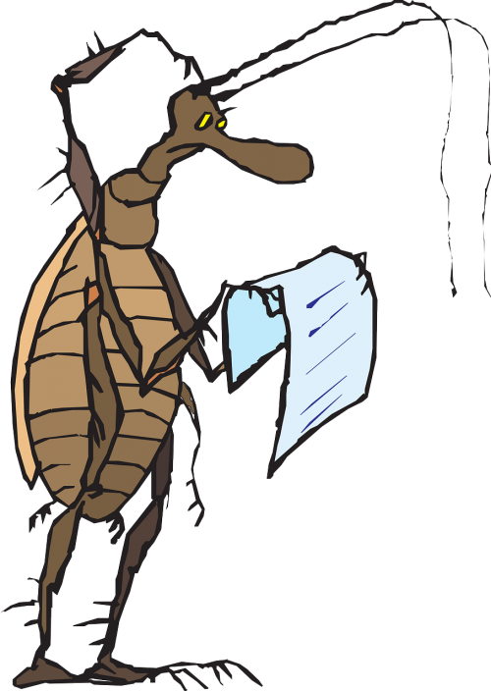
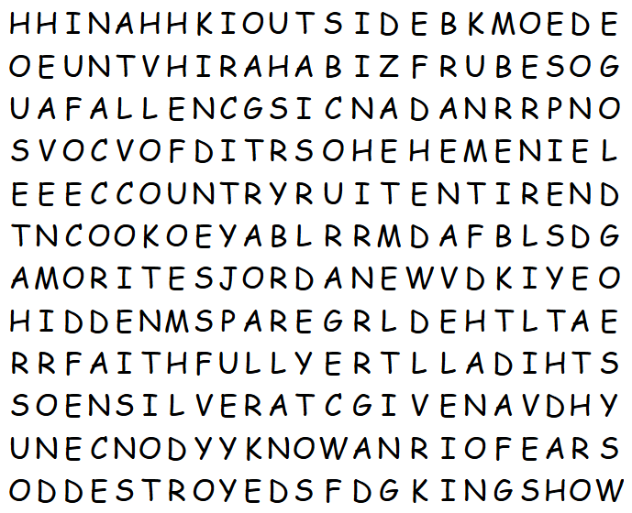
Family Activities
So, what is a “FRUBSOG”? Oh yes, it’s not in the list. But, help and other fun family activities are available at https://tinyurl.com/4w3zchsm

