Slide 1
Rahab: Courageous Faith
June 2

Slide 2
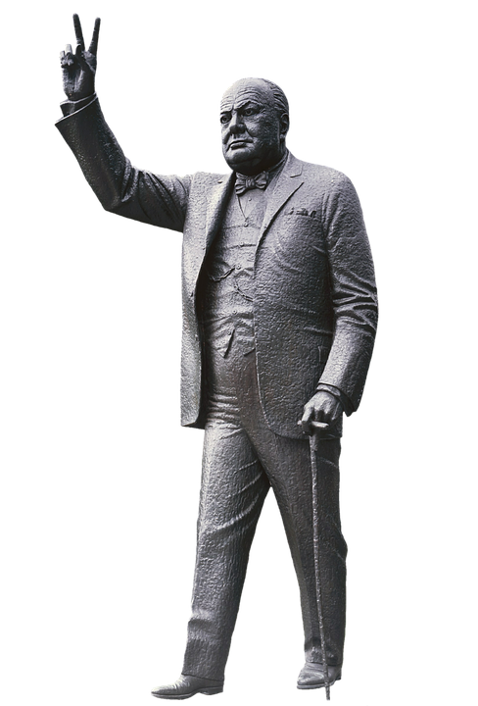
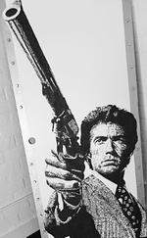
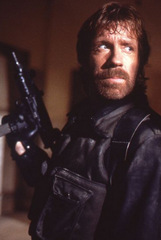
Admit it, now …
Who comes to mind when you hear the word “courage”
Today we study a person had courageous faith because of her awe of Jehovah God.
The power of God that leads us to fear Him also leads us to trust Him

Slide 3
Listen for how spies were protected.
Joshua 2:1-7 (NIV) Then Joshua son of Nun secretly sent two spies from Shittim. "Go, look over the land," he said, "especially Jericho." So they went and entered the house of a prostitute named Rahab and stayed there. 2 The king of Jericho was told, "Look! Some of the Israelites have come here tonight to spy out the land."3 So the king of Jericho sent this message to Rahab.

Slide 4
Listen for how spies were protected.
"Bring out the men who came to you and entered your house, because they have come to spy out the whole land." 4 But the woman had taken the two men and hidden them. She said, "Yes, the men came to me, but I did not know where they had come from. 5 At dusk, when it was time to close the city gate, the men left. I don't know which way they went.

Slide 5
Listen for how spies were protected.
Go after them quickly. You may catch up with them." 6 (But she had taken them up to the roof and hidden them under the stalks of flax she had laid out on the roof.) 7 So the men set out in pursuit of the spies on the road that leads to the fords of the Jordan, and as soon as the pursuers had gone out, the gate was shut.

Slide 6
Fear of God Fuels Courage
What action did Joshua take as further preparation for leading the Israelites across the Jordan into Canaan?
Why might the two spies have chosen to go to Rahab’s house, a known place of prostitution?
How do you imagine the spies felt about sneaking into Canaan, even though it was an important role?

Slide 7
Fear of God Fuels Courage
When have you ever been scared or nervous about doing something that you knew was right?
What actions did Rahab take to protect the Israelite spies?
Why was such action potentially risky for her; therefore an act of courage?

Slide 8
Listen for a confession
Joshua 2:8-11 (NIV) Before the spies lay down for the night, she went up on the roof 9 and said to them, "I know that the LORD has given this land to you and that a great fear of you has fallen on us, so that all who live in this country are melting in fear because of you. 10 We have heard how the LORD dried up the water of the Red Sea for you when you

Slide 9
Listen for a confession
came out of Egypt, and what you did to Sihon and Og, the two kings of the Amorites east of the Jordan, whom you completely destroyed. 11 When we heard of it, our hearts melted and everyone's courage failed because of you, for the LORD your God is God in heaven above and on the earth below.

Slide 10
Confidence in Who God Is and What He Does
What words and phrases did Rahab use to describe the feelings of the people of Jericho?
What reports of awesome events had proceeded the Israelites?
What is the significance of her use of God’s name, LORD, or Jehovah in her descriptions?

Slide 11
Confidence in Who God Is and What He Does
How would you explain the phrase “fear of God” to someone who isn’t a Christfollower?
What are some ways God has demonstrated awesome power in meeting your needs?
How does our recollection of victories God has brought in the past encourage us to believe He has the power to bring about victory in the future?

Slide 12
Listen for a promise.
Joshua 2:12-14 (NIV) Now then, please swear to me by the LORD that you will show kindness to my family, because I have shown kindness to you. Give me a sure sign 13 that you will spare the lives of my father and mother, my brothers and sisters, and

Slide 13
Listen for a promise.
all who belong to them, and that you will save us from death." 14 "Our lives for your lives!" the men assured her. "If you don't tell what we are doing, we will treat you kindly and faithfully when the LORD gives us the land."

Slide 14
Fear of God Fuels Trust
What promise did Rahab ask the men of Israel to make to her?
What was the basis of the request?
How did they respond?
How might their response reflect the character of the God they served?

Slide 15
Fear of God Fuels Trust
Consider the statement, Fear of God fuels faith into action. What do you think that means?
When have you experienced the fear of God leading you to trust God more?

Slide 16
View Application Video

Slide 17
Application
Express thanks.
Pray and thank God for His faithfulness and His promises.
Remember that your past does not determine your future.

Slide 18
Application
Tackle the wall.
Is there a “wall” in your life that you need God to tear down? Trust Him to do so.
Journal your fears and write out Scriptures that remind you of God’s faithfulness.
Remember Psalm 145:6: “They tell of the power of your awesome works—and I will proclaim your great deeds.”

Slide 19
Application
Leave a legacy.
Ask God to guide you in leaving the right kind of spiritual legacy to those who follow you.
It begins with sharing your faith in Christ.
Seek opportunities to talk and pray with someone who needs to turn from sin and trust in Christ.

Slide 20
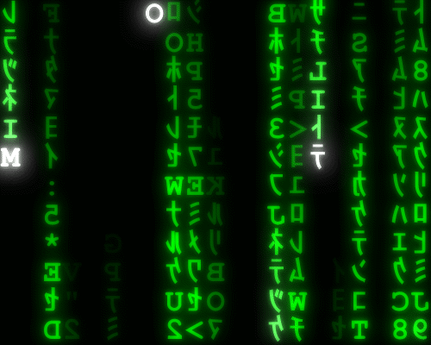
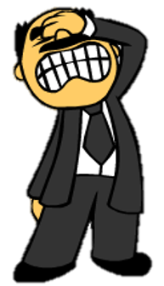
Family Activities
Oh the letters … they’ve fallen and they can’t get up. You’ve got to fix them. Go to https://tinyurl.com/y33dnu4t if you get stuck. You can get help (and other fun Family Activities) online.

Slide 21
Rahab: Courageous Faith
June 2

