Slide 1
Salvation
March 15

Slide 2
Video Introduction
View Video

Slide 3
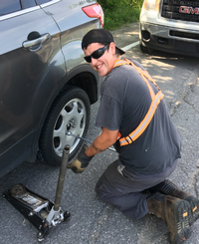
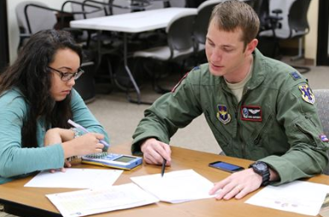
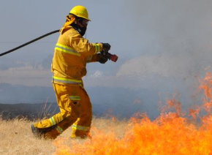
Admit it, now …
When have you been happy for someone to step in and fix something you couldn’t?
The biggest problem we have is our sin problem – which we can’t fix.
We were separated from God because of our sin.
Jesus made it possible for us to be righteous before God.

Slide 4
Listen for what the law does not do.
Romans 3:20-22 (NIV) Therefore no one will be declared righteous in his sight by observing the law; rather, through the law we become conscious of sin. 21 But now a righteousness from God, apart from law, has been made known, to which the Law and the Prophets testify. 22 This righteousness from God comes through faith in Jesus Christ to all who believe. There is no difference,

Slide 5
Declared Righteous by Christ
By what means did Paul say we cannot be justified?
What is one purpose of the law?
Aren’t we already conscious of sin? Why do we need the law to make us conscious of sin?
To what does the righteousness of God refer?

Slide 6
Declared Righteous by Christ
Note the starting words, “But now.” Why would these be important? What do they indicate?
So, what do you think Paul was referring to when he talks about “a righteousness that is apart from the law”?
How do people define or determine right and wrong in our culture?

Slide 7
Declared Righteous by Christ
Why do people think they’ve got to be “a good person” to get into heaven?
How does God’s righteousness become active or take effect in our lives? What new righteousness has been made known?

Slide 8
Listen for God’s solution.
Romans 3:23-24 (NIV) for all have sinned and fall short of the glory of God, 24 and are justified freely by his grace through the redemption that came by Christ Jesus.

Slide 9
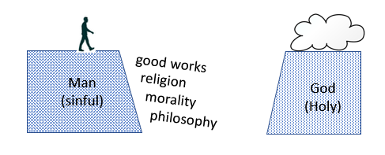
Redeemed by Christ
What does all humanity hold in common? What heritage do you share with every person who has ever lived?

Slide 10
Redeemed by Christ
Exactly what is justification?
What justifies us in God’s sight?
Why would God offer His righteousness free to every person from the penalty of sin?
How would you describe our sinful condition and God’s grace to someone for the first time?

Slide 11
Listen for what is accomplished by Christ.
Romans 3:25-28 (NIV) God presented him as a sacrifice of atonement, through faith in his blood. He did this to demonstrate his justice, because in his forbearance he had left the sins committed beforehand unpunished-- 26 he did it to demonstrate his justice at the present time, so as to be just

Slide 12
Listen for what is accomplished by Christ.
and the one who justifies those who have faith in Jesus. 27 Where, then, is boasting? It is excluded. On what principle? On that of observing the law? No, but on that of faith. 28 For we maintain that a man is justified by faith apart from observing the law.

Slide 13
Atonement through Christ
Verse 25 in the NIV uses the term “sacrifice of atonement” – what does the KJV use? What do these terms mean?
Demonstration of God’s Justice
Holy God – sinful man deserving of judgment (death)
Jesus came, lived a righteous life NOT deserving death
Jesus died in our place – God’s justice satisfied

Slide 14
Atonement through Christ
How do these Truths impact our lives today?
How do we relate this concept to witnessing to those who are lost?

Slide 15
Application
Believe.
Turn to God in faith and place your trust in Christ.
Turn from yourself and turn to Christ who offers salvation through His death and resurrection.
If you need help with this, read the inside front cover of your student book.

Slide 16
Application
Repent.
Examine your life for any boasting about who you are and what you’ve done.
Confess that to God, and thank Him for His forgiveness.
Recognize that anything you have or do is all from His grace.

Slide 17
Application
Share.
This good news is not intended to be kept to yourself.
Identify someone you know with whom you can share the gospel of God’s salvation.

Slide 18
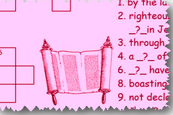
Family Activities
STOP! Security has been breached. The cryptogram has been concealed and the crossword has been leaked. Go to Family Activities at https://tinyurl.com/qrax9v7 for full disclosure. Your pastor is depending on you.

Slide 19
Salvation
March 15

