Slide 1
Set Apart The Holiness of God
July 16

Slide 2
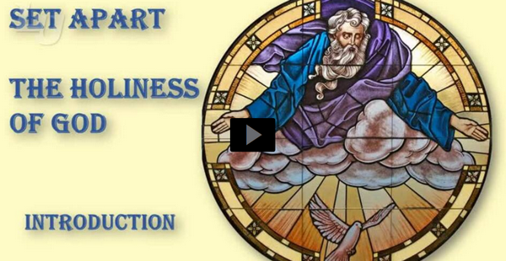
Video Introduction
View Video

Slide 3
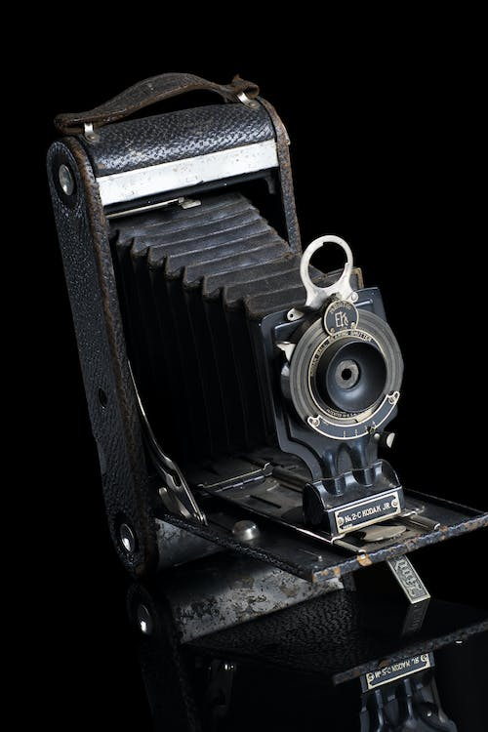
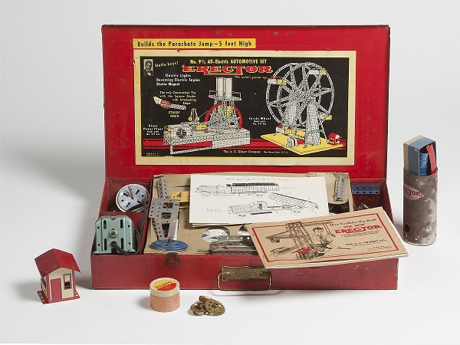
Think about it …
What is something you possess that you think is unique?
God is unique, different, set apart from everything in His creation.
Today’s lesson considers why God is holy !
https://longislandmuseum.org/

Slide 4
Listen for response to greatness.
Psalm 99:1-3 (NIV) The LORD reigns, let the nations tremble; he sits enthroned between the cherubim, let the earth shake. 2 Great is the LORD in Zion; he is exalted over all the nations. 3 Let them praise your great and awesome name-- he is holy.

Slide 5
Set Apart by His Greatness
What attributes does the psalmist describe of the Lord?
Over whom does He reign?
What is to be the response to He who reigns?
What does it mean to praise the name of the Lord?

Slide 6
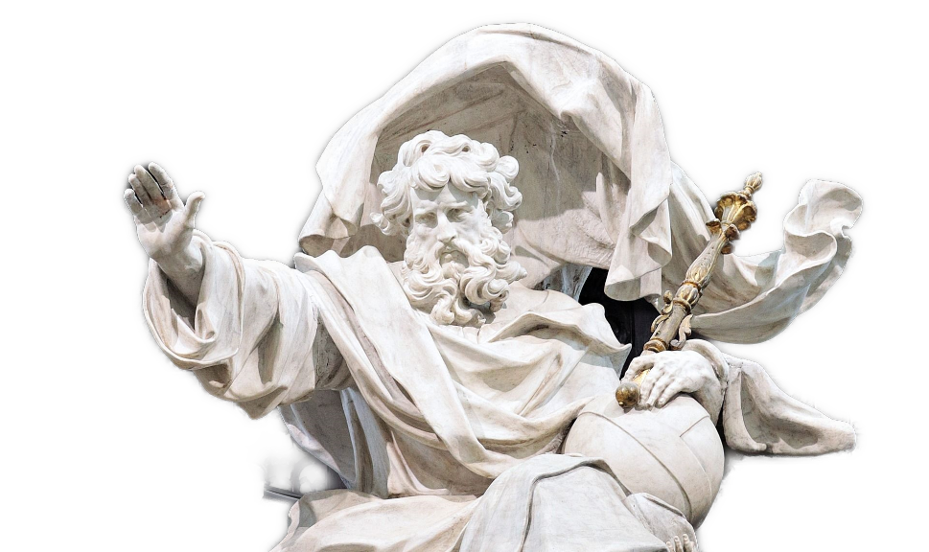
Set Apart by His Greatness
The psalm repeatedly emphasizes God's kingship and His authority over the nations. How does this perspective impact our understanding of God's sovereignty and our role as His people?

Slide 7
Listen for attributes of God
Psalm 99:4-5 (NIV) The King is mighty, he loves justice-- you have established equity; in Jacob you have done what is just and right. 5 Exalt the LORD our God and worship at his footstool; he is holy.

Slide 8
Set Apart by His Justice
Although the Lord is mighty in strength and as sovereign can do what He chooses, what characterizes His approach to judgment?
What should be the response of His people? Once again, why is the Lord worthy of praise?

Slide 9
Set Apart by His Justice
How does it impact your faith to know that God is all-powerful, and He is also good?
In verse 5, the psalmist praises God for establishing justice and equity. How does this resonate with contemporary issues of social justice and equality?

Slide 10
Set Apart by His Justice
How can we pursue justice in our own communities?
The psalm concludes with a call to exalt the Lord our God and worship at His footstool. What does it mean to exalt God, and how can we do so in our daily lives?

Slide 11
Listen for significant leaders.
Psalm 99:6-9 (NIV) Moses and Aaron were among his priests, Samuel was among those who called on his name; they called on the LORD and he answered them. 7 He spoke to them from the pillar of cloud; they kept his statutes

Slide 12
Listen for significant leaders.
and the decrees he gave them. 8 O LORD our God, you answered them; you were to Israel a forgiving God, though you punished their misdeeds. 9 Exalt the LORD our God and worship at his holy mountain, for the LORD our God is holy.

Slide 13
Set Apart by His Grace
What assurance does this psalm offer to those who call on the Lord?
The psalmist mentions the examples of Moses, Aaron, and Samuel who called upon God and received His answers. How does their faithfulness and interaction with God inspire us today?

Slide 14
Set Apart by His Grace
Moses, Aaron, and Samuel
What they did … | What we can do …
Communicate God’s words Called out to God for the people Received God’s answers and directions Exhorted the people to obey God Led in worship

Slide 15
Set Apart by His Grace
How should His people respond to Him because of His forgiveness?
How do we balance reverence for God with a close personal relationship with Him?
Why is God’s uniqueness/holiness so vital to our faith?

Slide 16
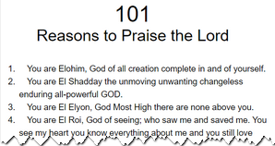
Set Apart by His Grace
What are some ways we can respond to God’s holiness this week?
Consider this document 101 Reasons to Praise the Lord

Slide 17
Application
Pray.
Ask God to reveal any times your thoughts, attitudes, or behavior have disappointed Him.
Ask God to redeem those character flaws and make you more like Him.

Slide 18
Application
Reflect.
Meditate on the moral attributes of God (holiness, righteousness, justice, love, mercy, wisdom).
Identify those principles and ask God to help you embody those attributes in your life.

Slide 19
Application
Search.
Search Scripture using available Bible tools in your library or online.
Record examples of God’s greatness and how He is set apart from all of creation.
Ask God to expand your mind to comprehend His glory, then to magnify Himself through you as you manifest His transforming power in your life.

Slide 20
Family Activities
The cop on his beat radioed in a report of fallen letters. Your pastor needs this quote to conclude his message. Put the letters straight back up into the correct row. For help and other fun Family Activities, go to https://tinyurl.com/mryaf335

Slide 21
Set Apart The Holiness of God
July 16

