Slide 1
Set Apart by Christ
July 23

Slide 2
Video Introduction
View Video

Slide 3
What do you think?
What would most people like to change about their lives?
Today we study Paul’s explanation of how believers’ lives can be changed for the better.
We learn that in Christ we are dead to sin
And we are alive to Christ
Your team WINS !!
New Job !!!

Slide 4
Listen for references to death
Romans 6:5-7 (NIV) If we have been united with him like this in his death, we will certainly also be united with him in his resurrection. 6 For we know that our old self was crucified with him so that the body of sin might be done away with, that we should no longer be slaves to sin-- 7 because anyone who has died has been freed from sin.

Slide 5
Set Free from Sin’s Grip
According to Paul, in what ways are we “united to” Christ?
How does being united with Christ through His death change our relationship to sin?
Why do we no longer have to live under the domination of sin?

Slide 6
Set Free from Sin’s Grip
If we are freed from sin, why do we continue to struggle with sin?
Why should a Christian stop sinning even though he or she knows God has forgiven and will forgive those sins?

Slide 7
Set Free from Sin’s Grip
Consider how our death to sin and being alive to Christ carries over to our resurrection when Jesus comes again
We are now “positionally” dead to sin – God views us
Now still in physical bodies
We must experience “death to sin” by faith
When Jesus comes, we will be “experientially” separated from (dead to) sin
We will be joined to Christ in eternal union – eternal life

Slide 8
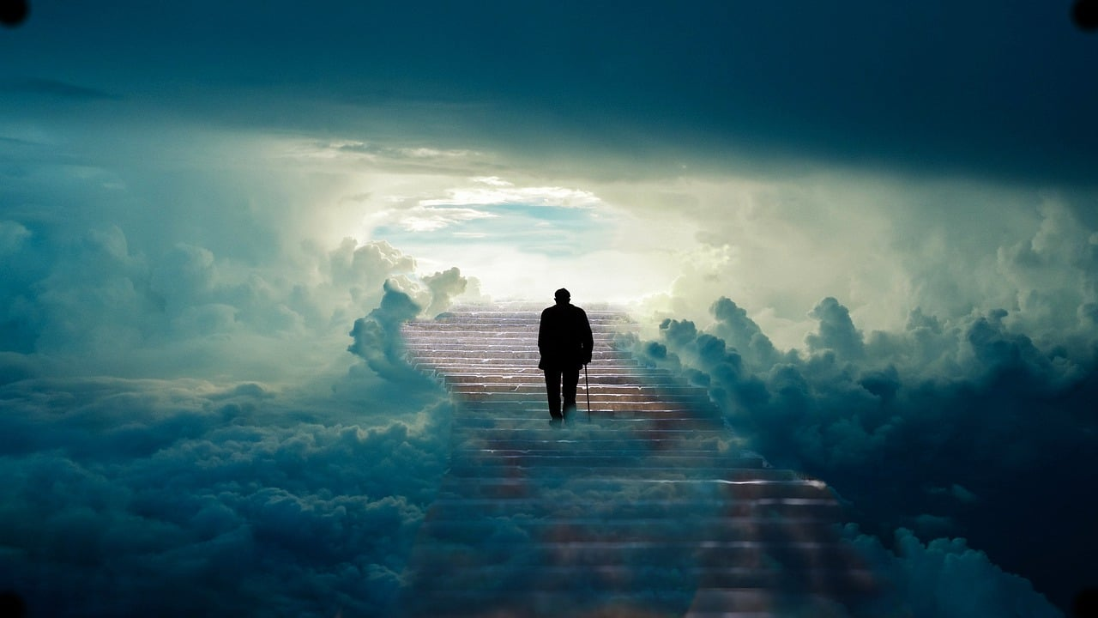
Set Free from Sin’s Grip
How might anticipating this truth affect our daily lives?

Slide 9
Listen for the meaning of being alive in Christ Jesus.
Romans 6:8-11 (NIV) Now if we died with Christ, we believe that we will also live with him. 9 For we know that since Christ was raised from the dead, he cannot die again; death no longer has

Slide 10
Listen for the meaning of being alive in Christ Jesus.
mastery over him. 10 The death he died, he died to sin once for all; but the life he lives, he lives to God. 11 In the same way, count yourselves dead to sin but alive to God in Christ Jesus.

Slide 11
The Promise of Eternal Life
Identify the truths in verse 8 Paul urged his readers to believe?
How will uniting with Christ in His death change the future of our lives?
What does the word “reckon” (or “count”) mean in this passage?

Slide 12
The Promise of Eternal Life
What is the value of thinking carefully about what Christ has done for those who believe?
How does the promise of living with Christ in the next life encourage you to face the challenges of this life?
How would your life change if you really lived as if your eternal life has already begun?

Slide 13
Listen for what the “therefore” is there for.
Romans 6:12-14 (NIV) Therefore do not let sin reign in your mortal body so that you obey its evil desires. 13 Do not offer the parts of your body to sin, as instruments of wickedness, but rather offer yourselves

Slide 14
Listen for what the “therefore” is there for.
to God, as those who have been brought from death to life; and offer the parts of your body to him as instruments of righteousness. 14 For sin shall not be your master, because you are not under law, but under grace.

Slide 15
Live in Righteousness
What are the commands in these verses?
To whom are believers not to yield themselves?
What does the word “offer” mean here?
Let’s make a list of things we can offer God.
What actions and attitudes will demonstrate to people around us that we have committed ourselves in obedience to God?

Slide 16
Applications
Consider.
Consider whether you have been trying to live the Christian life from the outside-in or the inside-out.
Ask God to help you rely on the power of His Spirit for overcoming sin.

Slide 17
Applications
Confess.
During the next week, invite God to expose areas of disobedience in your thoughts, beliefs, motivations, attitudes, and behaviors.
Commit to confess these, seeking cleansing and freedom.

Slide 18
Applications
Cooperate.
God has declared you victorious over sin through Christ (1 John 5:5).
That’s a fact, but we must still live out that truth through faith.
Invite a fellow group member (of the same gender) or another Christian you know to meet regularly for the purpose of accountability.
Develop a list of questions you can ask one another and spend time praying for one another.

Slide 19
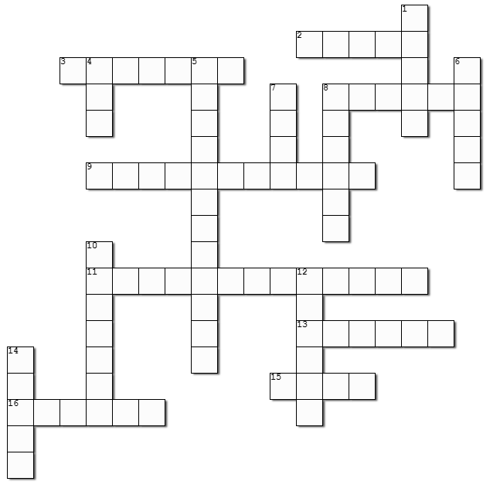
Family Activities
I must say, it’s about time we see the Crossword puzzle! Those men in the back row like the Cryptograms, but I like the Crossword better. Oh … don’t forget there’s help at https://tinyurl.com/mrnkhctv And there is a Cryptogram there also just for you guys at the back.

Slide 20
Set Apart by Christ
July 23

