Slide 1
Share Christ with Your Neighbor
August 28

Slide 2
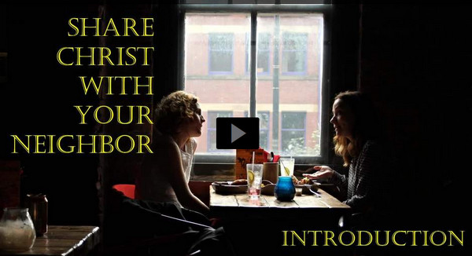
Video Introduction
View Video

Slide 3
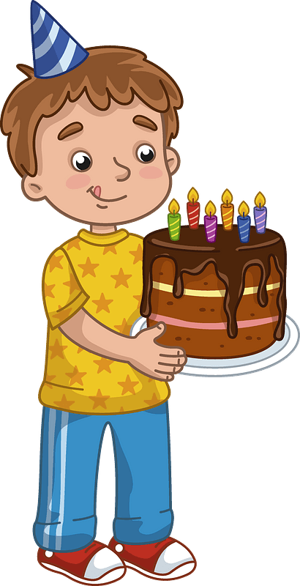
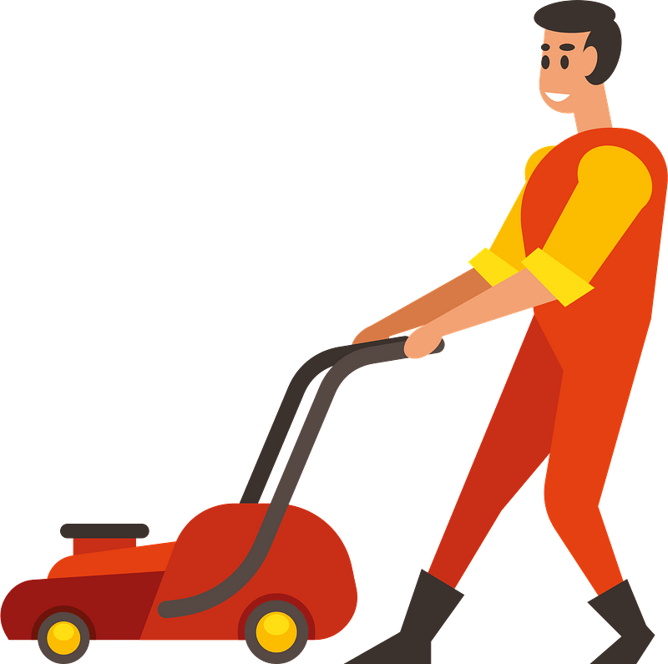
What do you remember?
What’s the nicest thing a neighbor has done for you?
A good neighbor is a wonderful gift from God.
We will demonstrate genuine love for our neighbors when we tell them about Jesus.

Slide 4
Listen for who pointed someone to Jesus.
John 1:40 – 42 (NIV) Andrew, Simon Peter’s brother, was one of the two who heard what John had said and who had followed Jesus. 41 The first thing Andrew did was to find his brother Simon and tell him, “We

Slide 5
Listen for who pointed someone to Jesus.
have found the Messiah” (that is, the Christ). 42 And he brought him to Jesus. Jesus looked at him and said, “You are Simon son of John. You will be called Cephas” (which, when translated, is Peter).

Slide 6
Tell of Your Experience with Jesus
What was the first thing Andrew did after he had followed Jesus?
Who is the first person you remember telling you about Jesus?
Who is someone in your circle of friends, acquaintances, family that you could bring to Jesus like Andrew brought his brother?

Slide 7
Tell of Your Experience with Jesus
Verse 30 says that Andrew “followed” Jesus. What does it mean to follow Jesus?
What hinders us from following Jesus in that way?

Slide 8
Tell of Your Experience with Jesus
Note that we know little about Andrew …
Mentioned only a few times …
Only 3 times in John’s gospel
Each time he was introducing someone to Jesus !!

Slide 9
Tell of Your Experience with Jesus
Peter became a “major player” in the spread of the gospel message
His brother, Andrew, played an important role in that ministry
He brought Peter to Jesus
⇨God calls us not so much to be “major players” … rather to bring people to Jesus

Slide 10
Listen for how people were invited.
John 1:43 – 46 (NIV) The next day Jesus decided to leave for Galilee. Finding Philip, he said to him, “Follow me.”44 Philip, like Andrew and Peter, was from the town of Bethsaida. 45 Philip found Nathanael and told him, “We have found

Slide 11
Listen for how people were invited.
the one Moses wrote about in the Law, and about whom the prophets also wrote—Jesus of Nazareth, the son of Joseph.” 46 “Nazareth! Can anything good come from there?” Nathanael asked. “Come and see,” said Philip.

Slide 12
Invite People to “Come and See” Jesus
What action did Jesus model in verse 43?
How did Philip follow the model of Jesus?
Nathanael was skeptical about someone from Nazareth. What about Christ stirs skepticism today?

Slide 13
Invite People to “Come and See” Jesus
Stereotypes are firmly held assumptions based on …
Generalizations (whether true or not),
Limited interactions with a person or group,
Even hearsay

Slide 14
Invite People to “Come and See” Jesus
What stereotypes about Christians hinder people from trusting Jesus today?
What can we do to overcome skepticism or stereotypes about our faith?

Slide 15
Listen for how Jesus convinced Nathanael.
John 1:47 – 49 (NIV) 47 When Jesus saw Nathanael approaching, he said of him, “Here truly is an Israelite in whom there is no deceit.” 48 “How do you know me?” Nathanael asked. Jesus answered, “I saw you while you were still under the fig tree before Philip called you.” 49 Then Nathanael declared, “Rabbi, you are the Son of God; you are the king of Israel.”

Slide 16
Trust God to Work in Hearts
What convinced Nathanael that Jesus was indeed the Messiah?
What convinced you that Jesus was the Son of God?
What titles did Nathanael declare about who Jesus is?

Slide 17
Trust God to Work in Hearts
How can Jesus’ identity as the Son of God inspire your confidence in Him?
When we know Jesus this way, how does that enable us to be more ready to invite people to “come see Jesus”?

Slide 18
Application
Trust.
What holds you back from sharing Christ?
Pray and ask God to make your faith in Him greater than your fears.

Slide 19
Application
Invite.
With the same “come and see” mindset seen in both Andrew and Philip, invite friends to come with you to your Bible study group.
Your group can provide a non-threatening way to “come and see” Jesus as your group discussed God’s Word.

Slide 20
Application
Share.
Draw three circles and make a list of people God has put in your life.
In the first circle, include your closest relationships.
In the second circle, write a list of your friends and co-workers.
In the third circle include acquaintances or neighbors you don’t know well.
Who in those circles does the Lord want you to reach with the gospel?

Slide 21
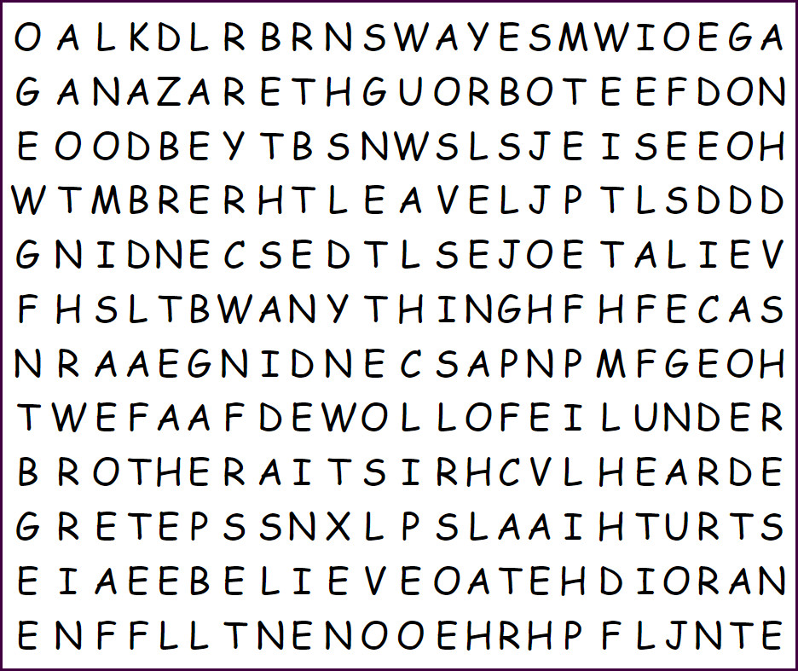
Family Activities
We have reason to believe there may be a hidden message in this Word Search puzzle. The Word Search Lady has doubts, but in any case, we need your help. My goodness, the words go in all directions. Technical help is available at https://tinyurl.com/mpf5332f And other Family Activities are there as well. Maybe I’m mistaken and the message is in the Crossword Puzzle.

Slide 22
Share Christ with Your Neighbor
August 28

