Slide 1
Speaking Truth
July 5

Slide 2

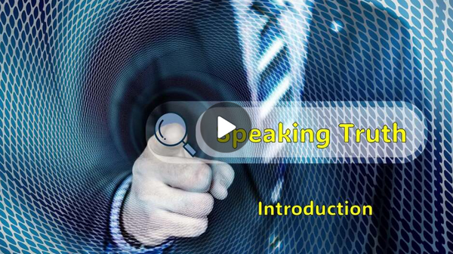
Video Introduction
View Video

Slide 3

Top Romantic Proposal Ideas
Recreate your first date.
At the spot where you first s
aid “I love you”
Candlelit dinner
Love letter trail – path of
handwritten notes, ends
up with the ring

Slide 4
Top Romantic Proposal Ideas
Live music surprise
Ferris wheel proposal
Scenic overlook proposal
Waterfall backdrop

Slide 5
But … what if she says “no”?
We can’t always be sure that a proposal will be received positively.
Similarly, when we invite others to follow Jesus, not everyone will say “yes”.
Today’s study looks at just such an event.

Slide 6
Listen for “one more thing”.
Luke 18:18-23 (NIV) A certain ruler asked him, "Good teacher, what must I do to inherit eternal life?" 19 "Why do you call me good?" Jesus answered. "No one is good--except God alone. 20 You know the commandments: 'Do not commit adultery, do not murder, do not steal, do not give false testimony, honor your father and

Slide 7
Listen for “one more thing”.
mother.'" 21 "All these I have kept since I was a boy," he said. 22 When Jesus heard this, he said to him, "You still lack one thing. Sell everything you have and give to the poor, and you will have treasure in heaven. Then come, follow me." 23 When he heard this, he became very sad, because he was a man of great wealth.

Slide 8
The Way to Eternal Life
What words or statements support the understanding that the man who came to Jesus was a decent man making a sincere inquiry of Jesus?
Where is the flaw in his question?

Slide 9
The Way to Eternal Life
Note the first part of Jesus’ explanation of the way to inherit eternal life.
  Obey the commandments
  Listed only commandments dealing with our interaction with other people

Slide 10
The Way to Eternal Life
What does the rich man’s answer to Jesus tell us about his character?
What further requirement did Jesus pose?
Why do you think Jesus called for the man to sell his possessions and give to the poor?

Slide 11
The Way to Eternal Life
What might be significant about the fact that Jesus had not yet addressed the first four commandments … those which deal with our relationship with God?
What kinds of things can become substitutes for God in our lives? What might Jesus ask us to set aside?
Why is it loving for Jesus to call us to do something difficult or even painful?

Slide 12
The Way to Eternal Life
Consider odd juxtaposition of the man’s situation in verse 23.
  Sadness and wealth in the same person
  Why was he so sad as a wealthy man?
  Seems like an oxymoron – those two things should not exist in the same person

Slide 13
Listen for hyperbole.
Luke 18:24-27 (NIV) Jesus looked at him and said, "How hard it is for the rich to enter the kingdom of God! 25 Indeed, it is easier for a camel to go through the eye of a needle than for a rich man to enter

Slide 14
Listen for hyperbole.
the kingdom of God." 26 Those who heard this asked, "Who then can be saved?" 27 Jesus replied, "What is impossible with men is possible with God."

Slide 15

The Peril of Loving Wealth
Jesus makes an astonishing statement: "How hard it is for the rich to enter the kingdom of God!”
Describe the figure of speech did He used to support His point.

Slide 16
The Peril of Loving Wealth
Probably the disciples would have been surprised to hear Him say that.
  The hyperbole implied impossibility
  Jewish culture - wealth demonstrated God’s blessing, God’s favor, God’s positive evaluation of one’s life
  Poverty showed God was withholding His blessing because of one’s poor spiritual condition
  Jesus’ comment was in direct opposition to that cultural belief

Slide 17
The Peril of Loving Wealth
How can a rich person—or any person—enter the kingdom of God?
In what ways can wealth and possessions get in the way of following Jesus?
How can we own possessions without possessions owning us?

Slide 18
Listen for a promise.
Luke 18:28-30 (NIV) Peter said to him, "We have left all we had to follow you!" 29 "I tell you the truth," Jesus said to them, "no one who has left home or wife or brothers or parents or children for the sake of the kingdom of God 30 will fail to receive many times as much in this age and, in the age to come, eternal life."

Slide 19
Benefits of Choosing Jesus
According to Jesus, what kinds of sacrifices might people make for the sake of God's kingdom?
Compare the rich ruler and the disciples. What made the difference between the ruler walking away and the disciples following Jesus?
Rich Ruler | Disciples

Slide 20
Benefits of Choosing Jesus
What kinds of things in our lives might we value so highly that it could keep us from fully following Christ?
What does Jesus mean when He says believers will receive "many times more" in this life? What are some benefits of following Jesus that cannot be bought with money?

Slide 21
Application
Walk.
  Pray and thank God for giving you the gift of eternal life.
  Humbly praise Him for it.

Slide 22
Application
Run.
  Reflect on the many ways God has been good to you as a believer.
  Write these blessings down and keep the list handy.
  In the future, whenever you remember an instance of God’s goodness or He blesses you again, record it.

Slide 23
Application
Soar.
  What do you need to leave behind to follow Jesus?
  Identify those things that can easily take God’s rightful place in your life.
  Develop an action plan to put them aside and replace them with a godly discipline.

Slide 24


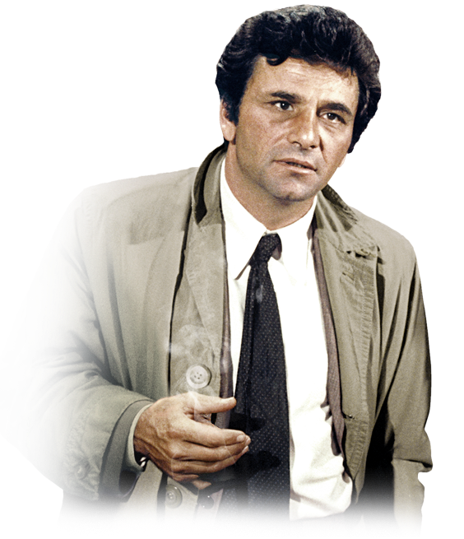
Family Activities
I was heading out when I noticed something about your sign out front. Those three fellas—Biff, Cliff, and the other one, Griff— knocked some of the letters right off, straight down into the dirt. Maybe we could fix it. I heard there’s help at https://tinyurl.com/44wpyffh Oh, and one more thing... do you happen to have a ladder?

Slide 25
Speaking Truth
July 5

