Slide 1
Stephen: A Faith that
Advances God’s
Kingdom
July 6

Slide 2

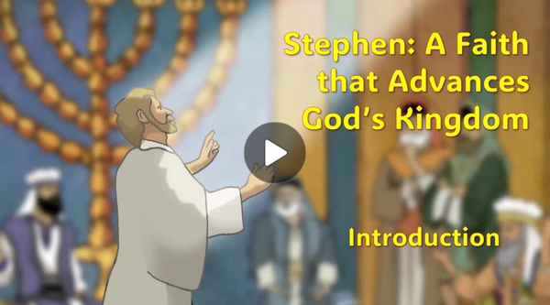
Video Introduction
View Video

Slide 3

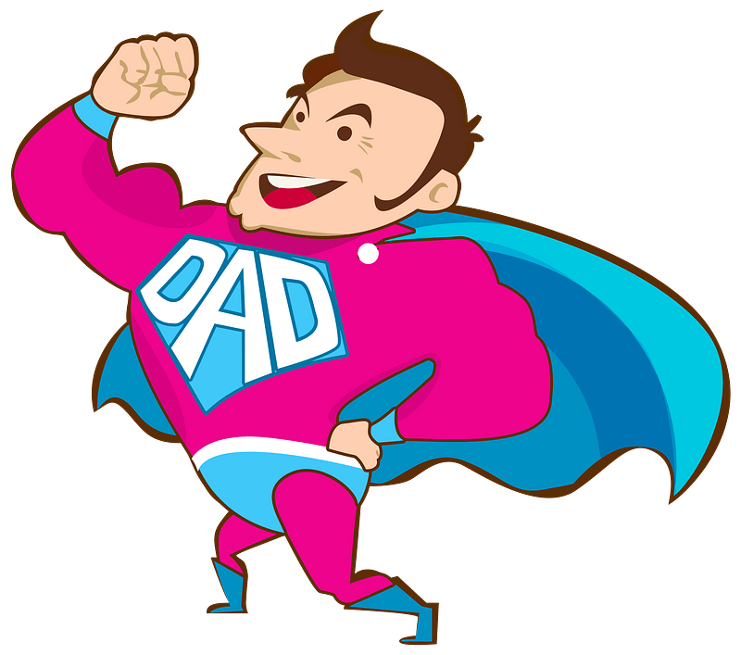
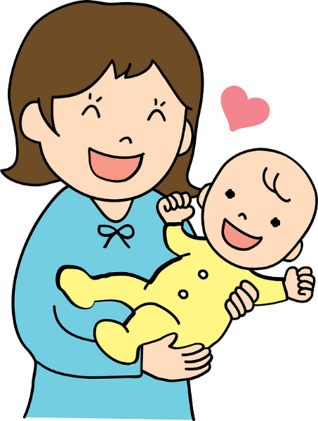
In your opinion …
Whom do you believe are the true heroes in our world today?
Only by faith do these people totally succeed.
  Bold faith helps advance the Kingdom of God

Slide 4
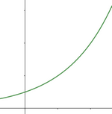
Listen for exponential growth.
Acts 6:3-7 (NIV) Brothers, choose seven men from among you who are known to be full of the Spirit and wisdom. We will turn this responsibility over to them 4 and will give our attention to prayer and the ministry of the word." 5 This proposal pleased the whole group. They chose Stephen, a man full of faith and of the Holy

Slide 5

Listen for exponential growth.
Spirit; also Philip, Procorus, Nicanor, Timon, Parmenas, and Nicolas from Antioch, a convert to Judaism. 6 They presented these men to the apostles, who prayed and laid their hands on them. 7 So the word of God spread. The number of disciples in Jerusalem increased rapidly, and a large number of priests became obedient to the faith.

Slide 6
Church and Community
The early church needed men who would oversee some of the social ministries within the groups. What were the qualifications they established for this ministry
Why do you think those qualities are essential for advancing God's Kingdom?

Slide 7
Church and Community
What additional qualities do you think would be important which might not have been mentioned here?
Scripture is specific about ministry to widows … what other kinds of needs might be overlooked in the overall ministry of a congregation in our society today?

Slide 8
Church and Community
How did they prepare these men for their ministry?
What does this special service say to us about the importance of this “administrative” ministry?

Slide 9
Listen for eloquence of speech.
Acts 6:8 - 10 (NIV) Now Stephen, a man full of God's grace and power, did great wonders and miraculous signs among the people. 9 Opposition arose, however, from members of the Synagogue of the Freedmen (as

Slide 10
Listen for eloquence of speech.
it was called)--Jews of Cyrene and Alexandria as well as the provinces of Cilicia and Asia. These men began to argue with Stephen, 10 but they could not stand up against his wisdom or the Spirit by whom he spoke.

Slide 11
Invite God to Work Through Us
What does it mean to be "full of God’s grace and power"?
If Stephen were alive today, how might other religious groups oppose him?
What kind of opposition might the evangelical church face today?

Slide 12
Invite God to Work Through Us
Verse 10 says that the opponents "could not withstand the wisdom and the Spirit with which he was speaking." How does Stephen's wisdom come from God, and how can we apply this to our own spiritual lives?
What can we do to prepare ourselves to stand firm and speak with grace and boldness, like Stephen, when we are opposed?

Slide 13
Listen for deceitful actions.
Acts 6:11-15 (NIV) Then they secretly persuaded some men to say, "We have heard Stephen speak words of blasphemy against Moses and against God." 12 So they stirred up the people and the elders and the teachers of the law. They seized Stephen and brought him before the Sanhedrin. 13 They produced false witnesses, who

Slide 14
Listen for deceitful actions.
testified, "This fellow never stops speaking against this holy place and against the law. 14 For we have heard him say that this Jesus of Nazareth will destroy this place and change the customs Moses handed down to us." 15 All who were sitting in the Sanhedrin looked intently at Stephen, and they saw that his face was like the face of an angel.

Slide 15
Faith that Meets Opposition
Stephen faced false accusations and manipulation of his words. How should believers respond when their faith work is misrepresented or attacked?
Both Jesus and Stephen faced false accusations and were put on trial before religious leaders. What do these parallels suggest about the cost of following Christ?

Slide 16
Faith that Meets Opposition
What character qualities help a person face conflict or opposition?
In what specific ways can you advance God's Kingdom in your current circumstances, even if you anticipate pushback?

Slide 17
Application
Compassion.
  Search out someone with physical or spiritual needs.
  Strive to meet those needs with God’s grace and guidance.
  Seek no recognition but to serve God and people with humility.

Slide 18
Application
Companionship.
  Never forget that the Holy Spirit resides in every believer, including you.
  Know that He will be with you and guide you to carry out your mission to tell others about Jesus, regardless of the consequences.
  Trust Him by reaching out to someone far from God this week.

Slide 19
Application
Continuation.
  Continue to obey God’s Word and share the story of His love for the world.
  Help others to do the same.
  Challenge family, friends, or coworkers to share God’s amazing grace.
  Gather together afterward to give praise for what God has done.

Slide 20

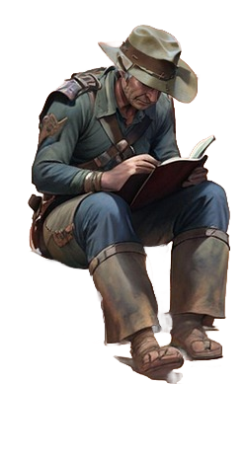

Family Activities
This manuscript is amazing. It’s from the area of the Waitthern Meengand peoples of ancient Mesopotamia. We need your help to translate it. Use the tools on your handout. Post the translation on Facebook when you finish. Get help and other Family Activities at https://tinyurl.com/2th6emcd

Slide 21
Stephen: A Faith that
Advances God’s
Kingdom
July 6

