Slide 1
Strong in Purity
June 27

Slide 2
Video Introduction
View Video

Slide 3
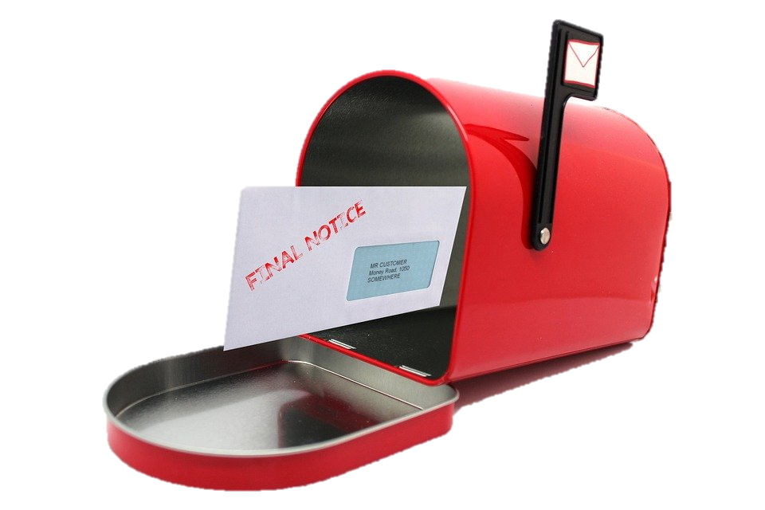
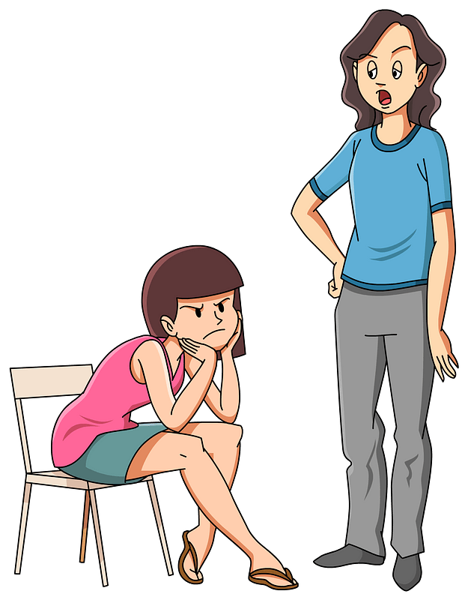
Admit it, now …
When has ignoring a warning been a mistake?
Most warnings are meant to help you avoid a problem.
God’s instructions are exactly that.
In today’s lesson He warns us, “Purity in all things impacts your service for God.”
I told you 11:30 …

Slide 4
Listen for the commendation.
Revelation 2:18-19 (NIV) To the angel of the church in Thyatira write: These are the words of the Son of God, whose eyes are like blazing fire and whose feet are like burnished bronze. 19 I know your deeds, your love and faith, your service and perseverance, and that you are now doing more than you did at first.

Slide 5
Deep Love and Increased Service
How does the Lord identify or describe Himself in this letter?
What does it mean that Christ’s eyes were "like blazing fire"?
For what does the Lord commend the church at Thyatira?

Slide 6
Deep Love and Increased Service
What are some good things for which our church is known by people in our community?
What are some ways to measure a church’s spiritual growth?
What are some ways to foster increased spiritual growth of those who attend a church?

Slide 7
Listen for Jesus’ condemnation.
Revelation 2:20-23 (NIV) Nevertheless, I have this against you: You tolerate that woman Jezebel, who calls herself a prophetess. By her teaching she misleads my servants into sexual immorality and the eating of food sacrificed to idols. 21 I have given her time to repent of her immorality, but she is unwilling.

Slide 8
Listen for Jesus’ condemnation.
So I will cast her on a bed of suffering, and I will make those who commit adultery with her suffer intensely, unless they repent of her ways. 23 I will strike her children dead. Then all the churches will know that I am he who searches hearts and minds, and I will repay each of you according to your deeds.

Slide 9
Purity Demonstrated through Morality
For what did the Lord hold the church accountable? For what did He chastise the church?
What sign of mercy and grace appears in verse 21?
What could this “Jezebel” and her adherents expect for refusing to repent?

Slide 10
Purity Demonstrated through Morality
What effect would this judgment have on others?
What sins do we tend to tolerate in our own lives or in the lives of our Christian friends when we should not?
Why can we expect the Lord to act justly toward us? What dangers do we face when we refuse to respond to God or repent of our sins?

Slide 11
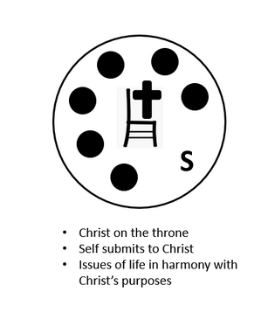
Purity Demonstrated through Morality
What are some characteristics of a person who lives a pure life?

Slide 12
Listen for words of encouragement.
Revelation 2:24-29 (NIV) Now I say to the rest of you in Thyatira, to you who do not hold to her teaching and have not learned Satan's so-called deep secrets (I will not impose any other burden on you): 25 Only hold on to what you have until I come. 26 To him who overcomes and does my will to the end,

Slide 13
Listen for words of encouragement.
I will give authority over the nations-- 27 'He will rule them with an iron scepter; he will dash them to pieces like pottery'-- just as I have received authority from my Father. 28 I will also give him the morning star. 29 He who has an ear, let him hear what the Spirit says to the churches.

Slide 14
Faithful to the Gospel
To whom does the Lord give His promises?
What value is there in choosing to remain ignorant of certain evil ideas and practices?
What does the Lord desire believers do with what they know about Him and have received from Him?

Slide 15
Faithful to the Gospel
When we are misled by others, what can we do to correct our mistakes? How?
What are two specific promises given to the ones who are victorious in Christ?

Slide 16
Application
Commit.
As you wake every day, even before you get out of bed, pause and pray.
Ask the Lord to give you the strength to live for Him and by His standards as you go through the day.

Slide 17
Application
Contrast.
Make a list of things the world says are perfectly OK to do.
Contrast those things with what the Bible says about them.
Dig into the Scripture and find verses that address those things.

Slide 18
Application
Witness.
If you have a friend who has embraced the world’s practices of idolatry and immorality, schedule time to visit.
Prayerfully share with this friend the truth of the gospel and the benefits it offers over the deceptiveness of sin.

Slide 19
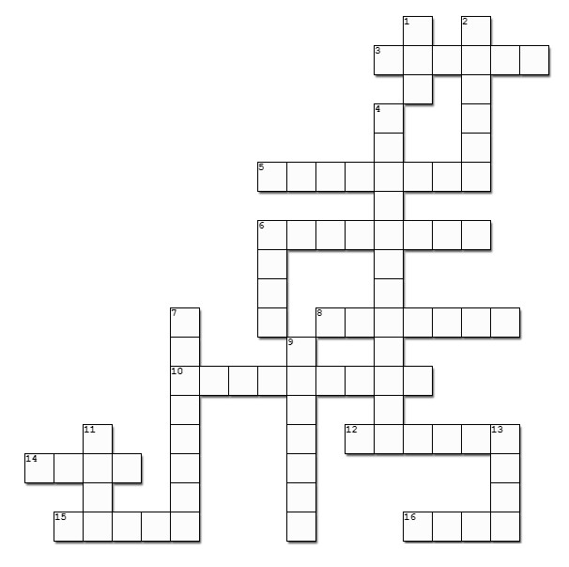
Family Activities
Aiee cucaracha! These clues are difficult. Oh, I see now, both they and the words come from our Bible Study in Revelation 2. Also, there’s help at https://tinyurl.com/472uad3b along with fun things for the whole family!

Slide 20
Strong in Purity
June 27

