Slide 1
The Attitude in Worship
February 2

Slide 2
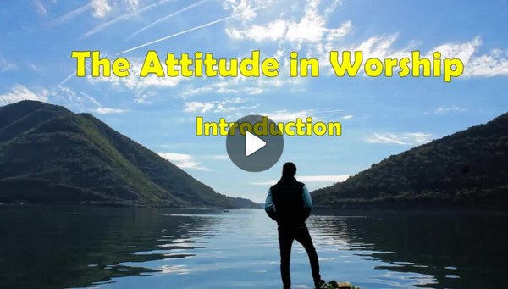
Video Introduction
View Video

Slide 3
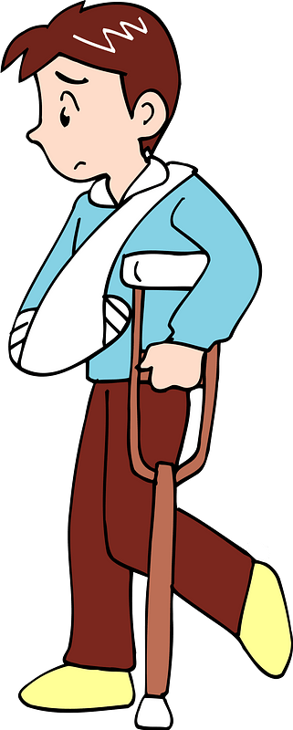
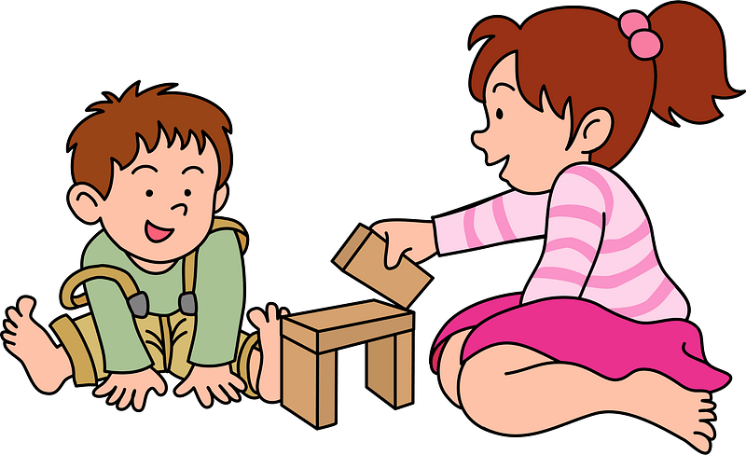
What could it be?
What kinds of things distract you when you read or study?
These same things can distract us when we read God’s Word or worship together as a congregation.
God wants us to come to Him with a heart fully focused on Him alone.

Slide 4
Listen for a comparison.
Psalm 40:1-5 (NIV) I waited patiently for the LORD; he turned to me and heard my cry. 2 He lifted me out of the slimy pit, out of the mud and mire; he set my feet on a rock and gave me a firm place to stand. 3 He put a new song in my mouth, a hymn of praise to our God. Many will see and fear and

Slide 5
Listen for a comparison.
put their trust in the LORD. 4 Blessed is the man who makes the LORD his trust, who does not look to the proud, to those who turn aside to false gods. 5 Many, O LORD my God, are the wonders you have done. The things you planned for us no one can recount to you; were I to speak and tell of them, they would be too many to declare.

Slide 6
Humble and Trusting
The psalmist found himself in a bad situation.
Speaks of a slimy pit, mud and mire
Something he was worried about
Needed encouragement, assurance

Slide 7
Humble and Trusting
List the words and phrases which describe where he turned and found relief and hope.
I waited patiently for the LORD; he turned to me and heard my cry. He lifted me out of the slimy pit, out of the mud and mire; he set my feet on a rock and gave me a firm place to stand. He put a new song in my mouth, a hymn of praise to our God.

Slide 8
Humble and Trusting
The psalmist says he “waited patiently”. Why is that a hard thing to do?
Consider the mention of God lifting David from a "pit of destruction" and "miry bog" (v.2). What modern situations might these metaphors represent?

Slide 9
Humble and Trusting
According to this psalm, what is the source of a blessed life, even when bogged down in a pit of destruction?
What benefit to others was the psalmist’s testimony concerning the goodness of the Lord?
Note: These suggestions area easy to contribute, sitting in a Bible Study class … harder to actually apply when lying sleepless in the night.

Slide 10
Humble and Trusting
Remember …
No situation is beyond the ability of the Lord.
Trust the Lord no matter how dreadful things may seem.
Our praise of the Lord can be our witness to others of His greatness.
God’s goodness, His works toward us, His plans for us are wonderful beyond measure

Slide 11
Listen for what God really prefers.
Psalm 40:6-8 (NIV) Sacrifice and offering you did not desire—but my ears you have opened— burnt offerings and sin offerings you did not require.7 Then I said, “Here I am, I have come— it is written about me in the scroll. 8 I desire to do your will, my God; your law is within my heart.”

Slide 12
Worship and Willing Obedience
On the surface, what seems unusual about the claims of the psalmist in verse 6?
Sacrifice and offering you did not desire—but my ears you have opened— burnt offerings and sin offerings you did not require

Slide 13
Worship and Willing Obedience
What is the meaning of the imagery of having his ears opened?
but my ears you have opened— burnt offerings and sin offerings you did not require. Then I said, “Here I am, I have come— it is written about me in the scroll. I desire to do your will, my God; your law is within my heart.”

Slide 14
Worship and Willing Obedience
What is the meaning of the reference to the book or scroll in verse 7? What did the psalmist mean in saying “it is written of/about me”?
I said, “Here I am, I have come— it is written about me in the scroll. I desire to do your will, my God; your law is within my heart.”

Slide 15
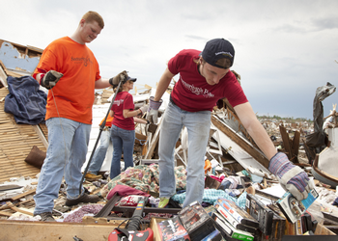
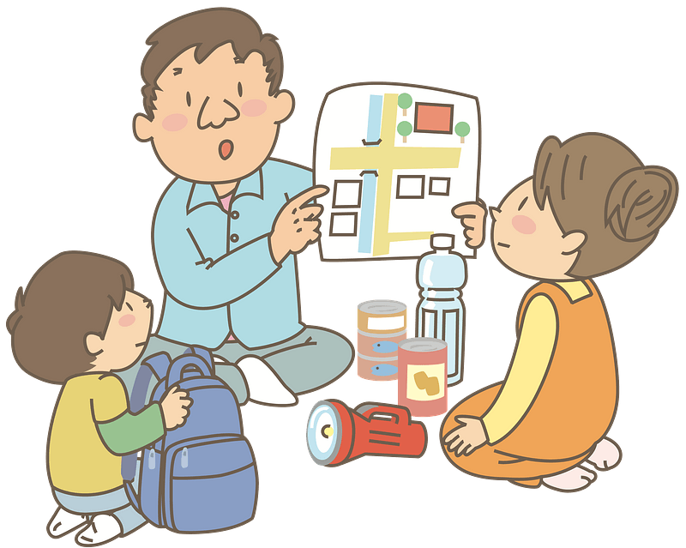
Worship and Willing Obedience
The psalmist declares that obeying God’s law is more than a ritual. How would you describe someone who delights in doing God's will?

Slide 16
Listen for determination.
Psalm 40:9-11 (NIV) I proclaim righteousness in the great assembly; I do not seal my lips, as you know, O LORD. 10 I do not hide your righteousness in my heart; I speak of your faithfulness and

Slide 17
Listen for determination.
salvation. I do not conceal your love and your truth from the great assembly. 11 Do not withhold your mercy from me, O LORD; may your love and your truth always protect me.

Slide 18
Worship Unashamedly
The psalmist was confident he had been faithfully and openly …
Proclaiming God’s righteousness/justice
Speaking of God’s faithfulness and salvation
Revealing God’s love and Truth

Slide 19
Worship Unashamedly
What additional appeal did the psalmist make of the Lord?
Do not withhold your mercy from me, O LORD; may your love and your truth always protect me.

Slide 20
Worship Unashamedly
These verses add to our understanding of worship. What does the psalmist proclaim about God?
I proclaim righteousness in the great assembly … I do not hide your righteousness in my heart; I speak of your faithfulness and salvation. I do not conceal your love and your truth … Do not withhold your mercy from me, O LORD; may your love and your truth always protect me.

Slide 21
Worship Unashamedly
How does he proclaim about God?
I proclaim righteousness in the great assembly … I do not hide your righteousness in my heart; I speak of your faithfulness and salvation. I do not conceal your love and your truth … Do not withhold your mercy from me, O LORD; may your love and your truth always protect me.

Slide 22
Worship Unashamedly
For what does he petition God? What does he ask?
I proclaim righteousness in the great assembly … I do not hide your righteousness in my heart; I speak of your faithfulness and salvation. I do not conceal your love and your truth … Do not withhold your mercy from me, O LORD; may your love and your truth always protect me.

Slide 23
Worship Unashamedly
How can Sunday worship prepare you for obedient service during the rest of the week?

Slide 24
Application
The Starting Place.
Reflect on David’s testimony in Psalm 40:1-2.
What’s your story? Describe your life before you met Christ.
Reflect on how you discovered your need for Him.

Slide 25
Application
The Growing Place.
God puts a song in the mouths of those He delivers. What’s your song?
Can people “hear” the song of praise in your life?
Be intentional this week in having personal worship.
Also, be sure to participate in corporate worship.

Slide 26
Application
The Sowing Place.
Make a list of the major priorities in your life.
Where does worship rate on the list?
How does your use of time, resources, and energy demonstrate the value of worship in your life?
What changes are needed for you to become a true worshiper, whose heart is fully focused on God?

Slide 27
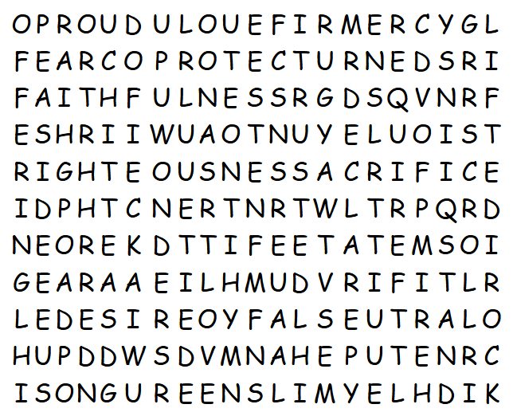
Family Activities
Bet I can do this with one eye closed and half my brain tied behind my back. Don’t worry, no backwards words horizontal or vertical. If you need help or the color page, go to https://tinyurl.com/39fpzbh9
Humph! Smartalek!

Slide 28
The Attitude in Worship
February 2

