Slide 1
The Basis of Confidence
October 17

Slide 2
Video Introduction
View Video

Slide 3
Admit it, now …
When have you seen confidence in someone, or something really pay off?
In some situations you just don’t know for some time if your confidence was justified.
Today’s passage speaks to the issue of trusting God
We can have full confidence when we are trusting God
You’ll do well with this stock.
You can trust me, Dad!
I recommend the escargot.

Slide 4
Listen for God’s command.
Genesis 12:1-3 (NIV) The LORD had said to Abram, "Leave your country, your people and your father's household and go to the land I will show you. 2 "I will make you into a great nation and I will bless you; I will make your name

Slide 5
Listen for God’s command.
great, and you will be a blessing. 3 I will bless those who bless you, and whoever curses you I will curse; and all peoples on earth will be blessed through you."

Slide 6
God Calls Us to Follow Him
What and where did God tell Abram to leave?
What kinds of thoughts would you have if God asked to do this?
What were some positive things you have experienced with a move?
What are the elements of the seven-fold promise the Lord gave to Abram?

Slide 7
God Calls Us to Follow Him
In what ways were all the people of the earth blessed through Abram?
How might people be blessed through you, your children, grandchildren?
What effect can God’s promises have on us when we face God’s call to change?

Slide 8
God Calls Us to Follow Him
Why should our obedience not depend on our comfort or understanding how all the details of God’s call seem logical to us?
As God directs your life’s journey …
Check out your spiritual map – the Bible
Find where you are, where you are going
Determine how to get there, know when you are there
Remember, God wants to bless others through you

Slide 9
Listen for how Abram responded to God.
Genesis 12:4-6 (NIV) So Abram left, as the LORD had told him; and Lot went with him. Abram was seventy-five years old when he set out from Haran. 5 He took his wife Sarai, his nephew Lot, all the possessions they had accumulated

Slide 10
Listen for how Abram responded to God.
and the people they had acquired in Haran, and they set out for the land of Canaan, and they arrived there. 6 Abram traveled through the land as far as the site of the great tree of Moreh at Shechem. At that time the Canaanites were in the land.

Slide 11
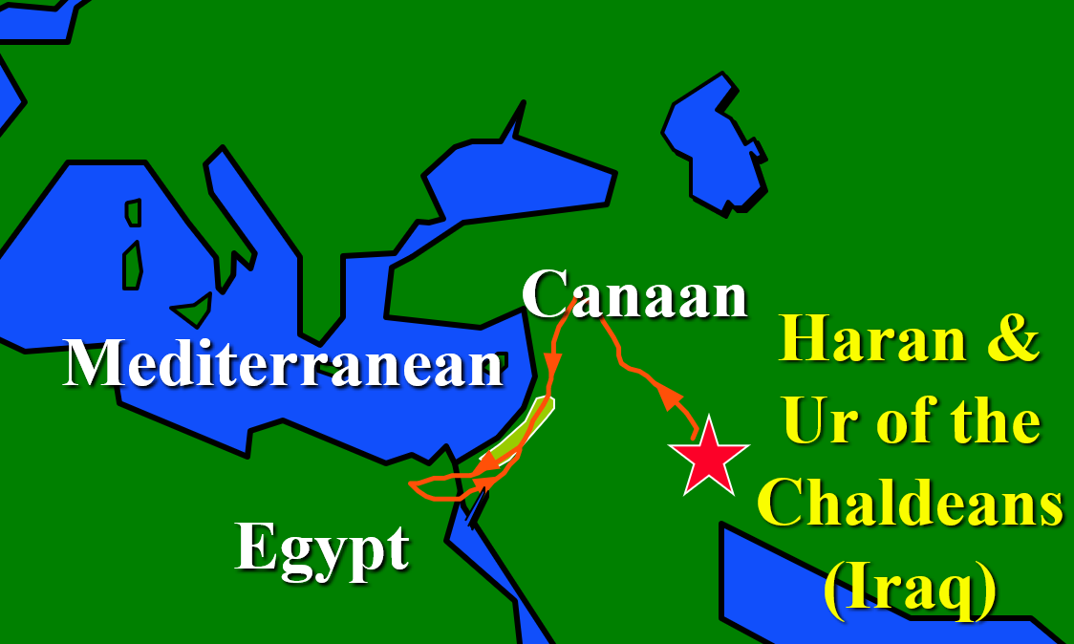
God Calls, We Obey
How does Abram’s response to the Lord demonstrate the meaning of faith?
What elements of this journey would make it a considerable effort?
What are some new directions we might face in our adult years?

Slide 12
God Calls, We Obey
When have you found it challenging to follow God’s leading?
Threats of evil existed in the land at this time. Why might God call His people to live in places where evil exists?

Slide 13
Listen for a reason to worship.
Genesis 12:7-8 (NIV) The LORD appeared to Abram and said, "To your offspring I will give this land." So he built an altar there to the LORD, who had appeared to him. 8 From there he went on toward the hills east of Bethel and pitched his tent, with Bethel on the west and Ai on the east. There he built an altar to the LORD and called on the name of the LORD.

Slide 14
Trusting God Leads to Worship
What is the significance of building an altar in Shechem?
After Abram left Shechem and moved on into the hill country, what did he do in that place as well?
In what ways have you discovered that worship, both personal and corporate, encourages you, equips you, and gives you confidence to step out in faithful service?

Slide 15
Trusting God Leads to Worship
What are some things people do to "build a monument" to honor themselves or their memory?
How might you memorialize your significant experiences with God? What kind of “monument” could you create to honor God and what He has accomplished at a certain point in your life?

Slide 16
Trusting God Leads to Worship
These locations must not be “shrines” that we worship
Rather they are special places or objects that remind us of …
God’s speaking to us in the past
His ongoing guidance and direction in our lives

Slide 17
Application
Evaluate.
Be real and take some honest, personal inventory and determine how distant or how close your relationship with God is right now.
Talk to God about how you truly feel things are going in your relationship

Slide 18
Application
Move.
Is there some area in your life where God has been stirring in you to make a move but you just keep ignoring it?
What move can you make today to start heading in the direction of what He has called you to do?

Slide 19
Application
Write it down.
Pick up a pen, grab a journal, and begin to write.
Reflect and remember how God has shown His presence and His promises to you in your life over the past month

Slide 20
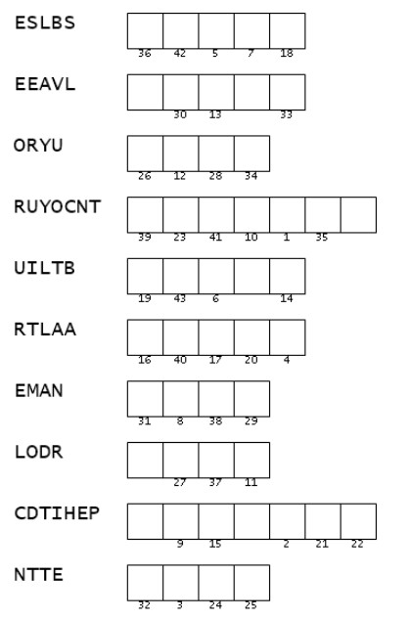
Family Activities
Those are supposed to be words from our Bible Study. Ayie Carumba! If you can get those, then you can figger out the message on the handout. Whew! If you need help or would rather do the crossword, go to https://tinyurl.com/yxnxprzm

Slide 21
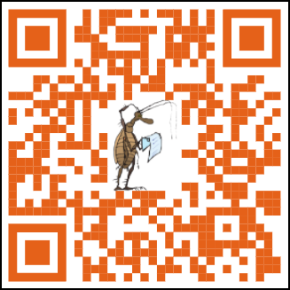
Family Discussion Video

Slide 22
The Basis of Confidence
October 17

