Slide 1
The Death of Jesus
March 28

Slide 2
Video Introduction
View Video

Slide 3
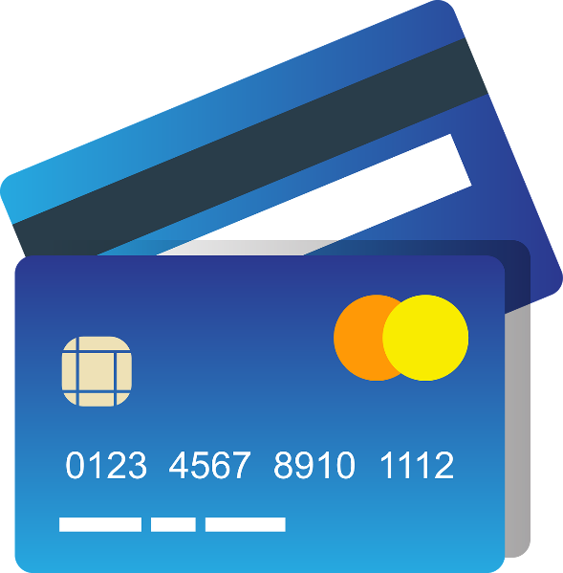
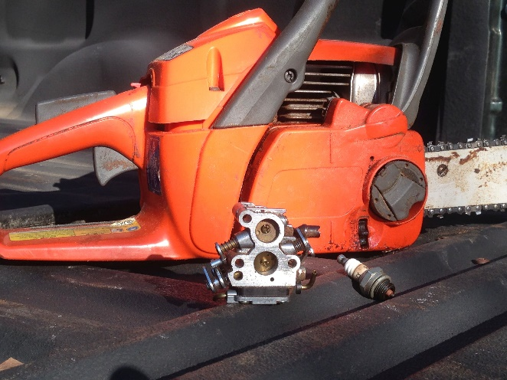
Remember that time?
When have you been frustrated by your inability to fix something?
Some things we just cannot fix on our own.
A broken relationship with God is certainly one of those things.
Forgiveness is possible only because Jesus died for our sins.

Slide 4
Listen for Pilate’s claim.
John 19:8-11 (NIV) When Pilate heard this, he was even more afraid, 9 and he went back inside the palace. "Where do you come from?" he asked Jesus, but Jesus gave him no answer. 10 "Do you refuse to speak to me?" Pilate said.

Slide 5
Listen for Pilate’s claim.
"Don't you realize I have power either to free you or to crucify you?" 11 Jesus answered, "You would have no power over me if it were not given to you from above. Therefore the one who handed me over to you is guilty of a greater sin."

Slide 6
God’s Control of History
What do you think Pilate was afraid of?
Why would Pilate want to question Jesus again?
Even though Pilate’s assessment of his own authority was true, how was his thinking flawed, especially in that moment?

Slide 7
God’s Control of History
What lessons might Jesus have been teaching in His response to Pilate recorded in verse 11?
How does God’s authority differ from the authority exercised by institutions in your life?
How does it make you feel to know the events around the passion of Jesus were part of God’s plan?

Slide 8
Listen for how Pilate is manipulated.
John 19:14-18 (NIV) It was the day of Preparation of Passover Week, about the sixth hour. "Here is your king," Pilate said to the Jews. 15 But they shouted, "Take him away! Take him away! Crucify him!" "Shall I crucify your king?" Pilate asked. "We have no king but Caesar," the chief priests answered. 16 Finally Pilate handed him

Slide 9
Listen for how Pilate is manipulated.
over to them to be crucified. So the soldiers took charge of Jesus. 17 Carrying his own cross, he went out to the place of the Skull (which in Aramaic is called Golgotha). 18 Here they crucified him, and with him two others--one on each side and Jesus in the middle.

Slide 10
Jesus Suffered in Our Place
Pilate wanted to preserve his authority. What position or possession might you be tempted to preserve at the expense of doing the right thing?
Pilate acted under political pressure. When and why might we allow the pressures of the moment to compromise our beliefs or standards?

Slide 11
Jesus Suffered in Our Place
The religious leaders rejected Jesus as King of their lives. Who or what are the "kings" that people worship today?
What emotions do you experience when you think about Jesus’ crucifixion?
When have you been overwhelmed by the sacrifice Jesus made for you?

Slide 12
Listen for Jesus final words.
John 19:28-30 (NIV) Later, knowing that all was now completed, and so that the Scripture would be fulfilled, Jesus said, "I am thirsty." 29 A jar of wine vinegar was there, so they soaked a sponge in it, put the sponge

Slide 13
Listen for Jesus final words.
on a stalk of the hyssop plant, and lifted it to Jesus' lips. 30 When he had received the drink, Jesus said, "It is finished." With that, he bowed his head and gave up his spirit.

Slide 14
Jesus Died for Our Salvation
What was the first saying from the cross John recorded and what was its significance?
Why did Jesus receive something to drink at this point when He had refused earlier?
What did Jesus mean when He said, "It is finished"? What is its significance, even to us?

Slide 15
Jesus Died for Our Salvation
What do you find hopeful about Jesus’ declaration, “It is finished”?
Why is the crucifixion of Jesus an essential element of the gospel?
How would you describe the importance of the cross to someone who needed to hear it?

Slide 16
Application
Give thanks.
Reflect on the salvation we have in Jesus
Thanking Him for forgiving your sins.

Slide 17
Application
Offer forgiveness.
Since you have been forgiven by the blood of Christ, identify someone in your life who has wronged you.
Reach out to them with a word of forgiveness.

Slide 18
Appplication
Share the message.
The forgiveness and salvation Jesus provided through His death is available to all.
Share this truth with a friend who does not know Jesus.

Slide 19
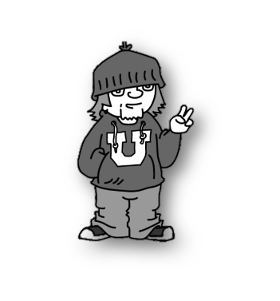
Family Activities
Don’t tell, but it was me what t’rew the message in the soda bottle over the embassy wall here in Rwangua Fagium. It’s an important message from the underground church in our country. Spiros the Spy says you can get help at https://tinyurl.com/se54bmff . There’s other good activities for the whole family there also

Slide 20
The Death of Jesus
March 28

