Slide 1
The Focus of Our Worship
January 12

Slide 2
Introduction Video
View Video

Slide 3
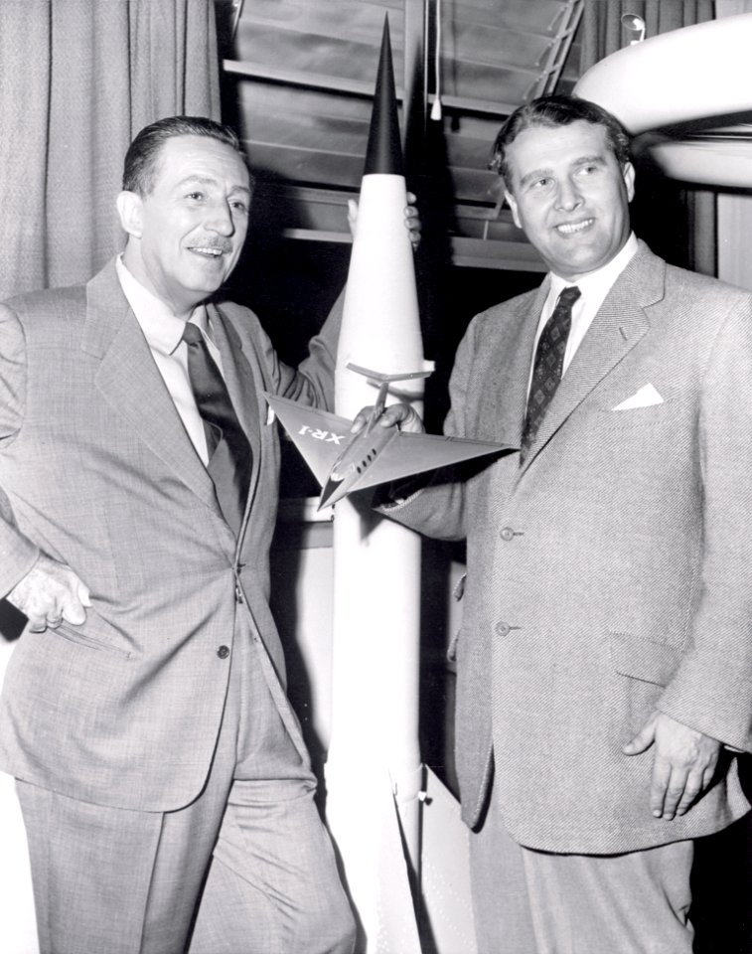
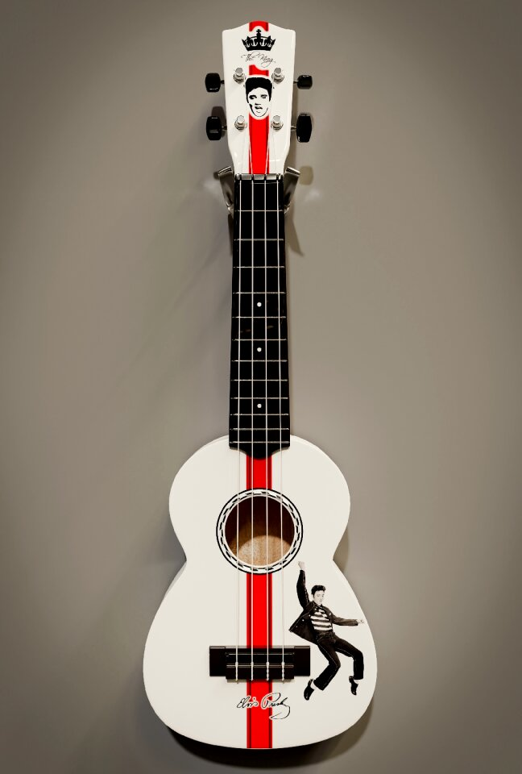
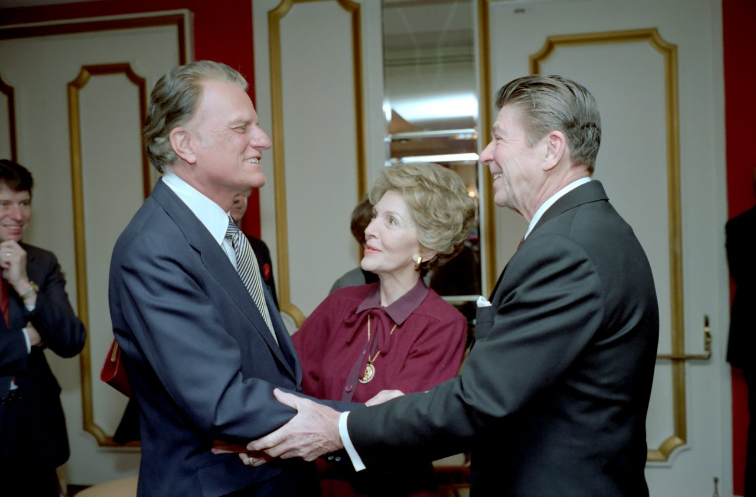
Admit it now …
Who are some celebrities you admire?
Some celebrities, such as Elvis in his day, are/were worshiped by their fans.
Only God deserves our worship.
Only God is worthy to be given praise and devotion.

Slide 4
Listen for power and authority
Isaiah 40:21-24 (NIV) 21 Do you not know? Have you not heard? Has it not been told you from the beginning? Have you not understood since the earth was founded? 22 He sits enthroned above the circle of the earth, and its people are like grasshoppers. He stretches out the heavens like a canopy, and

Slide 5
Listen for power and authority
spreads them out like a tent to live in. 23 He brings princes to naught and reduces the rulers of this world to nothing. 24 No sooner are they planted, no sooner are they sown, no sooner do they take root in the ground, than he blows on them and they wither, and a whirlwind sweeps them away like chaff.

Slide 6
Worshiping the All Powerful One
What are words and phrases used in this passage to describe God.
What are some ways people outside the church describe God today?
Consider just how inadequate and even demeaning such descriptions are !!

Slide 7
Worshiping the All Powerful One
Think about some examples of idols in our culture … things that replace God in one’s life.
Relationships
Economic power, influence
Material objects
Pleasure

Slide 8
Worshiping the All Powerful One
Why is looking to things or people for contentment and happiness in life foolish?
Contrast idols with what God has done for us, wants to do for us …
Our salvation
The Fruit of the Spirit
Make us holy, righteous
The presence of the Holy Spirit within our lives

Slide 9
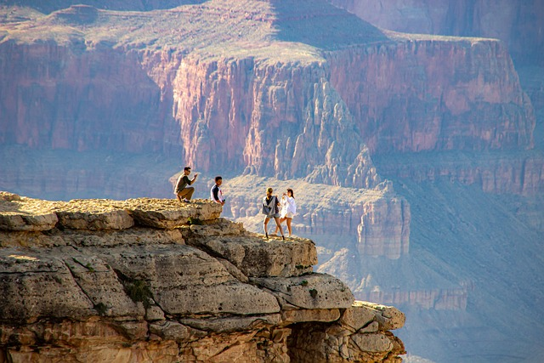
Worshiping the All Powerful One
How have you seen God’s power on display?
How do God’s attributes (power, authority, love) move you to worship Him?

Slide 10
Listen for an implied truth.
Isaiah 40:25-28 (NIV) "To whom will you compare me? Or who is my equal?" says the Holy One. 26 Lift your eyes and look to the heavens: Who created all these? He who brings out the starry host one by one, and calls them each by name. Because of his great power and mighty strength, not one of them

Slide 11
Listen for an implied truth.
is missing. 27 Why do you say, O Jacob, and complain, O Israel, "My way is hidden from the LORD; my cause is disregarded by my God"? 28 Do you not know? Have you not heard? The LORD is the everlasting God, the Creator of the ends of the earth. He will not grow tired or weary, and his understanding no one can fathom.

Slide 12
Worshiping the Creator - Sustainer
Though stated as a question, what is the implied truth found in verse 25?
How do these verses affirm that God is holy and in what way?
To what were the people directed to see evidence of the majestic power of God?

Slide 13
Worshiping the Creator - Sustainer
What flawed conclusion of the people did the prophet challenge?
Why did he suggest they should know better?
What are the practical implications of God knowing everything about us?

Slide 14
Listen for an oft repeated analogy.
Isaiah 40:29-31 (NIV) He gives strength to the weary and increases the power of the weak. 30 Even youths grow tired and weary, and young men stumble and fall; 31 but those who hope in the LORD will renew their strength. They will soar on wings like eagles; they will run and not grow weary, they will walk and not be faint.

Slide 15
Worshiping the One Who Strengthens
What do we read that the Lord does with His power?
What analogies did the prophet use to describe the effectiveness of God’s strength within those who trust Him?
How do these verses affirm that God is holy and in what way?

Slide 16
Worshiping the One Who Strengthens
What are some ways that we experience being faint and weary?
How does trusting God strengthen us?

Slide 17
Application
The Starting Place.
The worship journey begins with seeing God for who He is and responding to His offer of forgiveness in Christ.
How has God revealed Himself to you?
What attributes of God draw you into worship?
Take note of those things as you worship this week.

Slide 18
Application
The Growing Place.
Read Colossians 1:15-20. List all the attributes of Jesus found in these verses describing the essence of Christ.
Select two or three of the descriptions of Jesus and locate other scriptures or prophecies that corroborate each one

Slide 19
Application
The Sowing Place.
Do you know someone who seems to be hopeless?
How can your worship point the way to the God who loves and gives grace to those who will seek Him?
Begin praying for them by name and asking God to open the opportunity to point them to Christ, the only place where true hope and comfort are found

Slide 20
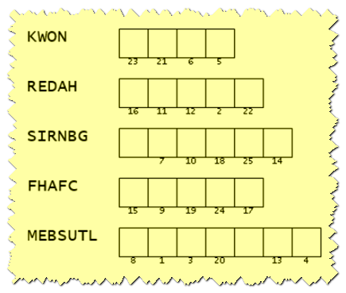
Family Activities
This key and a message was transmitted to you by the office of Spiros the Spy. It’s meant for me, your worship leader. Unscramble the clue words (from your verses in Isaiah 40). Then use the numbers to decode the message. It’s from the underground church in the country of Brimarnow.

Slide 21
The Focus of Our Worship
January 12

