Slide 1
The Lifestyle of Worship
February 16

Slide 2
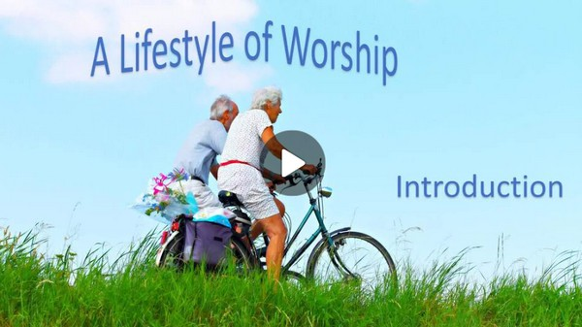
Video Introduction
View Video

Slide 3
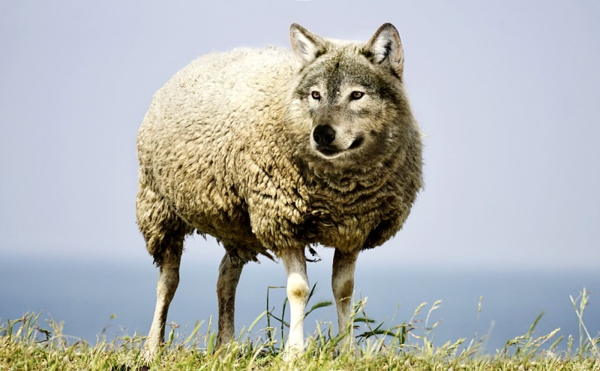
You were surprised …
What has ever caused you to say, “Looks can be deceiving”?
While people are not always as they appear, our worship should be genuine.
There should be evidence that validates our praise.
Everything we do in life is to be an act of worship.

Slide 4
Listen for advice about thinking.
Colossians 3:1-5 (NIV) Since, then, you have been raised with Christ, set your hearts on things above, where Christ is seated at the right hand of God. 2 Set your minds on things above, not on earthly things. 3 For you died, and your life is now hidden with

Slide 5
Listen for advice about thinking.
Christ in God. 4 When Christ, who is your life, appears, then you also will appear with him in glory. 5 Put to death, therefore, whatever belongs to your earthly nature: sexual immorality, impurity, lust, evil desires and greed, which is idolatry.

Slide 6
A Matter of the Mind
What are these “things above” that we should set our minds on?
What are earthly things which try to crowd out these “things above”?
What are some practical ways we can turn off the noise of the world to deliberately focus on Christ?

Slide 7
A Matter of the Mind
Verse 3 “you died,” your “old self” is dead. That is true, but its influence is still often felt.
Part of our physical, emotional make up
Still physically alive, these desires still exist
Experientially, we still live with a sinful nature
Positionally, we stand before God as “new creations” – forgiven, justified, righteous
God promises freedom from penalty and power of sin
In heaven will we be free from the presence of sin

Slide 8
A Matter of the Mind
What evidence would cause people to say someone is more focused on things above and not on what’s here on earth?
How did God change your perspective, your focus after you became a Christian?
How exactly do we set our heart and mind on things above? What are these “things above” that we should set our minds on?

Slide 9
Listen for a change of clothing.
Colossians 3:12-15 (NIV) Therefore, as God's chosen people, holy and dearly loved, clothe yourselves with compassion, kindness, humility, gentleness and patience. 13 Bear with each other and forgive whatever grievances you may have against

Slide 10
Listen for a change of clothing.
one another. Forgive as the Lord forgave you. 14 And over all these virtues put on love, which binds them all together in perfect unity. 15 Let the peace of Christ rule in your hearts, since as members of one body you were called to peace. And be thankful.

Slide 11
Being Like Christ
Paul speaks of spiritual attributes like clothing … with what spiritual attributes are we to clothe ourselves?
Note the similarities, with the Fruit of the Spirit
What instructions does he give about forgiveness?

Slide 12
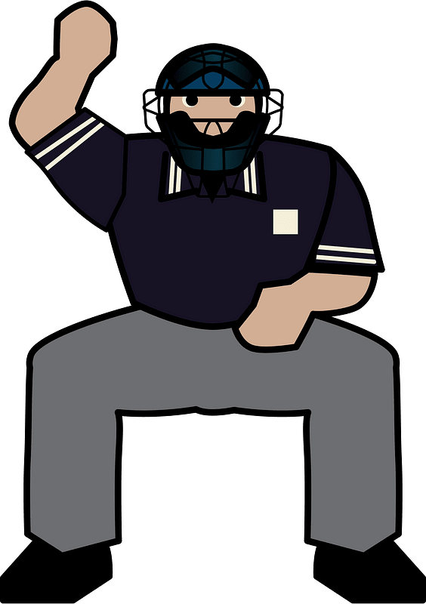
Being Like Christ
When Paul says “let the peace of Christ rule in your hearts” he uses a term similar to the rule of an umpire or referee in a sports competition. What kinds of rulings does an umpire or referee make?

Slide 13
Being Like Christ
How would this apply to the “peace of Christ” making the calls, making the “rulings” in a lifestyle of worship?
Paul says, “and be thankful”… consider what this has to do with worship?

Slide 14
Listen for music.
Colossians 3:16-17 (NIV) Let the word of Christ dwell in you richly as you teach and admonish one another with all wisdom, and as you sing psalms, hymns and spiritual songs with gratitude in your hearts to God. 17 And whatever you do, whether in word or deed, do it all in the name of the Lord Jesus, giving thanks to God the Father through him.

Slide 15
Gratitude and Honor
What does it mean to have the “word of Christ dwell in you richly”?
What actions demonstrate that believers treasure the word of Christ?
What actions demonstrate that believers treasure the word of Christ?

Slide 16
Gratitude and Honor
How has music helped shape your personal knowledge and worship of God?
How would acting “in the Name of Jesus” help us develop a lifestyle of worship anytime, anywhere?

Slide 17
Application
The Starting Place.
Looking back over your life as a believer, make a list of some things you have “put off” as you matured in your faith.
Evaluate further: What hurtful habits still hinder the flow of worship in your life?
Decide today to eliminate those habits with God’s help.

Slide 18
Application
The Growing Place.
Using Colossians 3:12-14 as a guide, make a list identifying those attributes of the Christ-life within you that challenge you the most.
Commit those verses to memory.

Slide 19
Application
The Sowing Place.
Reflect on your involvement in corporate worship.
Invite someone from your neighborhood or community to attend your church’s worship service with you.
Afterward, share some of the ways worship has made an impact in your life.

Slide 20
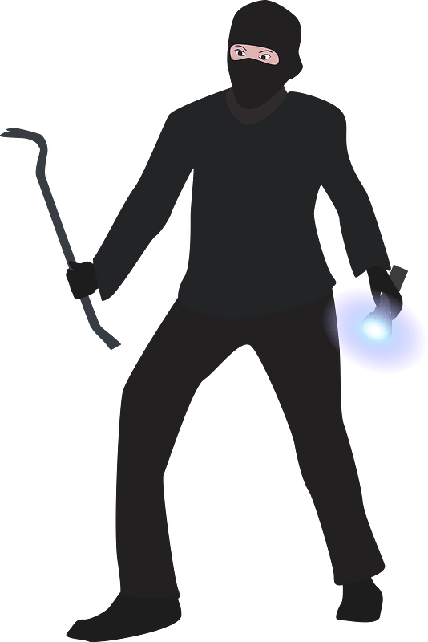
Family Activities
Hee hee hee!
What a great prank. All those letters fell straight down. Bet you can’t put them back in the right place. You’ll have to go to https://tinyurl.com/8xz448zj for help. Or you can wimp out and go for the Crossword Puzzle

Slide 21
The Lifestyle of Worship
February 16

