Slide 1
The Light and Glory of God
January 2

Slide 2
Video Introduction
View Video

Slide 3
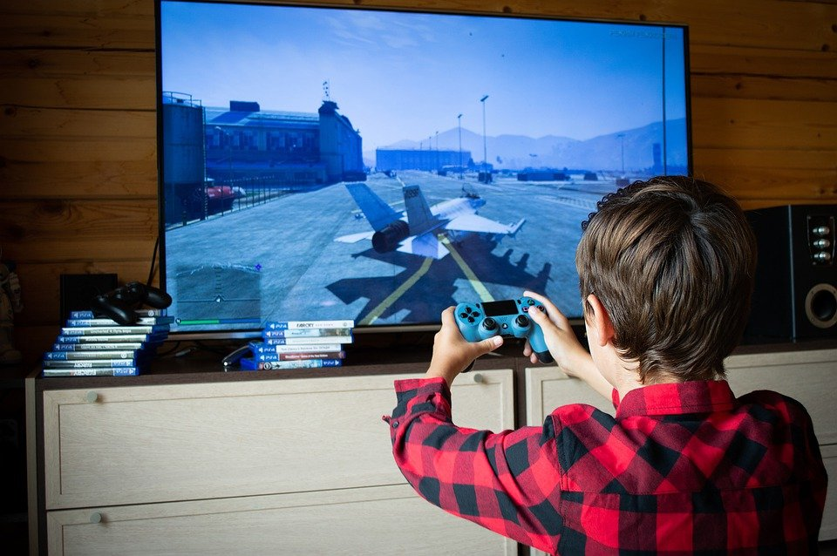
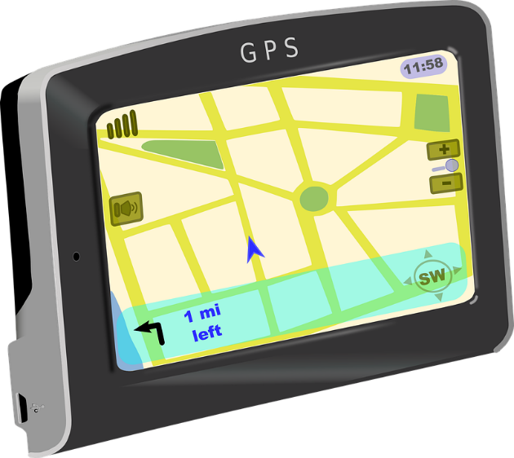
Who would’a thunk it?
What has happened in your lifetime that you never thought you’d see? What has amazed you?
Mary and Joseph were experiencing amazing events in their lives.
They met a man who told them their baby was the One that many people thought they’d never see.
Their baby son would reveal God’s glory and love

Slide 4
Listen for a revelation.
Luke 2:25-27a (NIV) Now there was a man in Jerusalem called Simeon, who was righteous and devout. He was waiting for the consolation of Israel, and the Holy Spirit was upon him. 26 It had been revealed to him by the Holy Spirit that he would not die before he had seen the Lord's Christ. 27 Moved by the Spirit, he went into the temple courts.

Slide 5
Promise to Simeon
How did Luke describe the man named Simeon? What spiritual characteristics are attributed to Simeon?
What revelation had he received from the Holy Spirit?
How do you think the Spirit told him these things?

Slide 6
Promise to Simeon
What characteristics of his life do you think contributed to his being described as “righteous and devout”?
In what ways can we see God working behind the scenes in the events of Christ’s childhood?
What is the role of the Holy Spirit in our lives?
How does the Holy Spirit influence how you see and approach the future?

Slide 7
Listen for prophecy about Baby Jesus.
Luke 2:27b-32 (NIV) When the parents brought in the child Jesus to do for him what the custom of the Law required, 28 Simeon took him in his arms and praised God, saying: 29 "Sovereign Lord, as you have promised, you now

Slide 8
Listen for prophecy about Baby Jesus.
dismiss your servant in peace. 30 For my eyes have seen your salvation, 31 which you have prepared in the sight of all people, 32 a light for revelation to the Gentiles and for glory to your people Israel."

Slide 9
Prophecy of Light
What was Simeon’s first response when he saw Mary, Joseph, and their baby?
What effect did this experience have for him personally?
How does Simeon talk about Jesus?
How do you think Simeon’s understanding of who the newborn Messiah affected the way he lived?

Slide 10
Prophecy of Light
Where in our culture is the light of Jesus desperately needed?
What of Simeon’s prophecy is still true today?
What do these verses teach us about God’s heart for the nations?

Slide 11
Listen for how Jesus would change the world.
Luke 2:33-35 (NIV) The child's father and mother marveled at what was said about him. 34 Then Simeon blessed them and said to Mary, his mother: "This child is destined to cause the

Slide 12
Listen for how Jesus would change the world.
falling and rising of many in Israel, and to be a sign that will be spoken against, 35 so that the thoughts of many hearts will be revealed. And a sword will pierce your own soul too."

Slide 13
Prophecy of Death
How did Mary and Joseph respond to Simeon?
What are some of the encouraging and yet sobering thoughts these prophecies would bring a brand-new parent?
What crisis would the child create for all people?
Encouraging Thoughts | Sobering Thoughts

Slide 14
Prophecy of Death
Why do some people respond positively to Jesus and others do not?
Consider who you know who has not accepted Jesus as Savior and Lord.
Their heart is “revealed.”
They still have opportunity to repent of unbelief.
They either need more Truth or to be convicted (convinced) by God’s Holy Spirit.
Let’s pray for them … right now

Slide 15
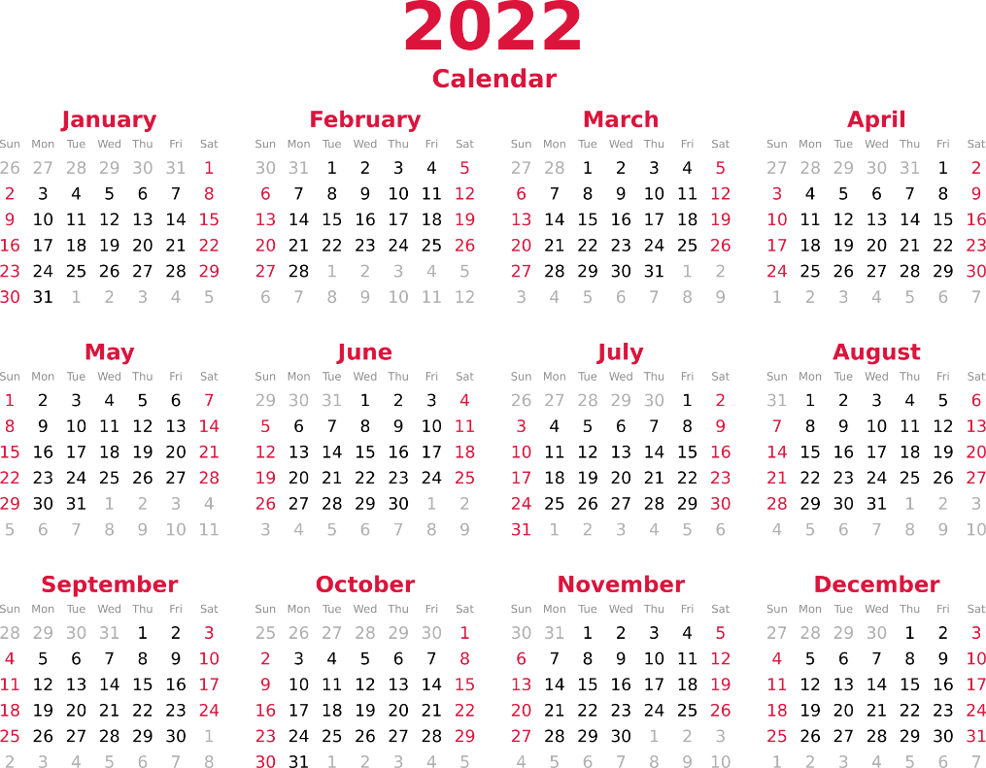
Prophecy of Death
How can the hope and peace of Jesus encourage you in 2022?

Slide 16
Application
Remember.
Take a moment and think about how Jesus’ life and ministry revealed the light and glory of God to you.
How can you remind yourself of Jesus’ example daily?

Slide 17
Application
Reflect.
Consider some people in your life who need to know that Jesus has revealed God’s glory and love.
Spend some time in prayer asking God for an opportunity to share the gospel with one of them in the coming week.

Slide 18
Application
Redeem.
Just as Jesus reveals the light and glory of God to us, we are called to follow His example and share the light and glory of God with others.
Find a place in your community that needs to see God’s light.
Invite some friends to go along with you to minister to that community.

Slide 19
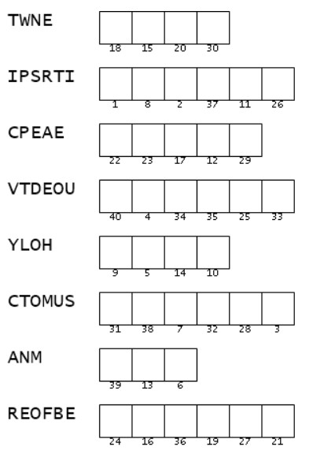
Family Activities
These scrambled words from Luke 2:25 – 35 (NIV) provide the key to the secret message from Republic of Kezilip. We need your help. If you get stuck find help and other intrigue at https://tinyurl.com/2p8d7sya

Slide 20
The Light and Glory of God
January 2

