Slide 1
The Light in the Darkness
December 12

Slide 2
Video Introduction
View Video

Slide 3
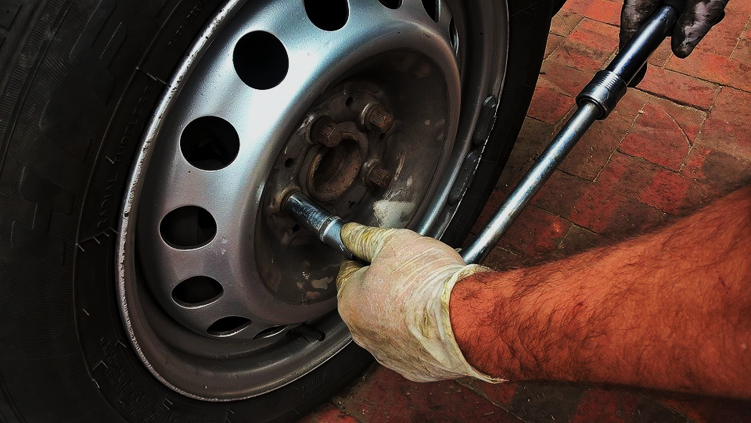
Remember that time …
When have you been most thankful you had some light?
We often struggle with physical darkness.
Spiritual darkness is even worse
We can now for sure that Jesus shines His light into a dark world.

Slide 4
Listen for a promise from God.
Isaiah 9:1-3 (NIV) Nevertheless, there will be no more gloom for those who were in distress. In the past he humbled the land of Zebulun and the land of Naphtali, but in the future he will honor Galilee of the Gentiles, by the way of the sea, along the Jordan--

Slide 5
Listen for a promise from God.
The people walking in darkness have seen a great light; on those living in the land of the shadow of death a light has dawned. 3 You have enlarged the nation and increased their joy; they rejoice before you as people rejoice at the harvest, as men rejoice when dividing the plunder.

Slide 6
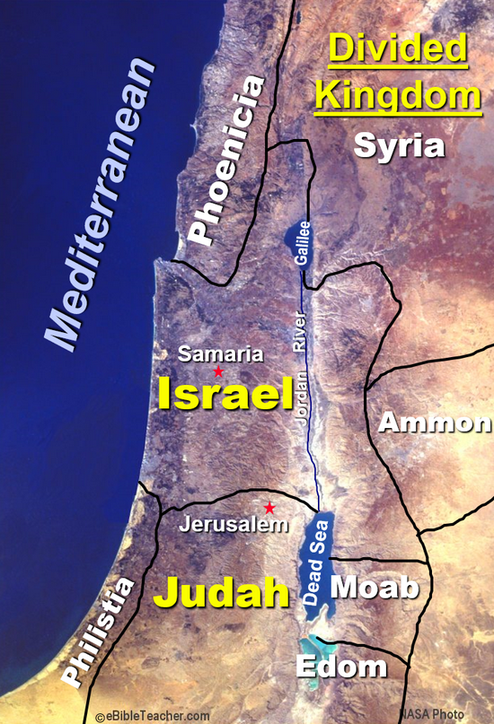
The Light Shines on Those in Darkness
Note the national situation:
Northern regions of Galilee in Israel had been devastated, depopulated, and annexed by the Assyrians
Result of God’s action because of Israel’s disobedience
What did God promise? What blessing would come?

Slide 7
The Light Shines on Those in Darkness
How might the “great light” be understood as a Messianic prophecy? How can various phrases of the passage be interpreted in that context?
People walking in darkness, shadow of death
See a great light
Increased joy
Enlarge the nation
Rejoice over plunder

Slide 8
The Light Shines on Those in Darkness
In what ways does our world, our culture walk in darkness?
Think about a time when you were physically walking in a dark place … how was it different when the light came on?

Slide 9
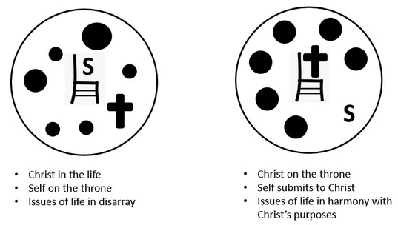
The Light Shines on Those in Darkness
Now recall a time when you were trying to proceed with a complete lack of understanding or wisdom as to what you should do? How was it different when God gave you “light” and revealed His direction?
⇨ God will give light when you pursue knowing and worshiping Him, putting Him in charge of your life, submitting to Him

Slide 10
Listen for the presence of Jesus.
John 1:1-4 (NIV) In the beginning was the Word, and the Word was with God, and the Word was God. 2 He was with God in the beginning. 3 Through him all things were made; without him nothing was made that has been made. 4 In him was life, and that life was the light of men.

Slide 11
Jesus is the Light
John uses the Greek word logos which is translated “the Word” to refer to Jesus. What statements does he make about “The Word”?
Why do you think John used the concept “Word” to identify Jesus?
John says in verse 4, In him was life. What are some ways in which Jesus gives us life?

Slide 12
Jesus is the Light
How has Jesus been light to you personally?
How can you be more receptive to God’s light in your life?

Slide 13
Listen for who was a witness.
John 1:5-9 (NIV) The light shines in the darkness, but the darkness has not understood it. 6 There came a man who was sent from God; his name was John. 7 He came as a witness to testify concerning that light,

Slide 14
Listen for who was a witness.
so that through him all men might believe. 8 He himself was not the light; he came only as a witness to the light. 9 The true light that gives light to every man was coming into the world.

Slide 15
Jesus Gives Light to All Men
What was John’s assignment in coming into the world? What was the goal of his witness?
In what ways is light a powerful metaphor for describing who Jesus is?
How powerful is the Light of the Word compared with the darkness of this world?

Slide 16
Jesus Gives Light to All Men
What are the consequences of walking in darkness instead of the light? List some contrasts.
Walking in Darkness | Walking in Light

Slide 17
Jesus Gives Light to All Men
Verse 5 speaks of the darkness not understanding “the light.” Why do you think that happens?
What opportunities exist for our group to display the light of Christ in our community?

Slide 18
Application
See the light.
Don’t deny the darkness around you.
Make a list of the darkness in your life, community, and world.
Then acknowledge the need for light and thank God for sending this Light into the world.

Slide 19
Application
Trust the light.
Don’t try to navigate your life in the dark.
Psalm 119:105 declares, “Your word is a lamp for my feet, a light on my path.”
Rely on God’s Word (Scripture) and the Word made flesh (Jesus) as you look for opportunities to share the gospel this week.

Slide 20
Application
Shine the light.
Choose a local ministry such as a food pantry.
Gather friends to volunteer with you.
Lead your group in a time of prayer emphasizing the opportunity to show the light of Jesus to your community.

Slide 21
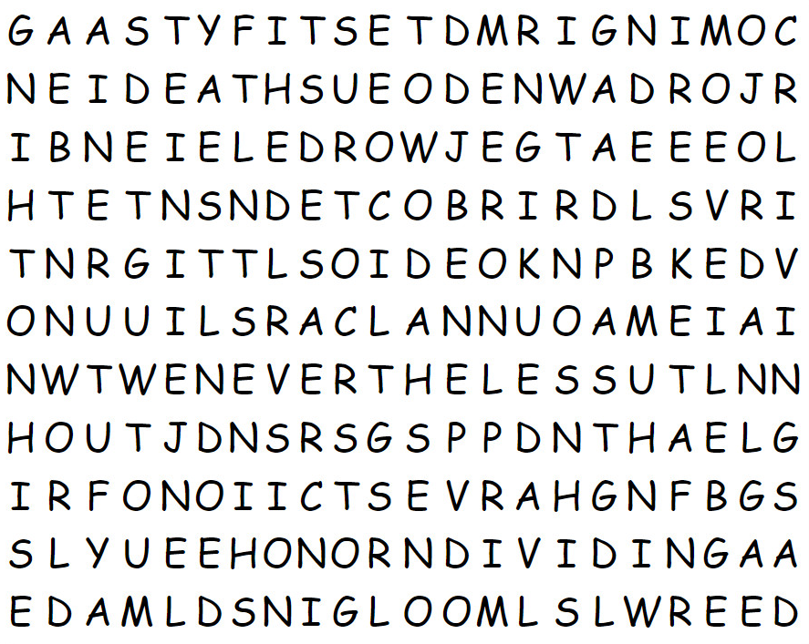
Family Activities
It is I … the Word Ninja. We need your help to find the words. They go left, right, up, down, and diagonally. You can find help and other Family Activities at https://tinyurl.com/2p8uxb5x

Slide 22
The Light in the Darkness
December 12

