Slide 1
The Message
May 2

Slide 2
Video Introduction
View Video

Slide 3
When you need to know …
Where do you turn for trustworthy information?
Ultimately, the only One we can trust is God.
Jesus said, “I am the Way, the Truth, and the Life …”
Jesus saves those who trust in Him.

Slide 4
Listen for what is necessary for salvation.
Romans 10:8b-10 (NIV) " that is, the word of faith we are proclaiming: 9 That if you confess with your mouth, "Jesus is Lord," and believe in your heart that God raised him from the dead, you will be saved. 10 For it is with your heart that you believe and are justified, and it is with your mouth that you confess and are saved.

Slide 5
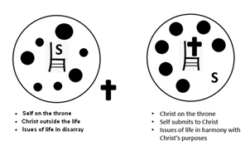
The Resurrection and Lordship of Christ
What were the simple instructions Paul gave regarding personal salvation?
What are the implications of confessing Jesus as Lord?

Slide 6
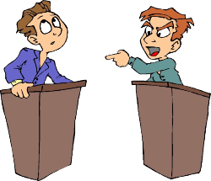
The Resurrection and Lordship of Christ
What does the dual response of “believe” and “confess” indicate about salvation?
Agree or disagree?
Confessing “Jesus is Lord” is more important than believing in Jesus’ resurrection.
Agree | Disagree

Slide 7
The Resurrection and Lordship of Christ
Why do you think both are necessary?
What hinders people today from believing Jesus Christ is the Lord and Savior of the world?
If someone is watching us, how would they know that we confess Jesus as Lord?

Slide 8
Listen for a promise.
Romans 10:11-13 (NIV) As the Scripture says, "Anyone who trusts in him will never be put to shame." 12 For there is no difference between Jew and Gentile--the same Lord is Lord of all and richly blesses all who call on him, 13 for, "Everyone who calls on the name of the Lord will be saved."

Slide 9
Salvation for All People
According to these verses, who does God desire to be saved?
How is the gospel both inclusive and exclusive?
If God desires everyone to be saved, then what responsibility does that place on the individual in need of salvation?
Inclusive | Exclusive

Slide 10
Salvation for All People
Racial or ethnic distinctions make no difference to God. Why do they sometimes still make a difference to us?
How can we overcome that kind of bias?

Slide 11
Listen for links of implication.
Romans 10:14-17 (NIV) How, then, can they call on the one they have not believed in? And how can they believe in the one of whom they have not heard? And how can they hear without someone preaching to them? 15 And how can they preach unless they are sent? As it is written,

Slide 12
Listen for links of implication.
"How beautiful are the feet of those who bring good news!" 16 But not all the Israelites accepted the good news. For Isaiah says, "Lord, who has believed our message?" 17 Consequently, faith comes from hearing the message, and the message is heard through the word of Christ.

Slide 13
The Gospel Communicated to Others
List the sequence of dependencies for someone to end up believing in Christ. Work your way from the end of the first sentence in verse 15 to the beginning of verse 14.
What happens when a link of the chain is missing?
Who is responsible at each stage of this sequence?

Slide 14
The Gospel Communicated to Others
What factors in this passage help to develop a sense of urgency for telling others about Jesus?
Maybe you cannot go to a faraway foreign country to share the gospel with someone who has never heard. In what ways can you be involved in sending the gospel to those places.

Slide 15
Application
Reflect.
Reflect on those who contributed to your salvation and consider what they did that led you to accept the good news they shared?
List ways you can do something similar for others.

Slide 16
Application
Write.
Write a note or call the individuals who played a role in your coming to faith in Christ.
Thank them for their love and obedience in sharing the gospel with you.

Slide 17
Application
Share.
Prayerfully consider those whom God has placed in your path.
Look for opportunities to tell them the message of Christ.
Let God empower you to be an instrument that brings others to a saving knowledge of Him.

Slide 18
How to Share Your Testimony in 15 Seconds

Slide 19
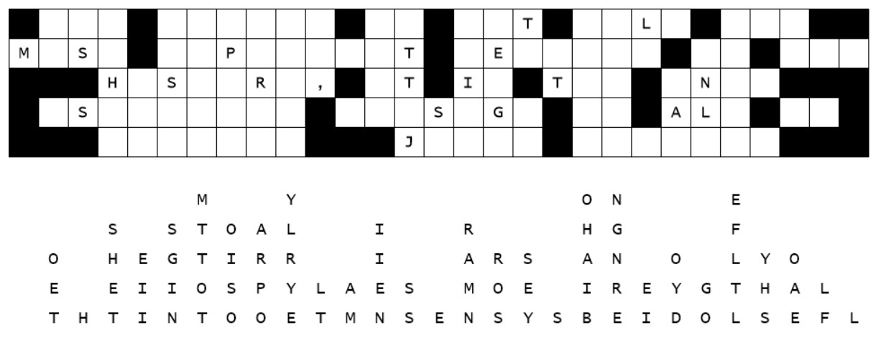
Family Activities
My boss needs your help. The letters slid down out of this sentence on his word processor screen. If you need help, go to https://tinyurl.com/fczb8m5x There’s more fun stuff therefor everyone in the family.

Slide 20
The Message
May 2

