Slide 1
The Pitfall of Bitterness
February 20

Slide 2
Video Introduction
View Video

Slide 3
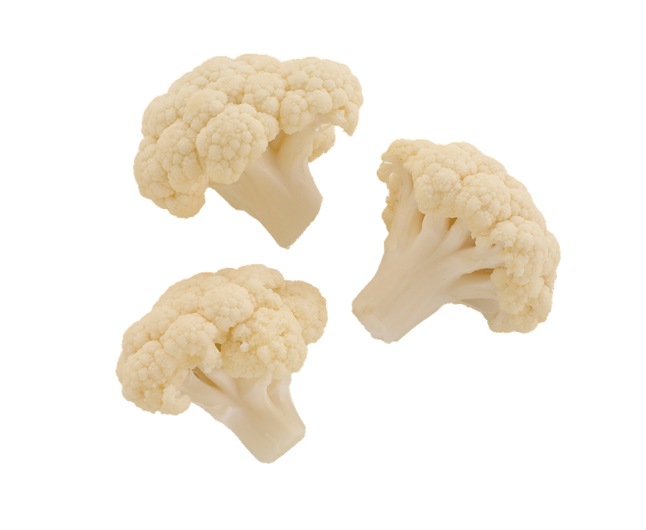
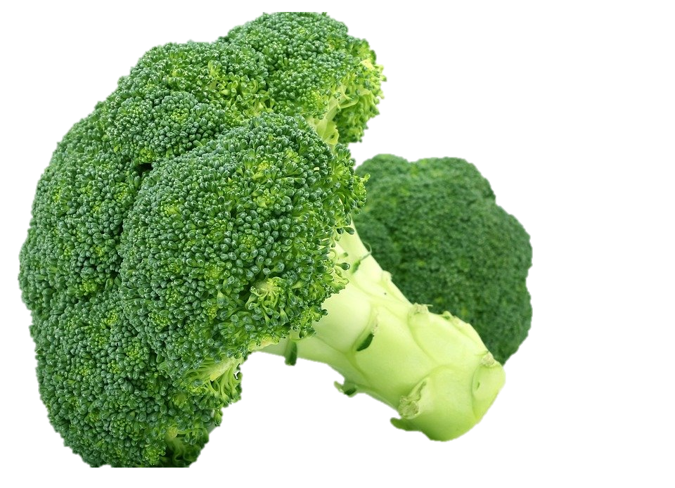
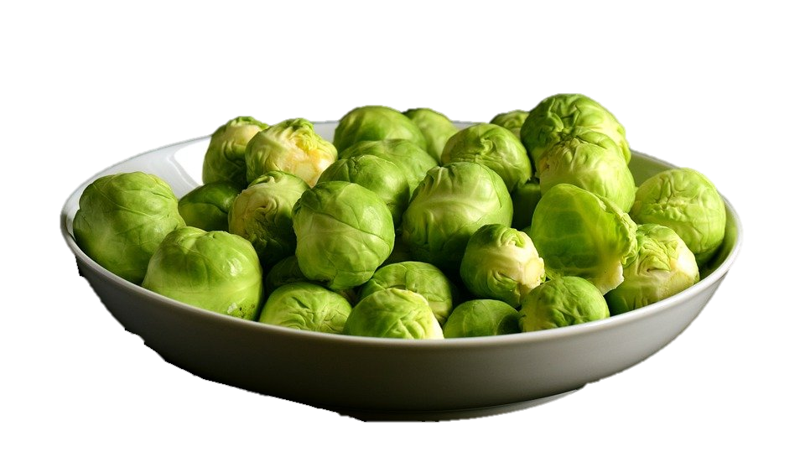
It was yucky …
What item on the dinner table did you dread as a kid?
Some foods may have seemed bitter to the taste
People also dislike relationships that go bitter
Today we look at how Joseph could have been bitter
We will conclude that bitter relationships can only move forward through forgiveness

Slide 4
Listen for a revelation.
Genesis 45:1-3 (NIV) Then Joseph could no longer control himself before all his attendants, and he cried out, "Have everyone leave my presence!" So there was no one with Joseph when he made himself known to his brothers. 2 And he wept

Slide 5
Listen for a revelation.
so loudly that the Egyptians heard him, and Pharaoh's household heard about it. 3 Joseph said to his brothers, "I am Joseph! Is my father still living?" But his brothers were not able to answer him, because they were terrified at his presence.

Slide 6
Embrace Your Pain
Recall what had transpired in the years since Joseph had been appointed as second in command of all Egypt and the event described in these verses.
Overseer of collecting surplus
In charge of distribution during famine
Now, brothers show up to buy grain

Slide 7
Embrace Your Pain
Imagine that you are Joseph, and your brothers show up. What reasons might you have for not telling them right away who you are?
Why would the brothers have been troubled at Joseph identifying himself to them?
What steps did Joseph initially take to try to ease their concern?

Slide 8
Embrace Your Pain
What are some unhealthy ways people deal with their emotional pain?
What are the dangers of covering up hurt in our lives?

Slide 9
Listen for how to treat those who wrong us.
Genesis 45:4-5 (NIV) Then Joseph said to his brothers, "Come close to me." When they had done so, he said, "I am your brother Joseph, the one you sold into Egypt! 5 And now, do not be distressed and do not be angry with yourselves for selling me here, because it was to save lives that God sent me ahead of you.

Slide 10
Forgive
Why do you think Joseph added the reminder that they had sold him into slavery in Egypt?
So what kind of mixed emotions did Joseph and the brothers experience?
Joseph acknowledged God’s guidance in and through his trials. Why would it be hard to view one’s trials in this way?
Joseph | Brothers

Slide 11
Forgive
What are some ways the bad intentions or bad actions of others could bring about good in your life?
Why is it hard to forgive someone who has wronged you?
Why is it important to forgive others?

Slide 12
Listen for how to restore broken relationships.
Genesis 45:9-11 (NIV) Now hurry back to my father and say to him, 'This is what your son Joseph says: God has made me lord of all Egypt. Come down to me; don't delay. 10 You shall live in the region of Goshen and be near me--you, your children

Slide 13
Listen for how to restore broken relationships.
and grandchildren, your flocks and herds, and all you have. 11 I will provide for you there, because five years of famine are still to come. Otherwise you and your household and all who belong to you will become destitute.'

Slide 14
Restore Broken Relationships
What did Joseph want his brothers to do immediately?
What assurance was Joseph trying to give his brothers through his plan for them?
What actions on our part lead to reconciliation?

Slide 15
Restore Broken Relationships
How does the gospel help us reconcile broken relationships?
What are some rewards that result from forgiveness?

Slide 16
Application
Be mindful.
In the next few days, be mindful in moments when you feel wronged.
Go immediately to God and seek grace to wipe away your hurt.

Slide 17
Application
Talk it out.
Be aware when you resort to stonewalling or choosing the silent treatment.
Though these forms of inner rage are subtle, they’re not less damaging.
Talk with others about your feelings and avoid the temptation to hold it all in.

Slide 18
Application
Help others.
Spend some time listening for the relational pain of others.
Plan a coffee time with someone who’s hurting and walk alongside them.
You might offer to help mediate or simply share some helpful biblical principles from the life of Joseph.

Slide 19
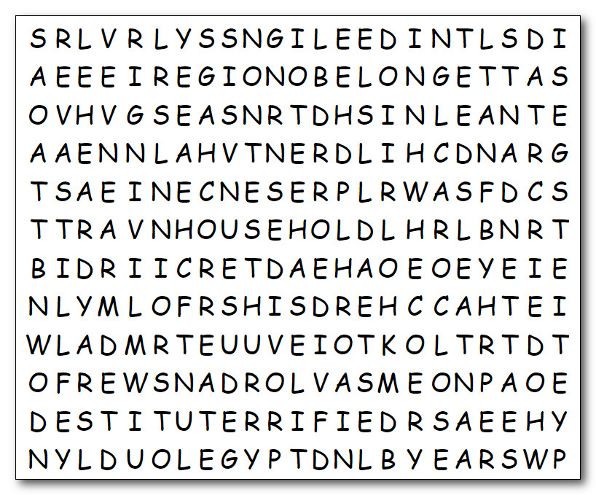
Family Activities
The Word Search Lady is quite upset. She accuses me of just throwing the words in there in a jumble. Little does she know there are hidden codes there. You can help by finding the words. If you get stuck, get help at https://tinyurl.com/6nn8mvwm . And you crossword lovers will find your favorite puzzle there along with other intriguing activities

Slide 20
The Pitfall of Bitterness
February 20

