Slide 1
The Problem with Pleasure
March 10

Slide 2
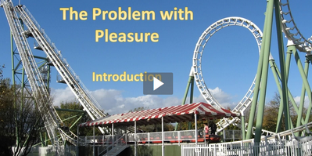
The Problem with Pleasure – Introduction
View Video

Slide 3
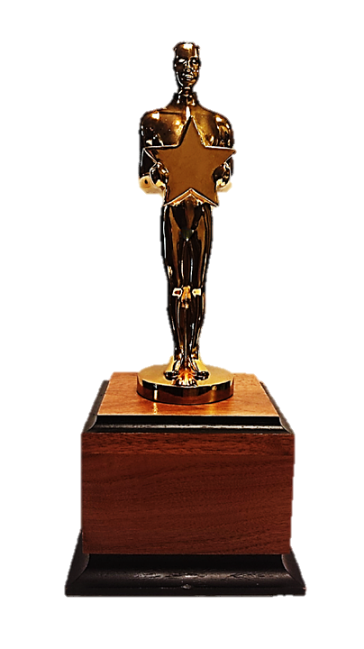
Your opinion, please …
Why do you think the entertainment industry (movies, television, etc.) is such a booming business?
Today we look at someone who had the money and time and power to experience everything that life in his day could offer
He came to the conclusion that it was futile … they were all dead ends.
Pleasures and possessions don’t offer lasting joy

Slide 4
Listen for attempts for satisfaction.
Ecclesiastes 2:1-3 (NIV) I thought in my heart, "Come now, I will test you with pleasure to find out what is good." But that also proved to be meaningless. 2 "Laughter," I said, "is foolish. And what does pleasure accomplish?"

Slide 5
Listen for attempts for satisfaction.
I tried cheering myself with wine, and embracing folly--my mind still guiding me with wisdom. I wanted to see what was worthwhile for men to do under heaven during the few days of their lives.

Slide 6
Pleasure Accomplishes Nothing
What things did Solomon try to find pleasure?
What was his conclusion?
How does society encourage the pursuit of pleasure?
When does pleasure become meaningless or even harmful?

Slide 7
Pleasure Accomplishes Nothing
What kinds of pleasures are bad, lead us away from God?
What kinds of pleasures can lead to God’s purposes in our lives?
Note Solomon’s risky behavior in regard to alcohol:
Solomon experienced the pull of alcohol without letting it take control of his life.
This is not always possible. Drunkenness and alcoholism can lead to misery.
Solomon practiced moderation. He maintained his senses and still found no purpose or meaning in wine.

Slide 8
Listen for all that Solomon acquired.
Ecclesiastes 2:4-8 (NIV) I undertook great projects: I built houses for myself and planted vineyards. 5 I made gardens and parks and planted all kinds of fruit trees in them. 6 I made reservoirs to water groves of flourishing trees. 7 I bought male and female slaves and had other slaves who were born in my house.

Slide 9
Listen for all that Solomon acquired.
I also owned more herds and flocks than anyone in Jerusalem before me. 8 I amassed silver and gold for myself, and the treasure of kings and provinces. I acquired men and women singers, and a harem as well--the delights of the heart of man.

Slide 10
Possessions Distract
List the possessions identified in the passage.
Identify the various actions he undertook to enhance his pursuit of pleasures that might add meaning to his life.
What might the fact that he tried so many things say about the effectiveness of any one of them?
Why do you think we find pleasure in accumulating stuff?

Slide 11
Possessions Distract
Consider Tim. 6:17-19
According to Timothy, what is God’s purpose for possessions?
Command those who are rich in this present world not to be arrogant nor to put their hope in wealth, which is so uncertain, but to put their hope in God, who richly provides us with everything for our enjoyment. [18] Command them to do good, to be rich in good deeds, and to be generous and willing to share. [19] In this way they will lay up treasure for themselves as a firm foundation for the coming age, so that they may take hold of the life that is truly life.

Slide 12
Listen for Solomon’s final conclusion.
Ecclesiastes 2:9-11 (NIV) I became greater by far than anyone in Jerusalem before me. In all this my wisdom stayed with me. 10 I denied myself nothing my eyes desired; I refused my heart no pleasure. My heart took delight in all my

Slide 13
Listen for Solomon’s final conclusion.
work, and this was the reward for all my labor. 11 Yet when I surveyed all that my hands had done and what I had toiled to achieve, everything was meaningless, a chasing after the wind; nothing was gained under the sun.

Slide 14
Pleasure and Possessions Don’t Last
What did Solomon seem to be bragging about?
But upon a deeper introspection in light of his desire to find meaning in life, what disturbing conclusion did he reach?
Why do you think he felt this way?
Why can’t we rely on our possessions to bring us fulfillment?

Slide 15
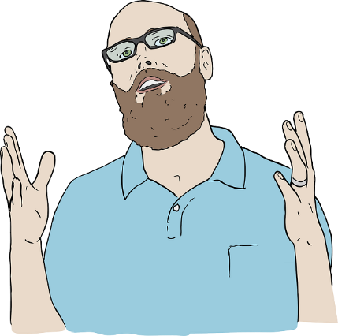
Pleasure and Possessions Don’t Last
How can we determine how much we are basing our self-worth on personal achievements or accumulations?
So how do we include God in how we spend our time and energy?
We may accomplish our heart’s desire, but those desires are void of meaning if they exclude God.

Slide 16
Application
Give God the glory.
How can you fight against the empty pursuit of pleasure?
Identify something you enjoy—and do it.
But do it to honor Christ and give God the glory.

Slide 17
Application
Memorize Philippians 4:4-7.
Memorize this passage and recall it when you become anxious, discouraged or the toils of your own struggle tempt you to seek “reward” in the wrong way.

Slide 18
Application
Acknowledge the achievements of others.
Too often, we get caught up in our own achievements. That leads to a false “reward” mentality.
Contact others and thank them for their achievements.
Encourage them.
Consider ways to do this that also affirms them in the presence of others.

Slide 19
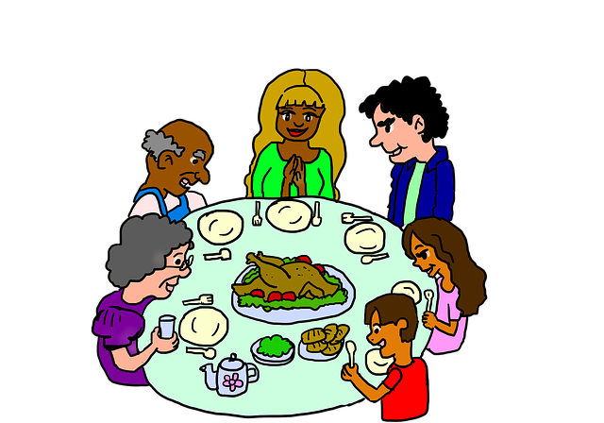
Family Activities
When we finish eating, we’ll go to https://tinyurl.com/y5cmtrdl and do the Family Discussion activity. Then you kids can do one of the puzzles there … but you have to clean your plates first.

Slide 20
The Problem with Pleasure
March 10

