Slide 1
The Sign of His Glory
March 2

Slide 2
Video Introduction
View Video

Slide 3
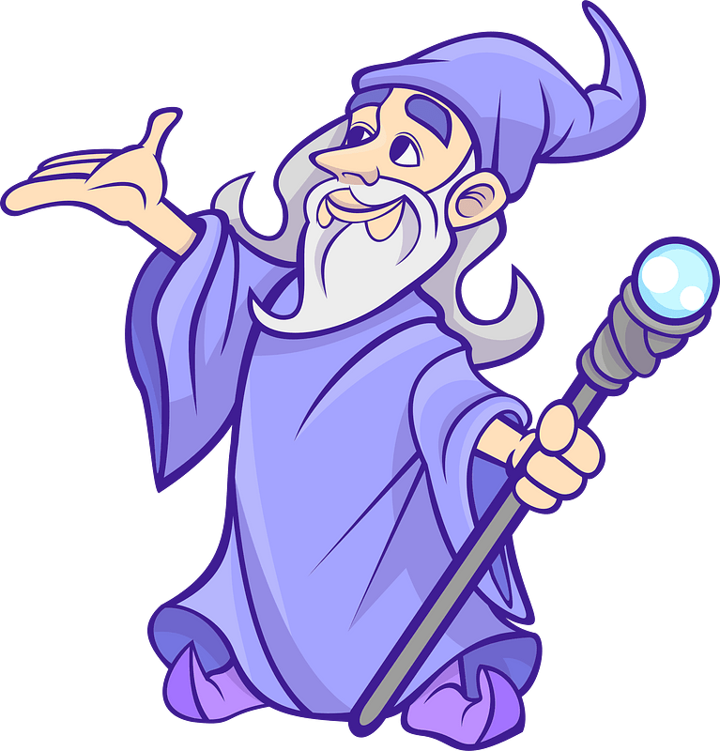
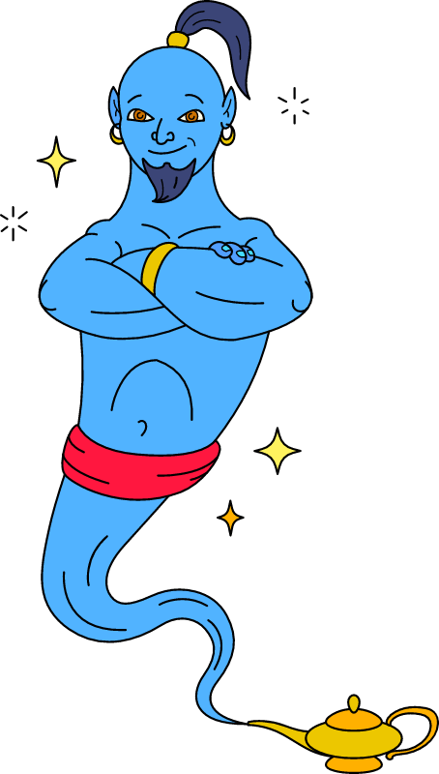
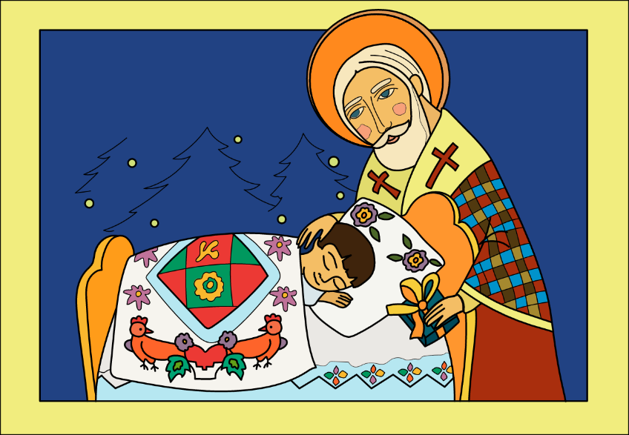
Think about it …
Why are people interested in miraculous or supernatural events?
People might try to use Jesus as an ATM or a 911 operator.
Jesus is more than a miracle worker
Jesus’ work in our lives is for His glory

Slide 4
Listen for a problem.
John 2:1-4 (NIV) On the third day a wedding took place at Cana in Galilee. Jesus' mother was there, 2 and Jesus and his disciples had also been invited to the wedding. 3 When the wine was gone, Jesus' mother said to him, "They have no more wine." 4 "Dear woman, why do you involve me?" Jesus replied. "My time has not yet come."

Slide 5
Jesus, We’ve Got a Problem
At the wedding celebration, Mary told Jesus the host had run out of wine. What did Jesus remind Mary when he replied?
Why do you think she got Jesus involved?
Why do you think Jesus seemed to hesitate to help?

Slide 6
Jesus, We’ve Got a Problem
What did she do to demonstrate trust and understanding that He was more than merely the little boy she had raised?
Why do we find it difficult to sometimes place our needs in Jesus’ hands and trust Him to do what is best?

Slide 7
Jesus, We’ve Got a Problem
Jesus was a guest at this wedding. How can we invite Jesus to be an honored guest at all our life events?
How does understanding Jesus’ mission help you see Him as more than a miracle worker or emergency responder?
What difference should this make in your prayers, attitudes and actions?

Slide 8
Listen for obedience.
John 2:5-8 (NIV) His mother said to the servants, "Do whatever he tells you." 6 Nearby stood six stone water jars, the kind used by the Jews for ceremonial washing, each holding from twenty

Slide 9
Listen for obedience.
to thirty gallons. 7 Jesus said to the servants, "Fill the jars with water"; so they filled them to the brim. 8 Then he told them, "Now draw some out and take it to the master of the banquet." They did so,

Slide 10
For Jesus, It Was No Problem
Mary gave sound advice … “Do whatever He tells you.” What do those instructions imply about her own convictions about Jesus?
In what way were Jesus’ instructions not an insignificant task?
Why is it hard sometimes to do what Jesus tells us to do?

Slide 11
For Jesus, It Was No Problem
The servants may have felt fear or trepidation taking the sample to the master of the banquet. Why?
What benefits did the servants receive from following Jesus’ command?

Slide 12
Listen for a quality miracle.
John 2:9-11 (NIV) and the master of the banquet tasted the water that had been turned into wine. He did not realize where it had come from, though the servants who had drawn the water knew. Then he called the bridegroom aside 10 and said, "Everyone brings out the

Slide 13
Listen for a quality miracle.
choice wine first and then the cheaper wine after the guests have had too much to drink; but you have saved the best till now." 11 This, the first of his miraculous signs, Jesus performed at Cana in Galilee. He thus revealed his glory, and his disciples put their faith in him.

Slide 14
More than a Cup of Wine
What did the table master think about the wine sample he was given?
More than just saving face for the wedding hosts, what was significant about this miracle?
Why do you think Jesus did not correct the MC and the bridegroom and let it be known that He had done it?

Slide 15
More than a Cup of Wine
What qualities of God do you think weighed heavily and shone brightly to the disciples as they observed Jesus?
The disciples believed. What things has Jesus accomplished in your life that have increased your faith in Him?

Slide 16
Application
Worship
Write down recent decisions, motivations, and actions taken in your life.
Evaluate how you are using these things to glorify the Lord and point people to Jesus.
Praise God for His work in your life.

Slide 17
Application
Obey
Write down two or three things that God may be calling you to obey Him in doing.
Pray about how you can begin to act upon those things.
Draw up an action plan.

Slide 18
Application
Share
Take some time to meet with another group member.
Ask questions about what they are celebrating and how they are handling struggles in their lives.
What are some needs they have that only Jesus can supply

Slide 19
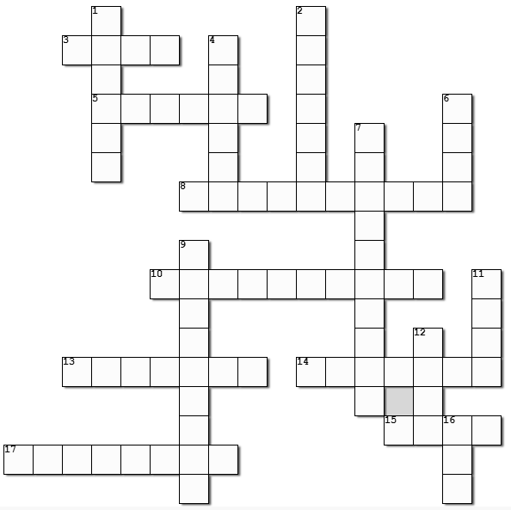
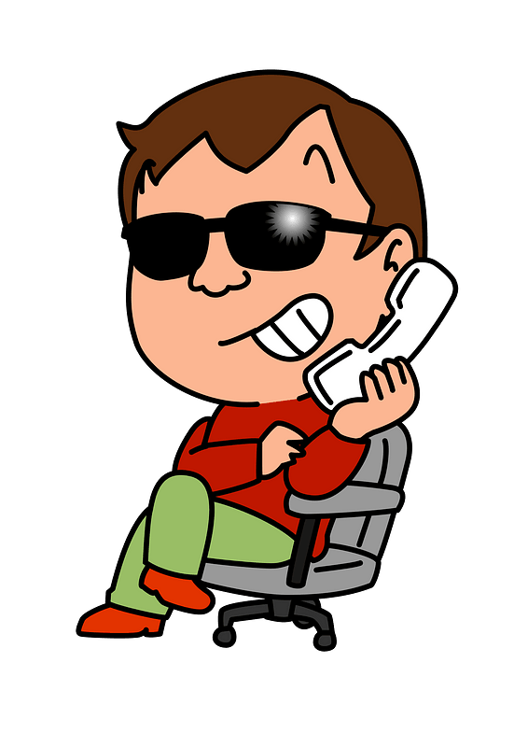
Family Activities
Frankly, I was hoping for another one of those cryptogram puzzles with the funny symbols.
Check at https://tinyurl.com/49mn3fbr

Slide 20
The Sign of His Glory
March 2

