Slide 1
The Wise Men’s Worship
January 6

Slide 2
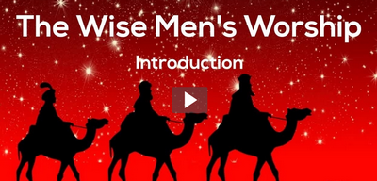
View Video

Slide 3
Think about this …
What was our favorite gift to give this Christmas?
Today we will discover some things about the original Christmas gift givers and the gifts they delivered to Jesus.
We study the Magi, the Wise Men
Their gifts were significant and showed their worship

Slide 4
Listen for international travelers.
Matthew 2:1-6 (NIV) After Jesus was born in Bethlehem in Judea, during the time of King Herod, Magi from the east came to Jerusalem 2 and asked, "Where is the one who has been born king of the Jews? We saw his star in the east and have come to worship him." 3 When King Herod heard this he was disturbed, and all Jerusalem with him. 4 When he had called

Slide 5
Listen for international travelers.
together all the people's chief priests and teachers of the law, he asked them where the Christ was to be born. 5 "In Bethlehem in Judea," they replied, "for this is what the prophet has written: 6 "'But you, Bethlehem, in the land of Judah, are by no means least among the rulers of Judah; for out of you will come a ruler who will be the shepherd of my people Israel.'"

Slide 6
The Supreme Ruler
What was extraordinary about the visit of these men from the east?
The Magi knew of the king of the Jews because of the special star they saw, what did the not know?
How did King Herod react to the visit of the Magi?
Why was a powerful king disturbed by the presence of a helpless baby?

Slide 7
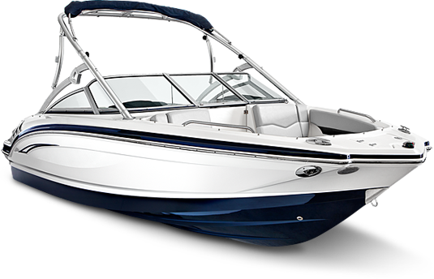
The Supreme Ruler
Herod felt that the Baby Jesus (the potential king) was in competition with him. Actually, Herod was in competition with God, Himself …
How can we tell if someone or something is in competition, vying for God’s position of ruler in our lives?

Slide 8
The Supreme Ruler
If the scholars knew what the scriptures said about the promised Messiah, why do you think they did not go worship Him themselves?
They missed the Truth God had placed in scripture. What are some things we can do so we do not miss Truth God wants us to know as we study His Word?

Slide 9
Listen for Herod’s scheme.
Matthew 2:7-8 (NIV) Then Herod called the Magi secretly and found out from them the exact time the star had appeared. 8 He sent them to Bethlehem and said, "Go and make a careful search for the child. As soon as you find him, report to me, so that I too may go and worship him."

Slide 10
Some Oppose Jesus’ Rule
What were King Herod’s instructions to the Magi?
How does it feel to have a rival—to feel as though you are being overlooked or replaced?
How can a competitive, prideful, or insecure spirit alter a person’s behavior?
Herod deceitfully used religion for personal ends. In what ways do people do this in our society today?

Slide 11
Some Oppose Jesus’ Rule
Herod wanted to keep other people from showing allegiance to this “new king” – what kinds of things might keep you from truly worshiping when you come to worship services?
Some of these things you cannot change – but what can you deal with?

Slide 12
Listen for how the Magi worshiped.
Matthew 2:9-11 (NIV) After they had heard the king, they went on their way, and the star they had seen in the east went ahead of them until it stopped over the place where the child was. 10 When they saw the star, they were

Slide 13
Listen for how the Magi worshiped.
overjoyed. 11 On coming to the house, they saw the child with his mother Mary, and they bowed down and worshiped him. Then they opened their treasures and presented him with gifts of gold and of incense and of myrrh.

Slide 14
Worship Jesus, the King
Why did seeing the star again create feelings of joy?
What did the wise men do when they finally saw the young King?
What might be the significance of their gifts?

Slide 15
Worship Jesus, the King
View Video

Slide 16
Worship Jesus, the King
What are some various "presents" we might give to Christ?
What do these verses teach us about authentic worship?
What are some ways we can best express worship of Jesus?

Slide 17
Application
Look.
Slow down and reflect on some aspects of God’s beauty in creation.
As you see something in God’s handiwork, like a star, let God lead you to worship Christ.
Look for ways to pursue worshiping God.

Slide 18
Application
Invite.
Invite others to join you in worshiping the King.
One way to start is by bringing them to your Bible study group.
Encourage their participation and let them find Christ as they meet and worship with others.

Slide 19
Application
Give.
Just as the wise men gave gifts to the King, we also express our worship though giving.
Make a commitment to give toward the ministry and mission of His kingdom’s work.

Slide 20
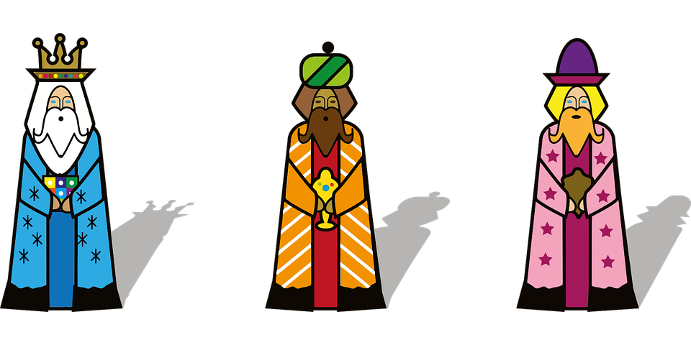
Family Activities
We three kings of orient are …
Family Activities at https://tinyurl.com/ycxa6mgv ... puzzles, color pages, videos … and more
… recommending to you ...

Slide 21
The Wise Men’s Worship
January 6

