Slide 1
The Work of the Holy Spirit
April 11

Slide 2
Video Introduction
View Video

Slide 3
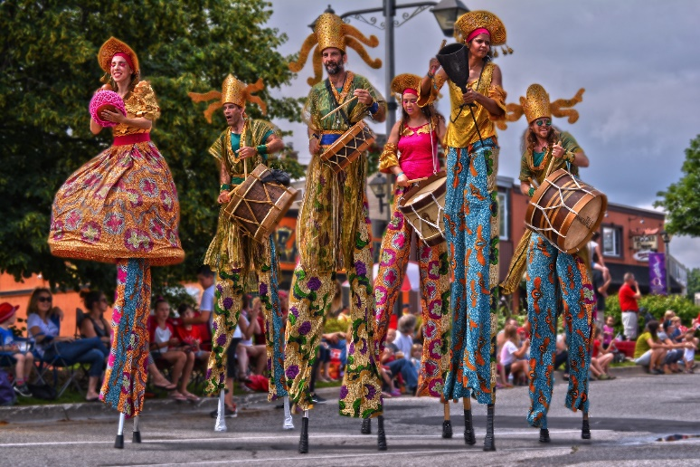
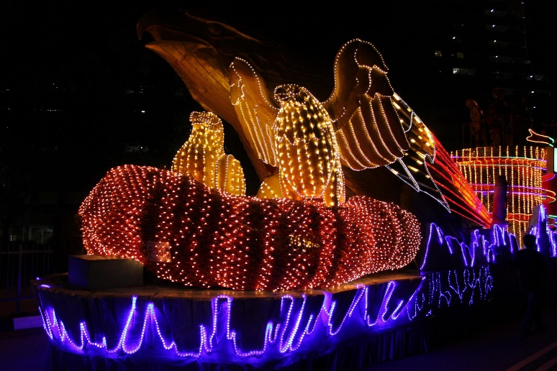
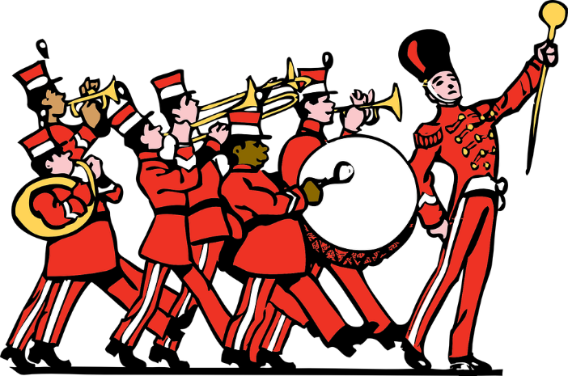
Remember the excitement?
What’s your favorite memory of a parade you’ve watched or attended?
These parades all celebrated someone or some particular occasion.
They magnify that person or event.
They draw attention to something worth celebrating.
It is the Holy Spirit’s role to magnify the work of Jesus, to draw attention to Him.

Slide 4
Listen for who testifies.
John 15:26-27 (NIV) "When the Counselor comes, whom I will send to you from the Father, the Spirit of truth who goes out from the Father, he will testify about me. 27 And you also must testify, for you have been with me from the beginning.

Slide 5
The Holy Spirit Empowers
What did Jesus reaffirm to the disciples?
How is the truth of the union of the Father, Son, and Spirit seen in verse 26?
Why do you think it is important that Jesus called Him the “Spirit of Truth?”

Slide 6
The Holy Spirit Empowers
The Greek word used for counselor has to do with one who “comes along side.” When you hire a counselor, what kind of service do you anticipate? How will they come alongside?
What are ways in which the Holy Spirit testifies/witnesses about Christ?
What does this have to do with Jesus instruction in verse 27?

Slide 7
Listen for another task of the Spirit.
John 16:7-11 (NIV) But I tell you the truth: It is for your good that I am going away. Unless I go away, the Counselor will not come to you; but if I go, I will send him to you. 8 When he comes, he will convict the world of guilt in regard to sin and righteousness and judgment:

Slide 8
Listen for another task of the Spirit.
in regard to sin, because men do not believe in me; 10 in regard to righteousness, because I am going to the Father, where you can see me no longer; 11 and in regard to judgment, because the prince of this world now stands condemned.

Slide 9
The Holy Spirit Convicts/Convinces
What advantage would come to the disciples only if Jesus went away to the Father?
What work of the Holy Spirit did Jesus introduce and to what three areas did He apply it?
What are some other words your translations use for convict? What are some other synonyms?

Slide 10
The Holy Spirit Convicts/Convinces
What are some ways the Holy Spirit helps us recognize our sins?
Why do unbelievers resist the convicting work of the Spirit?
Why might believers resist the convicting work of the Spirit?
Why is it a positive thing to be convicted of your sin?

Slide 11
Listen for other works of the Holy Spirit
John 16:12-15 (NIV) "I have much more to say to you, more than you can now bear. 13 But when he, the Spirit of truth, comes, he will guide you into all truth. He will not speak on his own; he will speak only what he hears, and he will tell you what is yet to come.

Slide 12
Listen for other works of the Holy Spirit
He will bring glory to me by taking from what is mine and making it known to you. 15 All that belongs to the Father is mine. That is why I said the Spirit will take from what is mine and make it known to you.

Slide 13
The Spirit Glorifies Jesus
What work of the Spirit does Jesus identify in verse 13?
Whose message does the Spirit declare and to whom does He bring glory?
What connection do these verses show between the Father, Son, and Holy Spirit that affirm their oneness and the consistency of their message?

Slide 14
The Spirit Glorifies Jesus
How does the Holy Spirit guide believers into all truth?
Verse 14 speaks of the Spirit’s task to glorify Jesus. Why is it so important that the Spirit always points to Jesus?

Slide 15
Application
Confess.
The Holy Spirit comes alongside us to convict us of sin.
If He is convicting you of an unconfessed sin, take a few minutes on your knees repent of that sin.

Slide 16
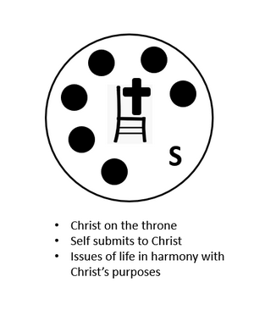
Application
Submit.
Allow the Holy Spirit to fill you and have control of your life.
Lean on Him to guide your steps.

Slide 17
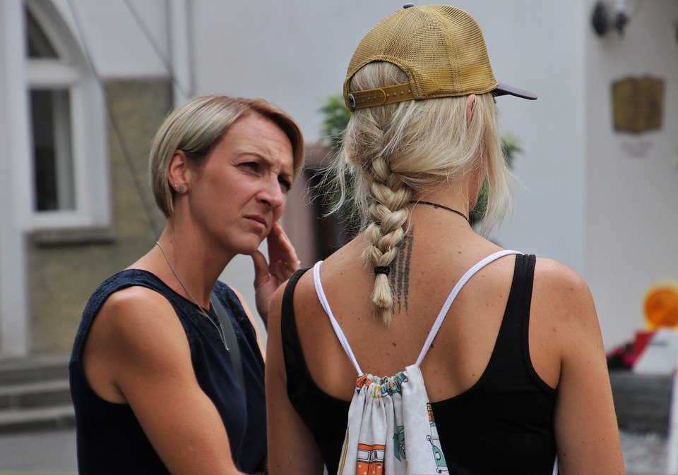
Application
Share.
Allow the Holy Spirit to use you to talk about Jesus with another person.
Trust Him to guide the conversation and give you words that bring honor to Christ.

Slide 18
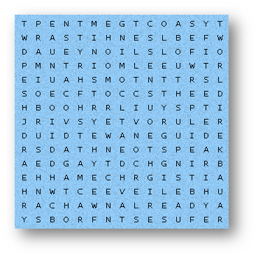
Family Activities
We’re sending a message to the church in the country of Waltaibujeerat. It’s hidden in the Word Search Grid. Can you help them decode it? For help and other Family Activities go to https://tinyurl.com/fbu3skk2

Slide 19
The Work of the Holy Spirit
April 11

