Slide 1
Three Reasons for Giving Thanks
November 27

Slide 2
Video Introduction
View Video

Slide 3
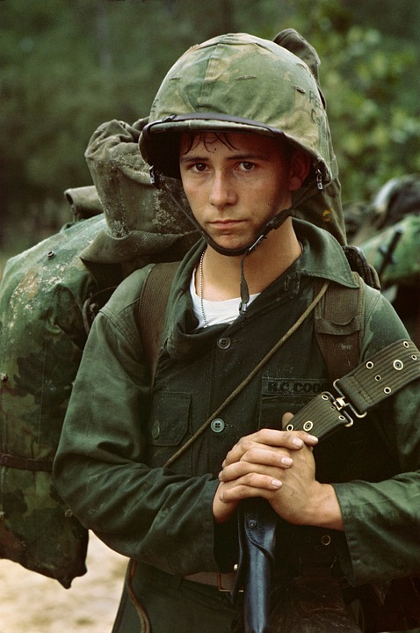
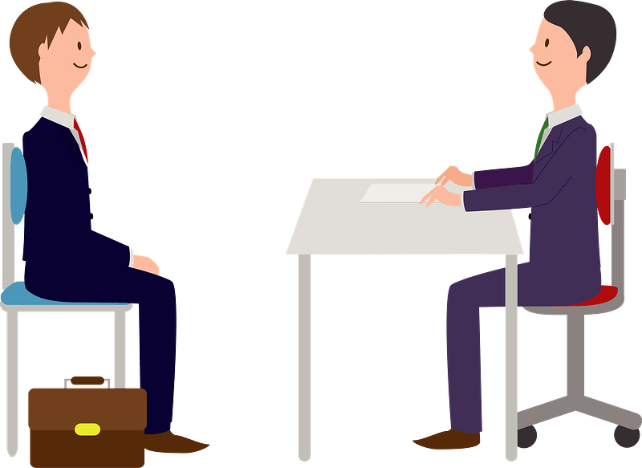
Ponder this …
What past event in your life are you now thankful for?
When we look back on our lives, we see how God made possible many good things.
We are challenged today to give thanks for the ways God has been and still is at work in your life.
You’re hired!

Slide 4
Listen for reasons to give thanks.
Psalm 107:1-3 (NIV) Give thanks to the LORD, for he is good; his love endures forever. 2 Let the redeemed of the LORD say this-- those he redeemed from the hand of the foe, 3 those he gathered from the lands, from east and west, from north and south.

Slide 5
God Redeems Us
We see here the action the people are called to and why.
Exhortation to give thanks to the Lord
Because – God is good and His love endures forever
How has God shown you that He is good?

Slide 6
God Redeems Us
Given that the psalmist was a Jewish person from Old Testament times, who are the redeemed he is writing about?
If we think of the psalm as speaking to us, who are the redeemed, from what have they been redeemed?
Who are the “foes” he talks about, for the people of Israel and for us?
Give thanks to God for setting us free from our foes!

Slide 7
God Redeems Us
When is it easy to recall God’s goodness?
When is it hard to recall God’s goodness?
When you don’t have a paycheck or don’t have nice things, how do you thank God?
What can we do to get back into recalling God’s goodness?

Slide 8
Listen for how God leads.
Psalm 107:4-7 (NIV) Some wandered in desert wastelands, finding no way to a city where they could settle. 5 They were hungry and thirsty, and their lives ebbed away. 6 Then they cried out to the LORD in their trouble, and he delivered them from their distress. 7 He led them by a straight way to a city where they could settle.

Slide 9
God Leads Us
Note the situation of the group spoken of in these verses.
Wandering in the wilderness
Cannot find a city to settle down
Hungry and thirsty
Lives ebbing away

Slide 10
God Leads Us
To what spiritual situations can these verses speak?
They cried out in their time of trouble. What was the Lord’s response?

Slide 11
God Leads Us
Consider the difference between whining (grumbling) and crying out to the Lord (lamenting) during trouble?
Remember … thank God for His leading. He gives direction when you cry out to Him
Whining or Grumbling | Crying Out or Lamenting
Attitude of entitlement Selfish motives “I want what I want when I want it … now” Springs from a bad attitude Ungratefulness | Admitting you don’t deserve anything An attitude of humility “Wrestling” with God Giving God the opportunity to teach you from the situation

Slide 12
Listen for good things God gives.
Psalm 107:8-9 (NIV) Let them give thanks to the LORD for his unfailing love and his wonderful deeds for men, 9 for he satisfies the thirsty and fills the hungry with good things.

Slide 13
God Gives Everything Good
Once again, the psalmist appeals for us to give thanks.
For God’s love
For God’s working in our lives

Slide 14
God Gives Everything Good
What does the Lord do for us that we cannot do for ourselves?
What are the good things for which we are “hungry” and “thirsty” at the deepest level?

Slide 15
God Gives Everything Good
How can our attitudes and actions help others recognize God as the giver of all good things?
What are some situations where knowing that “God is always at work for your good” is something you really need to hear and be convinced of?

Slide 16
Application
Recall.
Think of crises in your life in which God was working all things for good, even if you did not realize it in those moments.
Pray and thank God for His good work in your life.

Slide 17
Application
Write.
Who did God use to help you through one of those crisis moments?
This week, drop that person a note; let him or her know how thankful you are.

Slide 18
Application
Respond.
God often uses people as a conduit of His goodness.
Who do you know who are sick, grieving, hungry, or hurting?
Reach out and offer tangible support or assistance this week to at least one person who is going through a crisis.
Both of you will be thankful for what you did.

Slide 19
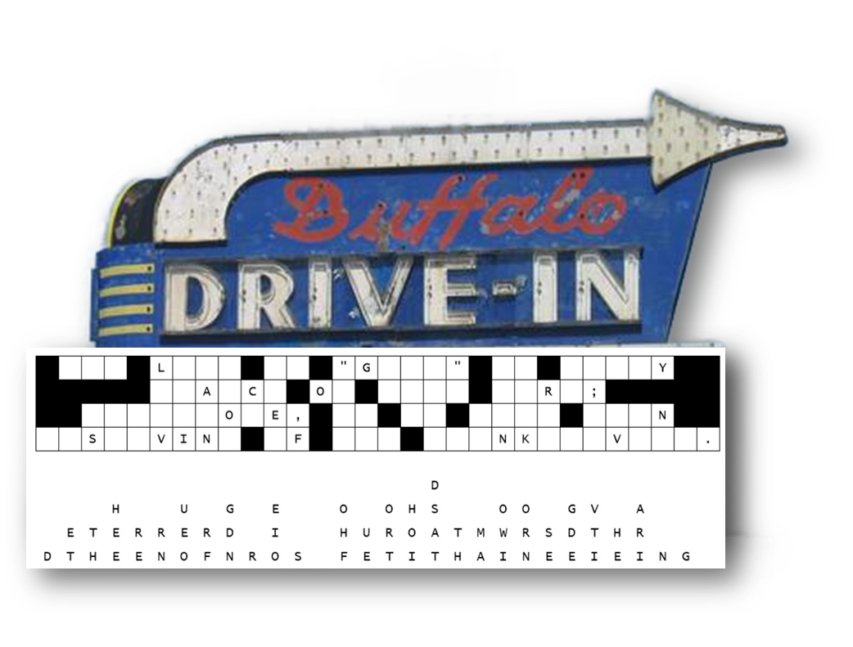
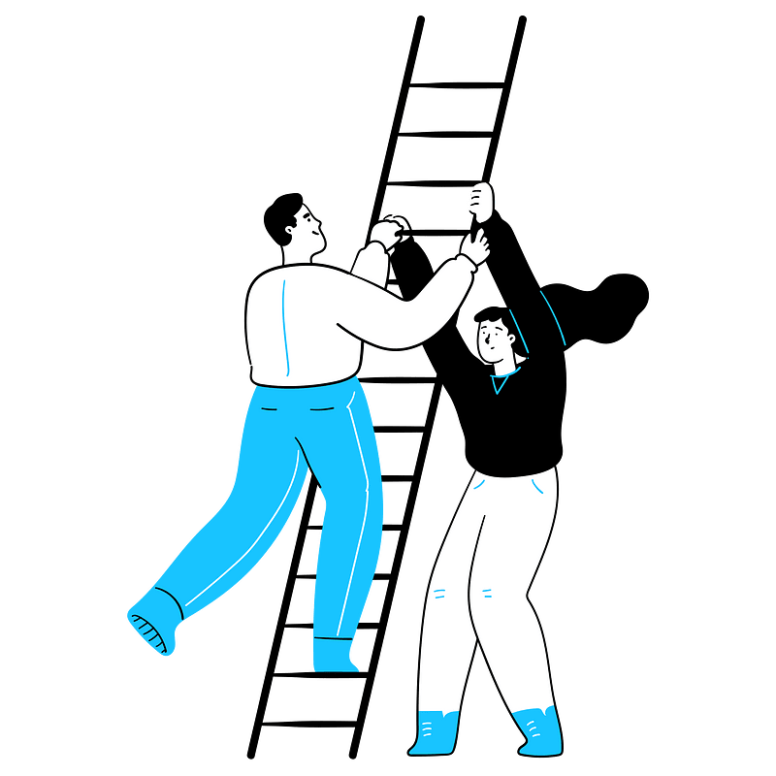
Family Activities
Our crew needs your help to replace the fallen letters in the right lines.. A free movie for you if you can fix it for us! Help and other Fun Family Activities at https://tinyurl.com/2p9pjcut

Slide 20
Three Reasons for Giving Thanks
November 27

