Slide 1
Trust God to Work
May 30

Slide 2
Video Introduction
View Video

Slide 3
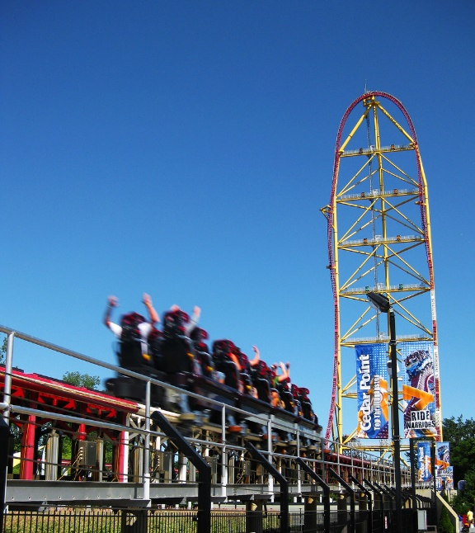
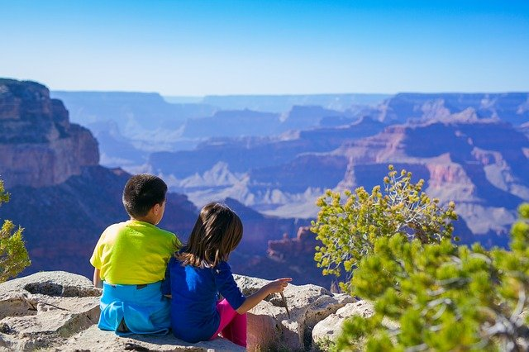
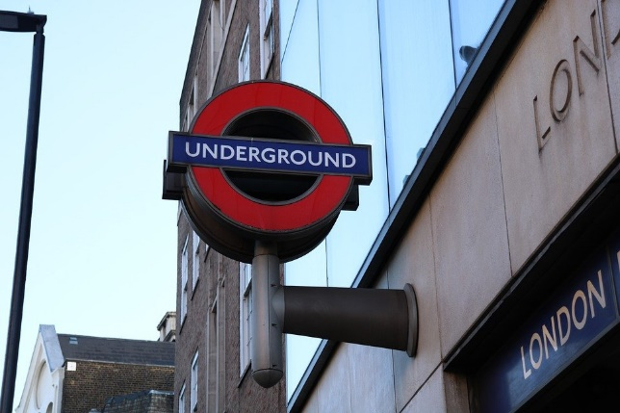
Brag on it !
What is something you have completed on your “bucket list”?
When we look back on our lives, we’ve had some interesting experiences.
No doubt we’ve met some interesting people and had interesting conversations along the way.
We can share Christ in many of these situations, but we must leave the results to God.
Photo by Craig Lloyd

Slide 4
Listen for good results.
Matthew 13:3-8 (NIV) Then he told them many things in parables, saying: "A farmer went out to sow his seed. 4 As he was scattering the seed, some fell along the path, and the birds came and ate it up. 5 Some fell on rocky places, where it did not have much soil. It sprang up quickly, because the soil was shallow.

Slide 5
Listen for good results.
But when the sun came up, the plants were scorched, and they withered because they had no root. 7 Other seed fell among thorns, which grew up and choked the plants. 8 Still other seed fell on good soil, where it produced a crop--a hundred, sixty or thirty times what was sown.

Slide 6
Share Jesus Wherever You Are
Our verses stated that Jesus taught in parables. What is a parable?
What was the purpose of teaching in parables?
What are the benefits of using stories to reveal truth?

Slide 7
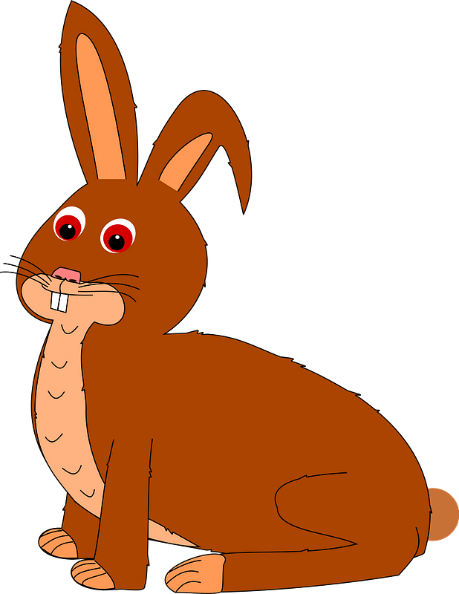
Share Jesus Wherever You Are
Think about important lessons have you learned through stories. What are some examples of children’s stories that teach a moral concept?

Slide 8
Share Jesus Wherever You Are
There is a significant effort today to similarly communicate the gospel to oral cultures.
Oral cultures not print oriented.
They prefer learning methods other than reading.
Mission organizations are developing evangelization strategies using orality.

Slide 9
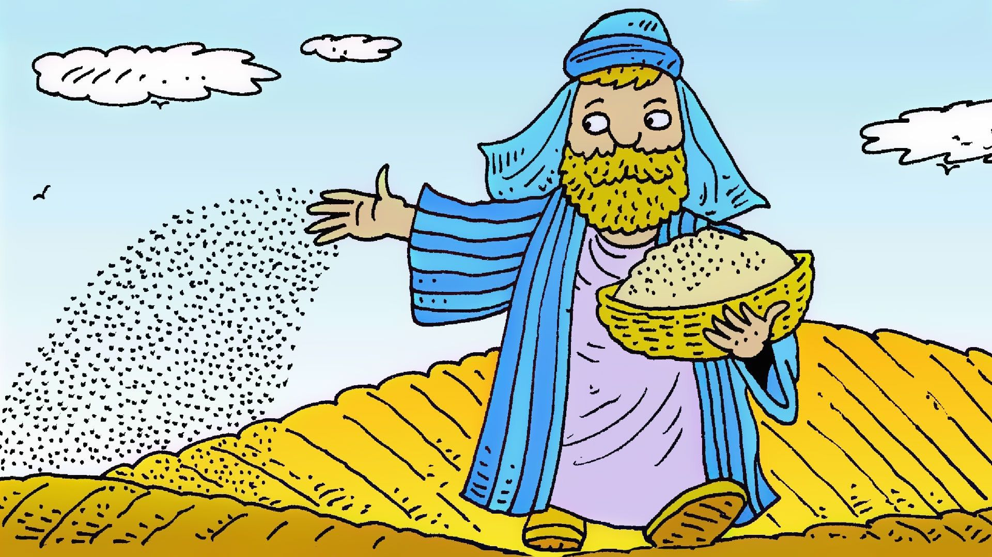
Share Jesus Wherever You Are
Let’s outline the details of the story Jesus told.
Art by Richard Gunther www.lambsongs.co.nz

Slide 10
Listen for Jesus explanation.
Matthew 13:18-22 (NIV) "Listen then to what the parable of the sower means: 19 When anyone hears the message about the kingdom and does not understand it, the evil one comes and snatches away what was sown in his heart. This is the seed sown along the path. 20 The one who received the seed that fell on rocky places is the man who hears the word

Slide 11
Listen for Jesus explanation.
and at once receives it with joy. 21 But since he has no root, he lasts only a short time. When trouble or persecution comes because of the word, he quickly falls away. 22 The one who received the seed that fell among the thorns is the man who hears the word, but the worries of this life and the deceitfulness of wealth choke it, making it unfruitful.

Slide 12
Not Everyone Accepts the Message
Consider whether the parable is about the seed, the sower, or the soil—or all three? What is the significance of each?
Seed The Word of God | Sower Those Who Witness | Soil Hearts of Hearers

Slide 13
Not Everyone Accepts the Message
Jesus talks specifically to the disciples, focuses on the “soil,” the hearts of the hearers. How do you see each of these on display in our culture?
Path – How does Satan “snatch away” Truth
Rocky Places – What “rocks” make our hearts shallow?
Thorny Ground – What “thorns” choke out growth of God’s Word

Slide 14
Not Everyone Accepts the Message
We might think that the farmer wasted a lot of seed on unproductive ground. But … what does the story tell us about God when we see that He continues to communicate the Gospel message to people who will likely not receive it?
Art by Richard Gunther www.lambsongs.co.nz

Slide 15
Listen for what happens in “good soil”.
Matthew 13:23 (NIV) But the one who received the seed that fell on good soil is the man who hears the word and understands it. He produces a crop, yielding a hundred, sixty or thirty times what was sown."

Slide 16
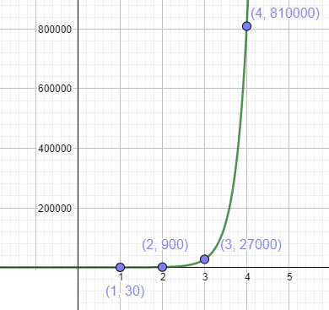
Abundant Growth of the Gospel
What does the situation described in verse 23 have in common with the situations described in verses 19‑22?
What appears to be the difference?
What is the significance of the multi-fold increase?

Slide 17
Abundant Growth of the Gospel
When have you experienced the gospel landing on good soil?
How can trusting God with the results impact your attitude toward evangelism?

Slide 18
Application
Grow.
If you’ve been distracted or challenged in your walk with Christ, renew your commitment to Him.
Ask God to work in your life and help you produce fruit for Him.

Slide 19
Application
Share.
Identify opportunities God gives you during the week to “sow seeds” in the lives of others.
Pray for boldness and take advantage of the opportunities God places in front of you.

Slide 20
Application
Care.
As you share Christ, “work the soil”, do more than speak words; show care and concern.
Display the love of Christ in your actions; invest time in someone’s life and let God use your words and actions to prepare the soil.

Slide 21
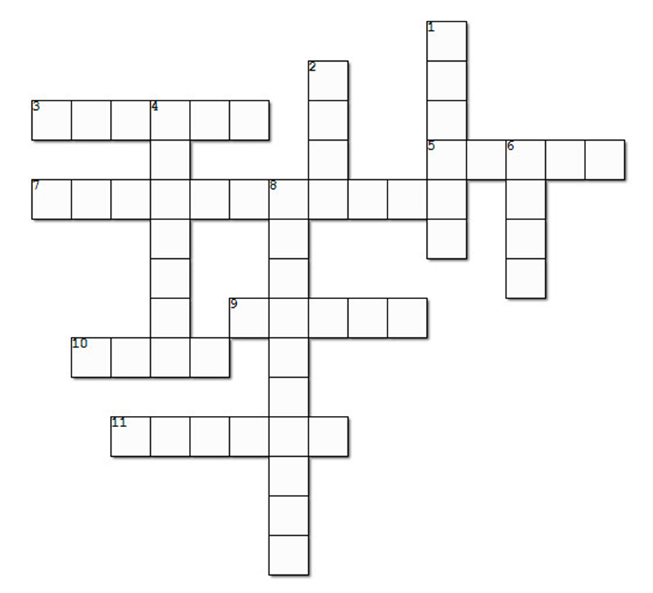
Family Activities
Aiee cucaracha ,,, how do you do this with no clues? Maybe if you count the letters and blanks?
Oh well, you can get help at https://tinyurl.com/32xewwa9 … and you could find the regular crossword and other cool stuff too.

Slide 22
Trust God to Work
May 30

