Slide 1
We Strengthen One Another
August 23

Slide 2
Introductory Video
View Video

Slide 3
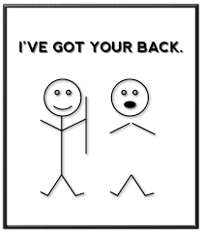
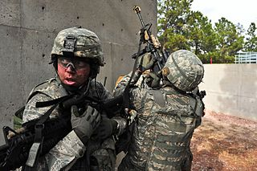
Remember that person?
When has someone shown you that they really “had your back”?
As we studied earlier, “no man is an island.”
We need one another
We strengthen one another to live a life honoring to God.

Slide 4
Listen for a contrast.
Ephesians 5:8-14 (NIV) For you were once darkness, but now you are light in the Lord. Live as children of light 9 (for the fruit of the light consists in all goodness, righteousness and truth) 10 and find out what pleases the Lord. 11 Have nothing to do with the fruitless deeds of darkness, but rather expose them.

Slide 5
Listen for a contrast.
For it is shameful even to mention what the disobedient do in secret. 13 But everything exposed by the light becomes visible, 14 for it is light that makes everything visible. This is why it is said: "Wake up, O sleeper, rise from the dead, and Christ will shine on you."

Slide 6
Help to Stand Against Worldly Sin
What contrasting imagery did Paul use to describe the change that had taken place in the lives of his readers?
What are effects of light on darkness?
These are physical qualities of light. What point is Paul trying to make spiritually? What does he mean is spiritual “light”?

Slide 7
Help to Stand Against Worldly Sin
What do you think it means to be ‘children of light’?
How does the apostle describe light or its fruit in Ephesians 5:9? Define each term in your own words.
What are some examples of “fruitless works of darkness” that exist in our culture?

Slide 8
Help to Stand Against Worldly Sin
What is to be the relationship of the believer to works of darkness?
How can we avoid becoming desensitized to this darkness?
How can we expose fruitless works of darkness without saying a word?

Slide 9
Listen for a contrast between wise and unwise.
Ephesians 5:15-17 (NIV) Be very careful, then, how you live--not as unwise but as wise, 16 making the most of every opportunity, because the days are evil. 17 Therefore do not be foolish, but understand what the Lord's will is

Slide 10
Help to Make Wise Use of Time
What is the admonition in these verses?
What would be some characteristics of a believer who lives wisely in the midst of our sensual culture?
How is it that even a believer can lose focus on living wisely?
Why is seeking pleasure an unwise way to spend life?

Slide 11
Help to Make Wise Use of Time
You may know (or admit to being) a “workaholic.” How might this be an unwise use of one’s time and even result in impurity?
In addition to time alone with God and quality time with family, what are some other wise uses of our time where you support others?

Slide 12
Listen for yet another contrast.
Ephesians 5:18-21 (NIV) Do not get drunk on wine, which leads to debauchery. Instead, be filled with the Spirit. 19 Speak to one another with psalms, hymns and spiritual songs.

Slide 13
Listen for yet another contrast.
Sing and make music in your heart to the Lord, 20 always giving thanks to God the Father for everything, in the name of our Lord Jesus Christ. 21 Submit to one another out of reverence for Christ.

Slide 14
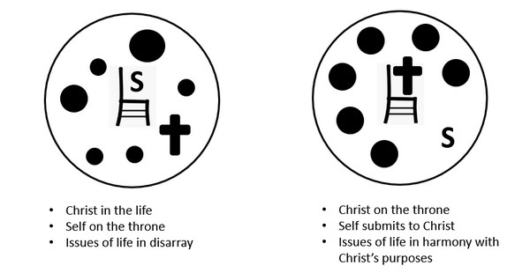
Help to Living in Mutual Submission
What two contrasting options are identified for determining our conduct.
What does it mean to be filled with the Spirit?

Slide 15
Help to Living in Mutual Submission
What are some of the results of being filled with the Spirit?
How does the biblical concept of being submissive differ from the popular cultural view?
What motive does Paul give for being submissive to one another?
Biblical Submission | Cultural View of Submission

Slide 16
Application
Identify.
Through prayer and introspection, identify recurring sins and temptations that weigh you down.
Confess those things to God and ask Him to bring others into your life to strengthen your walk

Slide 17
Application
Influence.
As you experience strength and victory in your own life, look for opportunities to influence others.
Be a self-less and submissive member of your church.

Slide 18
Application
Invite.
Invite another Christian or group of Christians to be a part of your fight against temptation.
Confess your temptations to them and allow them to confess theirs to you. Stand together against those struggles.

Slide 19
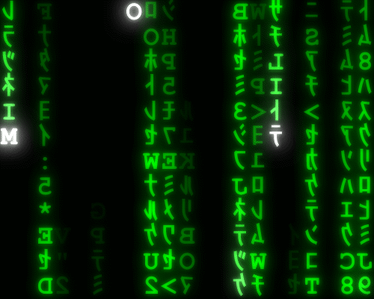
Family Activities
Well, at least the letters in our Falling Phrases puzzle are not from a foreign font. If you get stuck, there’s help at https://tinyurl.com/y6rmg8dk And there’s other stuff there for the whole family!

Slide 20
We Strengthen One Another
August 23

