Slide 1
What is God’s Answer to Suffering?
February 2

Slide 2
Introduction Video
View Video

Slide 3
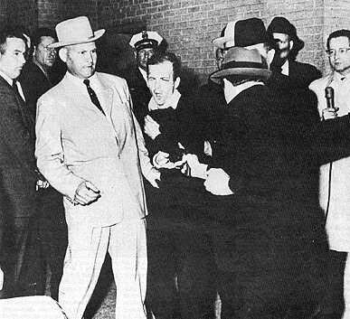
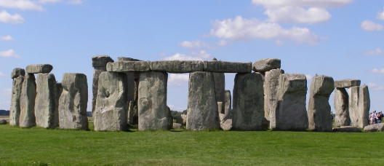
Think about it …
What’s a mystery you’d most like to see solved?

Slide 4
The Point
Sometimes, what we really wonder about is why things happen the way they do in our lives.
Why do good or bad things come into our lives?
Why did God let or cause them to happen?
Today we consider how God’s actions are often beyond our understanding, but we can trust Him.

Slide 5
Listen for Job’s answer to God.
Job 40:1-5 (NIV) The LORD said to Job: 2 "Will the one who contends with the Almighty correct him? Let him who accuses God answer him!" 3 Then Job answered the LORD: 4 "I am unworthy--how can I reply to you? I put my hand over my mouth. 5 I spoke once, but I have no answer-- twice, but I will say no more."

Slide 6
God’s Workings
What does the way God’s question was phrased suggest about Job?
How did Job respond to God’s challenge?
What’s really at the heart of our questioning of God when we’re suffering?

Slide 7
God’s Workings
What kinds of circumstances might lead one of us to question God?
What point do you suppose God wanted Job (and us) to understand through this series of questions?

Slide 8
Listen for God’s challenge.
Job 40:6-8 (NIV) Then the LORD spoke to Job out of the storm: 7 "Brace yourself like a man; I will question you, and you shall answer me. 8 "Would you discredit my justice? Would you condemn me to justify yourself?

Slide 9
God’s Justice
What might be the significance of God speaking out of the whirlwind or storm?
What challenge does God issue to Job?
Of what does God accuse Job?
What are some of the barriers that keep us from understanding God’s sovereignty over our lives?

Slide 10
God’s Justice
What kinds of things do we (should we) learn through suffering?
What can help us grow in our understanding of God’s justice?

Slide 11
Listen for Job’s confession.
Job 42:1-6 (NIV) Then Job replied to the LORD: 2 "I know that you can do all things; no plan of yours can be thwarted. 3 You asked, 'Who is this that obscures my counsel without knowledge?' Surely I spoke of things I did not understand, things too wonderful for me to know

Slide 12
Listen for Job’s confession.
"You said, 'Listen now, and I will speak; I will question you, and you shall answer me.' 5 My ears had heard of you but now my eyes have seen you. 6 Therefore I despise myself and repent in dust and ashes."

Slide 13
Acknowledge God, Humble Yourself
What was the essence of Job’s confession concerning the Lord?
Why is acknowledging the mystery and superiority of God actually a comfort and encouragement?

Slide 14
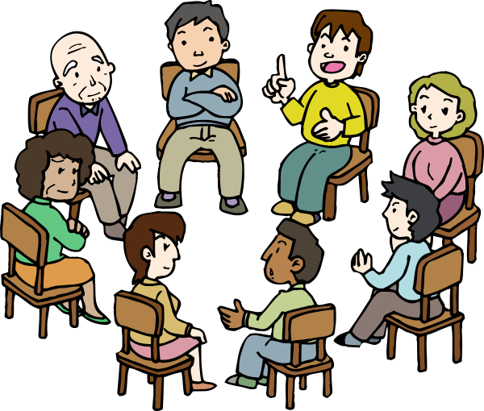
Acknowledge God, Humble Yourself
Job was being bold and arrogant when he had called for a face-to-face dialogue with the Lord.
Agree or Disagree?
Disagree | Agree

Slide 15
Acknowledge God, Humble Yourself
What are some other ways that we are tempted to respond to lengthy struggles?
What realization enabled Job to not yield to these kinds temptations and caused him to repent?
How can our group help one another trust God in times of suffering?

Slide 16
Application
Trust.
Even if you don’t see how God is at work in your life, trust Him.
Pray that He would strengthen your faith as you go through difficulty.

Slide 17
Application
Examine.
Dig into Scripture to see what God has revealed about His nature and character.
Choose attributes of God for deeper word studies.
Be driven to know what God says about Himself rather than relying on the opinions of others.

Slide 18
Application
Proclaim.
Look for an opportunity to tell someone else why you trust God even when walking the road of suffering.
Encourage others who are also suffering.

Slide 19
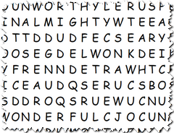
Family Activities
I say, these words are situated in a most beastly manner. What a despicable puzzle. Devised no doubt by a mean-spirited educator. Fortuitously, aid is available at https://tinyurl.com/rw55hvp along with other Family Activities. Rumors abound that a Crossword puzzle can be found at this location.

Slide 20
What is God’s Answer to Suffering?
February 2

