Slide 1
When Life Seems Empty
March 3

Slide 2
Think about it …
What is the most monotonous task you’ve ever had to do?
In reality, many elements of our lives seem repetitive and monotonous.
Even those things we anticipate being fun or interesting can become boring and tiresome.
Today we consider the fact that life without Christ is meaningless.

Slide 3
Listen for cycles of life.
Ecclesiastes 1:1-7 (NIV) The words of the Teacher, son of David, king in Jerusalem: 2 "Meaningless! Meaningless!" says the Teacher. "Utterly meaningless! Everything is meaningless." 3 What does man gain from all his labor at which he toils under the sun? 4 Generations come and generations go, but the earth remains forever. 5 The sun rises and the

Slide 4
Listen for cycles of life.
sun sets, and hurries back to where it rises. 6 The wind blows to the south and turns to the north; round and round it goes, ever returning on its course. 7 All streams flow into the sea, yet the sea is never full. To the place the streams come from, there they return again.

Slide 5
Without Christ, Life Feels Pointless
What evidence did the Preacher give for the validity of his thesis that life is vanity, meaningless?
How did Solomon illustrate his statement that the earth remains the same?
Why do you think Solomon was so dissatisfied with life?

Slide 6
Without Christ, Life Feels Pointless
What things in our lives today cause us to have feelings of futility?
What are some ways people deal with feelings of futility
Think of some joyous people you know. What makes them that way in the midst of this seeming world of futility?

Slide 7
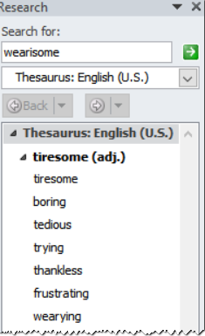
Without Christ, No Satisfaction
What are some synonyms for the word “wearisome”?
Listen for how Solomon describes life as having these qualities.

Slide 8
Listen for how Solomon describes life as wearisome.
Ecclesiastes 1:8-11 (NIV) All things are wearisome, more than one can say. The eye never has enough of seeing, nor the ear its fill of hearing. 9 What has been will be again, what has been done will be done again; there is nothing new under the sun.

Slide 9
Listen for how Solomon describes life as wearisome.
Is there anything of which one can say, "Look! This is something new"? It was here already, long ago; it was here before our time. 11 There is no remembrance of men of old, and even those who are yet to come will not be remembered by those who follow.

Slide 10
Without Christ, No Satisfaction
According to Solomon, why is life so wearisome?
Where is this seen in our culture?
How is there nothing new, according to these verses?
According to the passage, who will be forgotten?
How would most people like to be remembered?

Slide 11
Without Christ, No Satisfaction
Why do fame and popularity have no lasting value in and of themselves?
Solomon’s words reflect a negative perspective on life. How can a positive perspective make the difference between joy and despair?
Negative Perspective – Despair | Positive Perspective - Joy

Slide 12
Listen for Solomon’s efforts.
Ecclesiastes 1:12-14 (NIV) I, the Teacher, was king over Israel in Jerusalem. 13 I devoted myself to study and to explore by wisdom all that is done under heaven. What a heavy burden God has laid on men! 14 I have seen all the things that are done under the sun; all of them are meaningless, a chasing after the wind.

Slide 13
With Christ, Life Becomes Fulfilling
To what did Solomon devote himself?
As king what advantages did Solomon have in terms of searching out the meaning of life?
Why did the Preacher describe the search for significance as sore travail?
What conclusion did the preacher come to as stated in verse 14?

Slide 14
With Christ, Life Becomes Fulfilling
In what way does increased wisdom and knowledge bring increased sorrow and grief?
If we cannot find meaning in the pursuit of knowledge, in what can we find meaning and satisfaction in life?

Slide 15
Application
View Video

Slide 16
Application
Go for a walk.
Go outside to a place where you can enjoy God’s creation. Give thanks to God for what you see.
God wants His people to enjoy His creation.

Slide 17
Application
Set personal goals.
One reason life may seem meaningless is because we have no goals.
Think about what you want to accomplish over the next twelve months and write it down.

Slide 18
Application
Share the gospel.
Lots of people around us have no meaning in life.
Point them to Christ, the One who gives meaning to this world and to our lives.

Slide 19
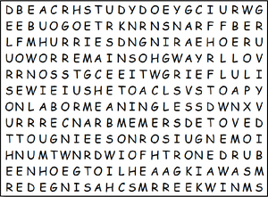
Family Activities
Humph! You know the drill … find the words! And if you know what’s good for you and your family, you’ll look up the Family Activities page at https://tinyurl.com/yy6tvant Humph!

Slide 20
When Life Seems Empty
March 3

