Slide 1
When Marriage Is Questioned
February 10

Slide 2
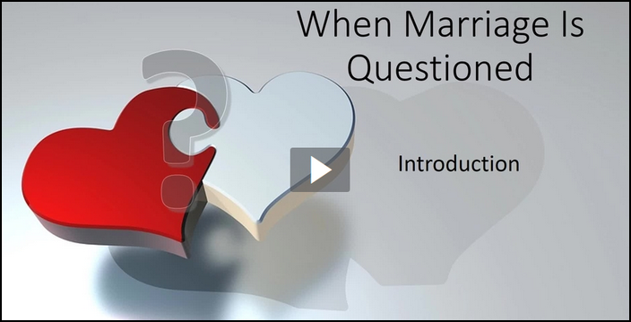
Introduction
View Video

Slide 3
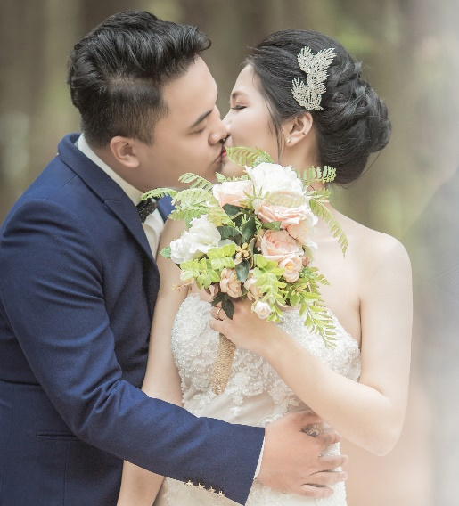
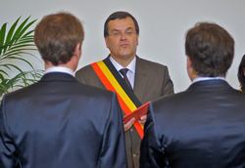
What’s your opinion?
Consider the fill in the blank statement, “Marriage is________.” What are some ways our current society might complete this statement?
Our culture’s views do not change God’s design for marriage.
Marriage is between one man and one woman for life.
Humanity needs marriage – the sacred relationship between one man and one woman

Slide 4
Listen for what God says about man being alone.
Genesis 2:18-20 (NIV) The LORD God said, "It is not good for the man to be alone. I will make a helper suitable for him." 19 Now the LORD God had formed out of the ground all the beasts of the field and all the birds of the air. He brought them to the man to see

Slide 5
Listen for what God says about man being alone.
what he would name them; and whatever the man called each living creature, that was its name. 20 So the man gave names to all the livestock, the birds of the air and all the beasts of the field. But for Adam no suitable helper was found.

Slide 6
Marriage Was Designed by God
What did the Lord God identify as not good as far as the man was concerned?
What was one act the man took as part of his assignment to have dominion over other living creatures?
The King James Version says God wanted an “help meet” for him? What does that mean?

Slide 7
Marriage Was Designed by God
What does the fact that it was not good for man to be alone tell us about the importance of relationships?
What is the value in a spouse who complements but is different than you?

Slide 8
Marriage Was Designed by God
Why is it still true that it is not good for us to be alone?
How can the God-given need for fellowship be met regardless of our marital status?

Slide 9
Listen for how Eve’s creation was different.
Genesis 2:21-22 (NIV) So the LORD God caused the man to fall into a deep sleep; and while he was sleeping, he took one of the man's ribs and closed up the place with flesh. 22 Then the LORD God made a woman from the rib he had taken out of the man, and he brought her to the man.

Slide 10
Man and Woman Created as Unique Genders
What steps did the Lord take in making the woman?
How did this differ from the way He created the man and the other creatures of the land?
What does God’s creating the woman from a part of the man (his rib) say about the relationship God wants for the husband and wife?

Slide 11
Man and Woman Created as Unique Genders
In what ways does our culture challenge God’s distinct design of men and women?
How did God bring you together with your spouse? If you are unmarried, tell about how God brought your parents together.

Slide 12
Man and Woman Created as Unique Genders
Note that God brought Eve to Adam. What does this suggest about choosing a spouse?
On what attributes of God were Adam and Eve forced to trust? What attributes of God should we likewise be trusting?

Slide 13
Listen for Adam’s response to God’s gift.
Genesis 2:23-25 (NIV) The man said, "This is now bone of my bones and flesh of my flesh; she shall be called 'woman,' for she was taken out of man." 24 For this reason a man will leave his father and mother and be united to his wife, and they will become one flesh. 25 The man and his wife were both naked, and they felt no shame.

Slide 14
Marriage Is One Man, One Woman, United for Life
What was Adam’s response when the Lord presented the woman to him?
According to these verses, in what ways are man and women similar / dissimilar?
Similar | Dissimilar

Slide 15
Marriage Is One Man, One Woman, United for Life
Note the phrase “become one flesh.” We usually think of a sexual union, but what else is implied by “one flesh” or marriage unity?
How does this understanding of “oneness” change and grow during the years of a marriage?
What are the gifts that result from God’s design of a marital relationship?

Slide 16
Application
Pray.
If you are married, pray for your spouse daily.
If you’re not married, pray for those who are.
Pray marriages would be lived in ways that honor Christ.

Slide 17
Application
List.
Make a list of the strengths and qualities your spouse brings to your marriage—those traits that make for a strong marriage.
If you’re not married, list the qualities you would look for in a mate.

Slide 18
Application
Respect.
Respect all individuals as created in the image of God.
Show grace and compassion to those who disagree with the biblical definition of marriage.

Slide 19
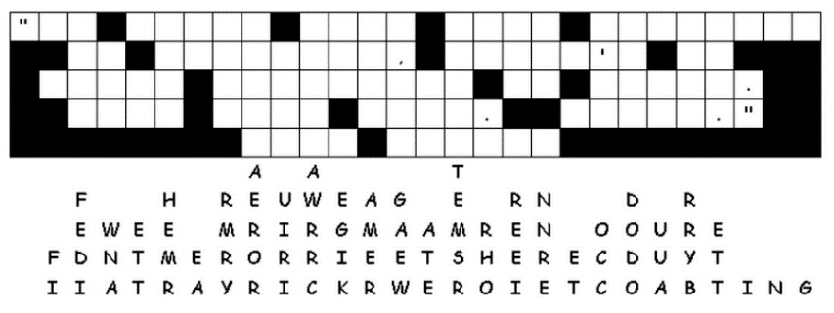
Family Activities
When we have children, we’ll be sure to do the after class Family Activities. You can find fun things to do at https://tinyurl.com/y9en7bs5 Actually we’ll check it out this week, ourselves. That Fallen Phrases puzzle looks interesting.

Slide 20
When Marriage Is Questioned
February 10

