Slide 1
When Cultures Collide
January 13

Slide 2
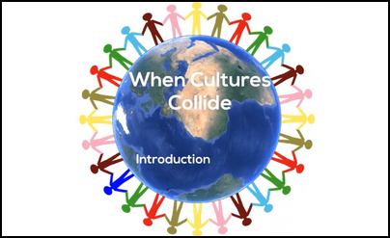
Introduction Video
View Video

Slide 3
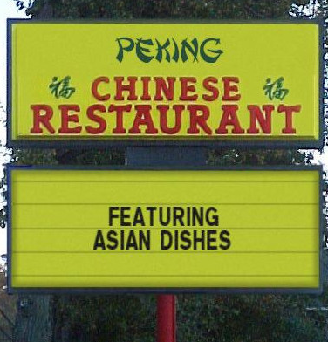
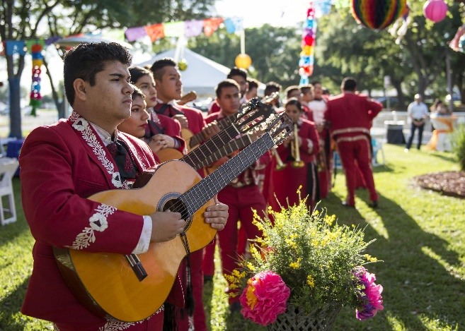
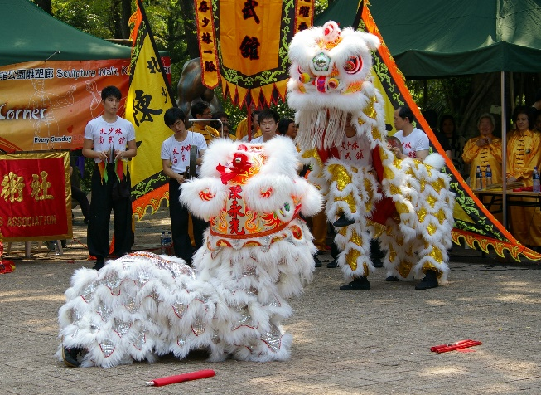
Consider …
What do you appreciate most about other cultures?
There are both things we like and things we don’t appreciate about cultures we come in contact with.
Most of us have varying degrees of negative response to some aspects other cultures.
However, our relationship with Christ should be result in our unity with one another.

Slide 4
Listen for past spiritual condition.
Ephesians 2:11-12 (NIV) Therefore, remember that formerly you who are Gentiles by birth and called "uncircumcised" by those who call themselves "the circumcision" (that done in the body by the hands of men)-- 12 remember that at that time you were separate from Christ, excluded from citizenship in Israel and foreigners to the covenants of the promise, without hope and without God in the world.

Slide 5
Differences Divide
What four phrases did Paul use to describe the spiritual state of the Gentiles in the past, their condition before coming a follower of Jesus?
What is the importance of remembering who we were before knowing Christ?
What kinds of things contribute to someone being “far away” from Jesus Christ today?

Slide 6
Differences Divide
For someone struggling with one or more of these problems, what are the disadvantages of living without Christ?
What then would be present advantages of living your life with Christ?
Why could it be beneficial to look back at your life BC (before Christ) and recall the hopelessness you experienced?

Slide 7
Listen for how Jesus is our peace.
Ephesians 2:13-18 (NIV) But now in Christ Jesus you who once were far away have been brought near through the blood of Christ. 14 For he himself is our peace, who has made the two one and has destroyed the barrier, the dividing wall of hostility,

Slide 8
Listen for how Jesus is our peace.
by abolishing in his flesh the law with its commandments and regulations. His purpose was to create in himself one new man out of the two, thus making peace, 16 and in this one body to reconcile both of them to God through the cross, by which he put to death their hostility.

Slide 9
Access to God the Father
How did Christ’s work on the cross transform the condition of the Gentiles?
How did the enmity between Jews and Gentiles come to an end? Who changed the past and what difference did He make in the relationship between Gentiles and Jews and in both group’s relationship with God?

Slide 10
Access to God the Father
What does the word “access” imply about the needs of Gentiles and Jews alike and what benefit came to each?
What kind of barriers cause hostility in our world?
How does what Christ has done bring down these kinds of barriers?

Slide 11
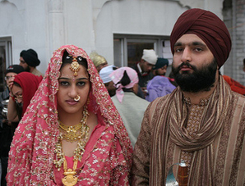
Access to God the Father
What if this couple showed up to our Small Group next week? How should churches treat “foreigners and aliens”?

Slide 12
Listen for a foundation described.
Ephesians 2:19-22 (NIV) Consequently, you are no longer foreigners and aliens, but fellow citizens with God's people and members of God's household, 20 built on the foundation of the apostles and prophets, with Christ Jesus himself as the chief cornerstone.

Slide 13
Listen for a foundation described.
In him the whole building is joined together and rises to become a holy temple in the Lord. 22 And in him you too are being built together to become a dwelling in which God lives by his Spirit.

Slide 14
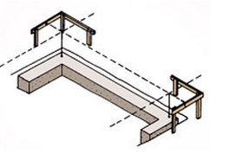
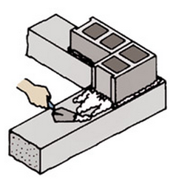
Believers Are One in Christ
In Christ, how did the Gentiles achieve new spiritual and social status?
On what foundation were the Ephesian believers built?
http://www.acehardware.com/info/index.jsp?categoryId=1283397

Slide 15
Believers Are One in Christ
What images did Paul use to describe the union of all believers in Christ?
Why do you think the church is slow to embrace ethnic diversity in the body of Christ?
How can we focus on what we have in common in Christ over any differences that separate us?
What are some practical steps our group can take to positively impact race relations in our community?

Slide 16
Application
Admit.
Racism still exists.
Confess to God any prejudice you feel toward another person.

Slide 17
Application
Meet.
Get to know your neighbors and coworkers who have a different ethnicity than yours.
Don’t treat them differently— treat them simply as a neighbor or coworker.
You can build bridges by focusing on what you share in common.

Slide 18
Application
Invite.
Invite someone of a different race or ethnicity to come with you to your Bible study group.
The smaller group environment is a great way for them to build relationships with other believers.

Slide 19
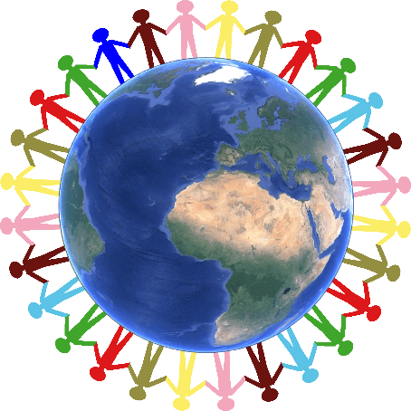
Family Activities
Greetings from India. On the Family Activities, your family can learn about how God unites all cultures together through Jesus Christ. Check out the activities at https://tinyurl.com/yapbkkoj

Slide 20
When Cultures Collide
January 13

