Slide 1
Why Do We Suffer
October 29

Slide 2
Video Introduction
View Video

Slide 3
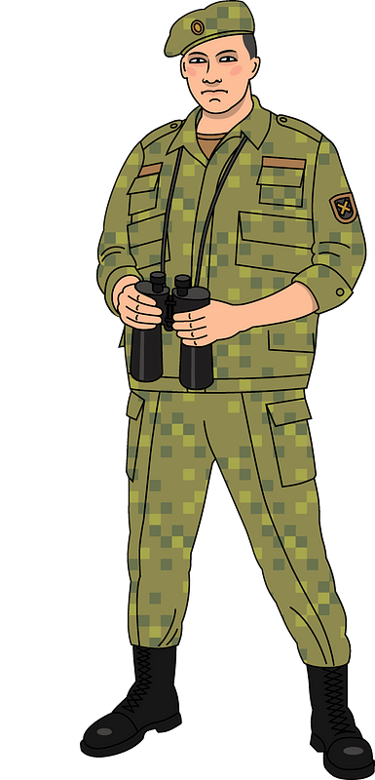
What about it …
What significant events in your life have helped to shape your view of life and your view of God?
Most everyone will list an illness or injury which caused suffering to themselves of someone close.
A song from the 1940’s, “Into Each Life Some Rain Must Fall” expresses this.
We may not know why we suffer, but God meets us in our suffering.

Slide 4
Listen for Job’s complaint.
Job 30:26-31 (NIV) Yet when I hoped for good, evil came; when I looked for light, then came darkness. 27 The churning inside me never stops; days of suffering confront me. 28 I go about blackened, but not by the sun; I stand

Slide 5
Listen for Job’s complaint.
up in the assembly and cry for help. 29 I have become a brother of jackals, a companion of owls. 30 My skin grows black and peels; my body burns with fever. 31 My harp is tuned to mourning, and my flute to the sound of wailing.

Slide 6
We All Experience Suffering
Before his suffering, where do you suppose Job got his sense of security?
What are words and phrases that describe physical suffering?
Which words or phrases may be describing emotional and spiritual suffering?

Slide 7
We All Experience Suffering
What are some ways people try to cope with suffering?
How did Job let his circumstances shape his perception of his life?

Slide 8
We All Experience Suffering
Note that Job let his circumstances affect his relationship with God and his relationship with others.
Questioned God
Doubted that God had done him right
Wanted to confront God

Slide 9
We All Experience Suffering
Why do you think Job found his personal suffering so confusing and unfair?
Giving voice to our suffering-making a groaning lament-is sometimes good for us.
It acknowledges our pain
Helps us to remember that suffering is common to all humans,
It doesn't last forever

Slide 10
Listen for how Job responds to God.
Job 42:1-3 (NIV) Then Job replied to the LORD: 2 "I know that you can do all things; no plan of yours can be thwarted. 3 You asked, 'Who is this that obscures my counsel without knowledge?' Surely I spoke of things I did not understand, things too wonderful for me to know.

Slide 11
Trust that God Is Sovereign
What brought Job to this point of response?
What was the essence of Job’s confession concerning the Lord?
What realization enabled Job to not yield to these kinds temptations and caused him to repent?

Slide 12
Trust that God Is Sovereign
Consider these strategies to learn to listen to God, rather than dictate to Him?
When you read His word, consider first the facts that it is stating
Then think about (maybe even write down) what it means to you
Now ask God to tell you what you how you should be responding to or applying the Truth that you have found

Slide 13
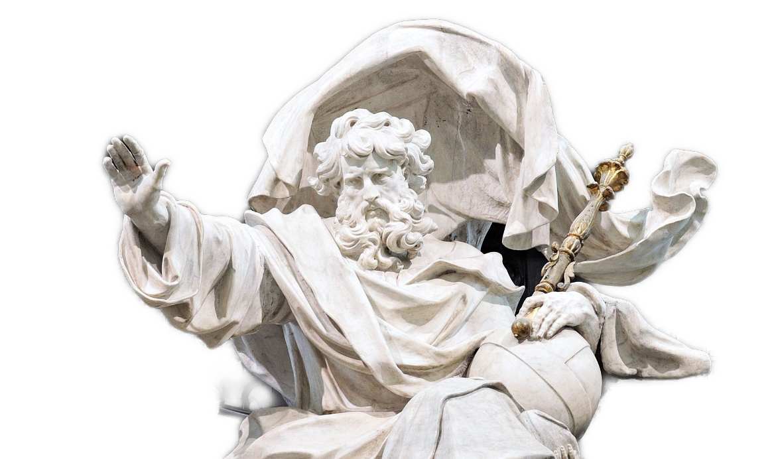
Trust that God Is Sovereign
Why is acknowledging the mystery and superiority of God a comfort and encouragement?

Slide 14
Listen for evidence of Job’s humility.
Job 42:4-6 (NIV) "You said, 'Listen now, and I will speak; I will question you, and you shall answer me.' 5 My ears had heard of you but now my eyes have seen you. 6 Therefore I despise myself and repent in dust and ashes."

Slide 15
Experience the Presence of God
What two sources of knowledge about God did Job identify?
What's the difference between knowing about God and knowing God?
Knowing About God | Knowing God

Slide 16
Experience the Presence of God
What response did it generate from Job?
Now Job is expressing an attitude of faith. What can we do to express faith in the midst of suffering?

Slide 17
Application
Confess.
All suffering is not a result of sin, but sin can lead to suffering.
Ask God to reveal any sin in your life.
Confess that and thank Him for His grace and forgiveness.

Slide 18
Application
Honor.
Ask God to show you how He wants to strengthen you during a time of suffering.
While dealing with difficulties, look for ways to honor Christ.

Slide 19
Application
Encourage.
Everyone’s experience with suffering is different.
Share with someone how God helped you, strengthened you, and brought glory to Himself during a time of hardship or suffering.

Slide 20
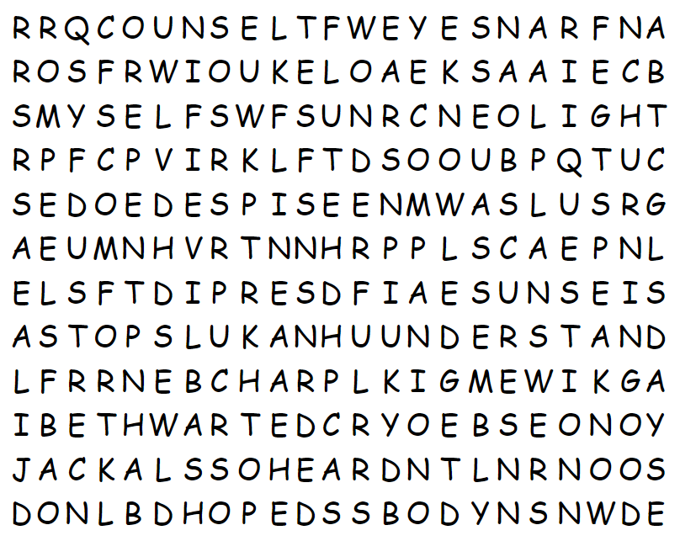
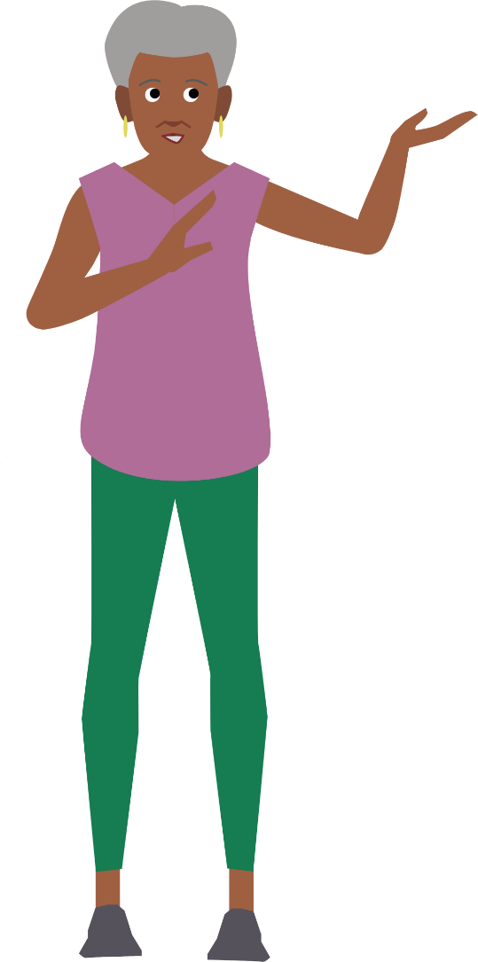
Family Activities
The Word Search Lady says she’s letting you off easy. No words are backwards or from down to up. “So you won’t suffer,” she says. But if you struggle, go to https://tinyurl.com/2vstymmc There’s other fun Family Activities also. Like the crossword for you ladies in the back row, who always ask about it.

Slide 21
Why Do We Suffer
October 29

