Slide 1
Why Does Suffering Exist?
January 12

Slide 2
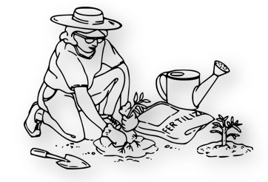
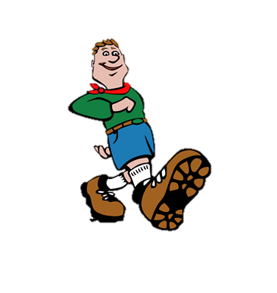
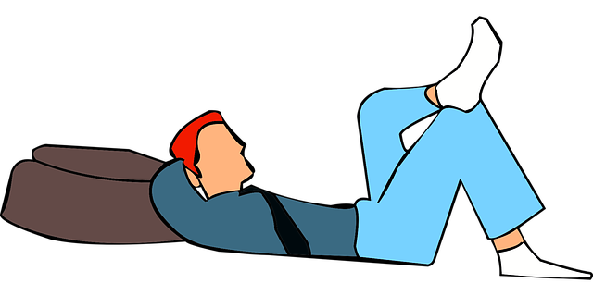
Think about it …
What’s your favorite way to relax and recover after a hard day?
Everyone occasionally has a difficult day at work – physically, mentally, or emotionally.
Life also can also bring tragedies and grief.
Today we consider why suffering is a part of living in a fallen world.

Slide 3
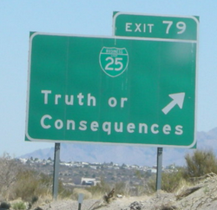
Consequences of Sin Hardship and Pain
What are some synonyms for “consequences”
Listen for consequences of sin.

Slide 4
Listen for consequences of sin.
Genesis 3:16-19 (NIV) To the woman he said, "I will greatly increase your pains in childbearing; with pain you will give birth to children. Your desire will be for your husband, and he will rule over you." 17 To Adam he said, "Because you listened to your wife and ate from the tree about which I commanded you, 'You must not eat of it,' "Cursed is the

Slide 5
Listen for consequences of sin.
ground because of you; through painful toil you will eat of it all the days of your life. 18 It will produce thorns and thistles for you, and you will eat the plants of the field. 19 By the sweat of your brow you will eat your food until you return to the ground, since from it you were taken; for dust you are and to dust you will return."

Slide 6
Consequences of Sin Hardship and Pain
What do we learn about the effects of sin from these verses? How did God punish the man and the woman?
What emotions do you experience when you read these verses?
How do the curses given to the man and woman affect twenty-first century humanity? How does this original sin affect us on a daily basis?
The Man | The Woman

Slide 7
Consequences of Sin Hardship and Pain
Adam and Eve in the garden (then thrown out) experienced consequences as they chose to sin. What consequences of sin do people experience when they choose to sin?
What surprises you about the way people respond to sin’s consequences?
What can long time Christians do to help people understand that sin has consequences?

Slide 8
Listen for the effect of sin on creation.
Romans 8:18-22 (NIV) I consider that our present sufferings are not worth comparing with the glory that will be revealed in us. 19 The creation waits in eager expectation for the sons of God to be revealed. 20 For the creation was subjected to frustration, not by its own choice, but by the will of the one who subjected it, in hope

Slide 9
Listen for the effect of sin on creation.
that the creation itself will be liberated from its bondage to decay and brought into the glorious freedom of the children of God. 22 We know that the whole creation has been groaning as in the pains of childbirth right up to the present time.

Slide 10
All Creation Suffers
How did Paul describe the difference between his present and his future?
How does this contrast help us endure the sufferings we experience?
How would you describe the contrast between original creation and our current state?
Original Creation | Current State of Natural Environment

Slide 11
All Creation Suffers
What does the passage say about the future of God’s creation?
Why does it help to know that suffering will end?
We all experience some futility and some bondage of corruption this side of heaven. How do we keep serving God in the midst of it?

Slide 12
Listen for how we are rescued from suffering.
Romans 8:23-25 (NIV) Not only so, but we ourselves, who have the firstfruits of the Spirit, groan inwardly as we wait eagerly for our adoption as sons, the redemption of our bodies. 24 For in this hope

Slide 13
Listen for how we are rescued from suffering.
we were saved. But hope that is seen is no hope at all. Who hopes for what he already has? 25 But if we hope for what we do not yet have, we wait for it patiently.

Slide 14
Full Redemption from Suffering
What do believers have in common with all creation?
Paul talks about the “redemption” of our bodies. What are some synonyms of “redemption”?
What does it mean to live in hope? What are some ways the Holy Spirit helps you experience deliverance and redemption from suffering and look forward with hope?

Slide 15
Full Redemption from Suffering
How does Paul’s description of hope differ from our culture’s use of the word?
What hope can we share with people around us?
“Hope” in Modern Culture | “Hope” as Used by Paul

Slide 16
Application Video
View Video

Slide 17
Application
Acknowledge your sin.
Admit to God that you are a sinner.
While you may live with the consequences of past sin, you can be forgiven and look forward to a future in Christ that will ultimately be free of suffering.

Slide 18
Application
Look to God.
As you “groan with hope” and look to the future, make a list of the ways God can use your current situation to deepen your walk with Him.

Slide 19
Application
Share your hope.
As you encounter others who are suffering, allow God to use your suffering to help others.
Be aware of opportunities to help and encourage others who are suffering.

Slide 20
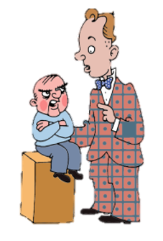
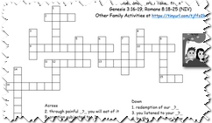
Family Activities
Don’t act like the Word Search Lady. The Crossword Puzzle is on this week’s handout … just for you. And there are other things to see and do at https://tinyurl.com/tjffz2k
Humph!

Slide 21
Why Does Suffering Exist?
January 12

