Slide 1
Wisdom from God
July 26

Slide 2

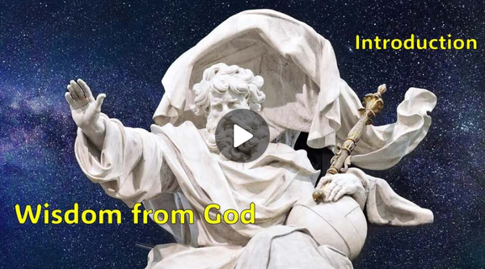
Video Introduction
View Video

Slide 3



It’s amazing …
What are some different ways you access information for home, work, church, areas of curiosity?
Today we look at ⇨ WISDOM
  God grants wisdom as we learn from Him and apply what we learn
  Believers have the Wisdom of God because we have the Spirit of God

Slide 4
Listen for leading questions.
1 Corinthians 1:20-25 (NIV) Where is the wise man? Where is the scholar? Where is the philosopher of this age? Has not God made foolish the wisdom of the world? 21 For since in the wisdom of God the world through its wisdom did not know him, God was

Slide 5
Listen for leading questions.
pleased through the foolishness of what was preached to save those who believe. 22 Jews demand miraculous signs and Greeks look for wisdom, 23 but we preach Christ crucified: a stumbling block to Jews and

Slide 6
Listen for leading questions.
foolishness to Gentiles, 24 but to those whom God has called, both Jews and Greeks, Christ the power of God and the wisdom of God. 25 For the foolishness of God is wiser than man's wisdom, and the weakness of God is stronger than man's strength.

Slide 7
Worldly Wisdom – Foolishness
What kinds of things do the Jews seek? What are the Greeks looking for?
Jews | Greeks

Slide 8
Worldly Wisdom – Foolishness
Why do you think each group would struggle with the message of the cross?
Jews | Greeks

Slide 9
Worldly Wisdom – Foolishness
In what ways are we tempted to trust human wisdom more than God's wisdom?
Why do you think people often admire intelligence, education, wealth, or influence more readily than humility, faith, or obedience?

Slide 10

Worldly Wisdom – Foolishness
If God's wisdom often runs contrary to worldly wisdom, how can we become better at recognizing which voice we're listening to?

Slide 11
Worldly Wisdom – Foolishness
Consider Deuteronomy 6:6-7 (NIV) These commandments that I give you today are to be upon your hearts. Impress them on your children. Talk about them when you sit at home and when you walk along the road, when you lie down and when you get up.
How would following this command help both child and parent?

Slide 12
Listen for how God’s “mystery” is discovered.
1 Corinthians 2:9-11 (NIV) However, as it is written: "No eye has seen, no ear has heard, no mind has conceived what God has prepared for those who love him"-- 10 but God has revealed it to us by his Spirit.

Slide 13
Listen for how God’s “mystery” is discovered.
The Spirit searches all things, even the deep things of God. 11 For who among men knows the thoughts of a man except the man's spirit within him? In the same way no one knows the thoughts of God except the Spirit of God.

Slide 14
The Spirit Reveals the Mind of God
What is the essence of verse 9 and why is verse 10a essential to understanding Paul’s intent?
However, as it is written: "No eye has seen, no ear has heard, no mind has conceived what God has prepared for those who love him"-- but God has revealed it to us by his Spirit.

Slide 15
The Spirit Reveals the Mind of God
Who enables us to know and understand the things of God?
Why is the Spirit capable of making known the things of God to us?

Slide 16

The Spirit Reveals the Mind of God
Why do people often fail to see God’s purpose for them?
How can we discern whether it’s the Holy Spirit who is speaking to and leading us?

Slide 17
Listen for more foolishness.
1 Corinthians 2:12-16 (NIV) We have not received the spirit of the world but the Spirit who is from God, that we may understand what God has freely given us. 13 This is what we speak, not in words taught us by human wisdom but in words taught

Slide 18
Listen for more foolishness.
by the Spirit, expressing spiritual truths in spiritual words. 14 The man without the Spirit does not accept the things that come from the Spirit of God, for they are foolishness to him, and he cannot understand them, because they are spiritually

Slide 19
Listen for more foolishness.
discerned. 15 The spiritual man makes judgments about all things, but he himself is not subject to any man's judgment: 16 "For who has known the mind of the Lord that he may instruct him?" But we have the mind of Christ.

Slide 20
Depend on the Holy Spirit
Note the characteristics of the wisdom that the Spirit teaches us.
  Spiritual Truth has its own vocabulary
  It is not human wisdom
  It is God’s wisdom
  It is not so much a case of the persuasion of logic or debate
  It is Truth that is revealed by God, that we accept by faith, because God said it

Slide 21
Depend on the Holy Spirit
According to this passage, how are spiritual and unspiritual people different?
Spiritual People | Unspiritual People

Slide 22
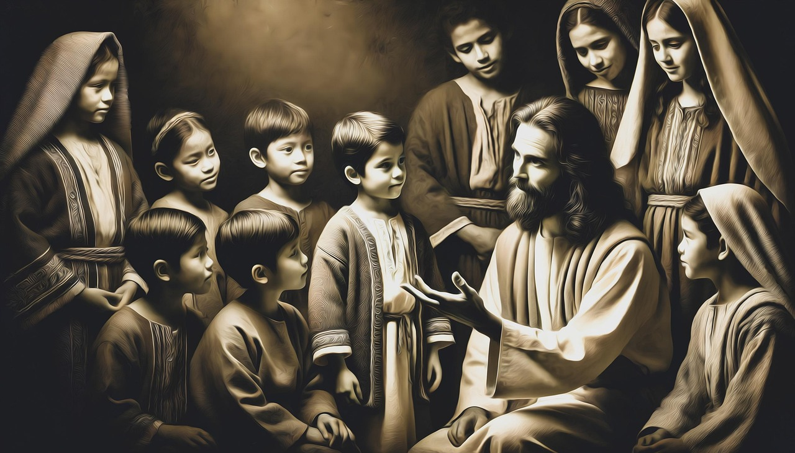
Depend on the Holy Spirit
What does it mean to have the mind of Christ?
How can you know if you have the mind of Christ?

Slide 23
Application
Submit.
  Evaluate your life and consider if you are living in dependence on the Holy Spirit.
  Ask God to fill you with His Holy Spirit (Eph. 5:18) and guide your thoughts and actions.

Slide 24
Application
Examine.
  If you are facing a decision and need counsel, look to Scripture and examine passages that address that issue.
  Contrast what Scripture says with the counsel the world might offer.
  Determine to follow the wisdom God has given through His Word.

Slide 25
Application
Share.
  Tell others in your group the insights God has given you.
  As God’s Spirit gives you discernment, He may desire for you to be a conduit of His wisdom to others

Slide 26



Family Activities
Whooo … is looking
for wisdom? Look in the
Bible passage for the words in the clue phrases. Help is available (along with the color page) at
https://tinyurl.com/r83e4r2p

Slide 27
Wisdom from God
July 26

