Slide 1
Worship Continuously
August 11

Slide 2
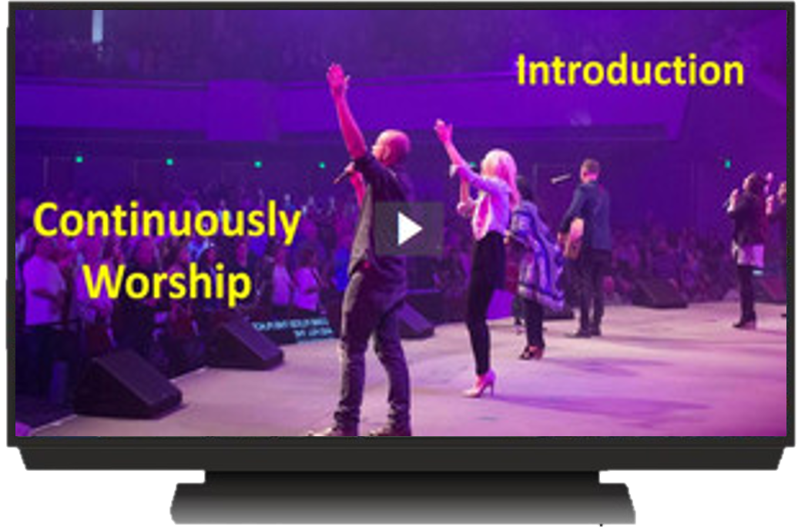
Introduction Video
View Video

Slide 3
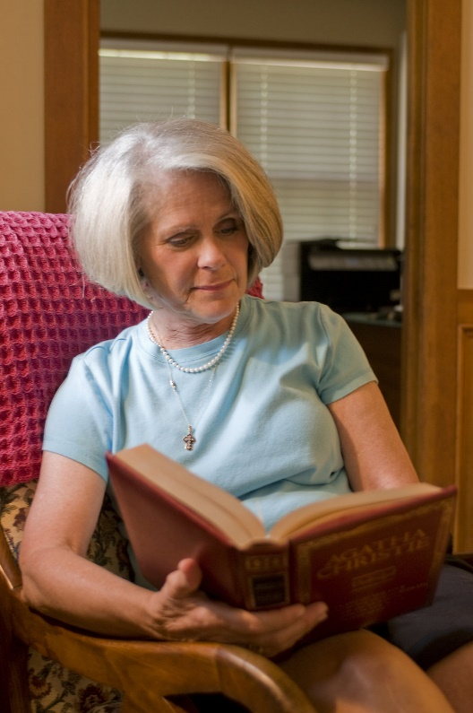
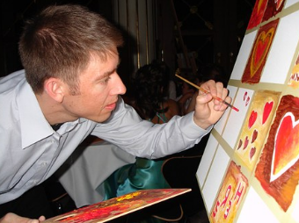
Be honest, now …
What’s something you enjoy doing so much that you lose track of time?
How you use your time is a commentary on what is important to you.
Today we consider the importance of worship in our lives
God calls us to live our lives as an act of worship.

Slide 4
Listen for extravagance of worship.
2 Chronicles 15:10-15 (NIV) They assembled at Jerusalem in the third month of the fifteenth year of Asa's reign. 11 At that time they sacrificed to the LORD seven hundred head of cattle and seven thousand sheep and goats from the plunder they had brought back. 12 They entered into a covenant to seek the LORD, the God of their fathers, with all their heart and soul. 13 All who

Slide 5
Listen for extravagance of worship.
would not seek the LORD, the God of Israel, were to be put to death, whether small or great, man or woman. 14 They took an oath to the LORD with loud acclamation, with shouting and with trumpets and horns. 15 All Judah rejoiced about the oath because they had sworn it wholeheartedly. They sought God eagerly, and he was found by them. So the LORD gave them rest on every side.

Slide 6
Worship – Sacrifice and Obedience
What was extravagant about the numbers of the animals sacrificed? What was the source of the offerings they sacrificed unto the Lord?
Note when the people gathered in Jerusalem and the significance of it being the third month?

Slide 7
Worship – Sacrifice and Obedience
What were elements of the covenant they entered into? Through what practices did they affirm their commitment to the covenant agreement and declare their loyalty to the Lord?
How did the Lord respond to them?
What do you think it means for us today to “seek God eagerly”?

Slide 8
Worship – Sacrifice and Obedience
What does it look like to worship God with both your mind and heart?
Worship of God includes giving unto Him from all the resources with which He has blessed us. What are resources from which we can give to God?
How can believers demonstrate the seriousness of their commitment to Christ?

Slide 9
Listen for how Asa was totally committed.
2 Chronicles 15:16-19 (NIV) King Asa also deposed his grandmother Maacah from her position as queen mother, because she had made a repulsive Asherah pole. Asa cut the pole down, broke it up and burned it in the Kidron Valley. 17 Although he did not remove the high places from Israel,

Slide 10
Listen for how Asa was totally committed.
Asa's heart was fully committed [to the LORD] all his life. 18 He brought into the temple of God the silver and gold and the articles that he and his father had dedicated. 19 There was no more war until the thirty-fifth year of Asa's reign.

Slide 11
Focus on God Alone
What or who could have been one major, personal challenge Asa faced in carrying out his reform?
So, what did Asa do to his grandmother?
Why would such action be necessary?
What additional actions of worship did Asa carried out?

Slide 12
Focus on God Alone
What evidence is there that the Lord accepted Asa’s worship?
What is our responsibility to help our family members be wholehearted followers of the Lord? How should we respond to family members who don’t follow the Lord?
How can we identify and remove idols from our lives?

Slide 13
Focus on God Alone
How can authentic worship happen beyond Sunday?
How does your giving express your worship to God? How does it bring you joy?
What are some of the greatest challenges to your worship of the Lord?
How can we overcome these challenges and distractions?

Slide 14
Application
Memorize.
Memorize Psalm 105:4: “Look to the Lord and his strength; seek his face always.”
Let the challenge of that verse become second nature to you.

Slide 15
Application
Take inventory.
During the coming week, take note of the things that distract you on a daily basis.
Beside each item on your list, note practical steps you can take to avoid these distractions.

Slide 16
Application
Share.
Talk with a trusted friend about the things that tend to pull you away from wholehearted worship.
Ask them to hold you accountable to stay away from away distractions and to covenant with you to pray.

Slide 17
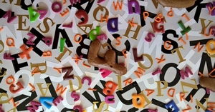
Family Activities
Oh, no! All the letters fell down and the message has disappeared. You can fix them. Check out this puzzle and other interesting activities at https://tinyurl.com/yxhynvju

Slide 18
Worship Continuously
August 11

