Slide 1
STEWARDSHIP

Slide 2
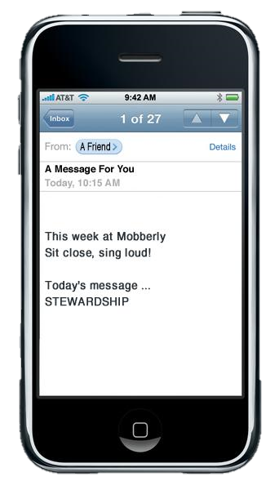
Be honest, now …
When you see a sermon title announced that contains the word “stewardship”, what does that suggest to you?

Slide 3
Stewardship
Today we are going to look at the concept of stewardship.
We will see that it is more than how we use our money.
It is the management of everything that God brings into the life of a believer

Slide 4
Listen for who owns what.
"The earth is the Lord's, and everything in it, the world, and all who live in it." (Psalm 24:1) "To the Lord your God belong the heavens, even the highest heavens, the earth and everything in it." (Deuteronomy 10:14) "Who has a claim against me that I must pay?

Slide 5
Listen for who owns what.
Everything under heaven belongs to me." (Job 41:11) For every animal of the forest is mine, and the cattle on a thousand hills. Psalm 50:10 (NIV)

Slide 6
God Is the Owner
Keeper
Curator
Superintendent
Supervisor
Guardian
Manager
List what these verses say belong to God.
If all “our” time, treasure, and talent belong to God, that makes us “stewards”. What are some synonyms of “steward”
Note: in this context WE are NOT the owners.

Slide 7
God Is the Owner
In what ways do we too often squander or mismanage each of these resources which God owns?
Time | Treasure | Talent

Slide 8
God Is the Owner
Stewardship Continuum
Excessive
Conservative
Generous
Restricted `

Slide 9
God Is the Owner
How does a healthy view of your being a steward of what God owns draw you closer to God?
We so often stress daily reading and applying God’s Word to our lives. How would that practice make you more aware that God is the owner of all we have?

Slide 10
Listen for how Joseph was responsible.
Genesis 39:3-6 (NIV) 3 When his master saw that the LORD was with him and that the LORD gave him success in everything he did, 4 Joseph found favor in his eyes and became his attendant. Potiphar put him in charge of his household, and he entrusted to his care everything he owned.

Slide 11
Listen for how Joseph was responsible.
From the time he put him in charge of his household and of all that he owned, the LORD blessed the household of the Egyptian because of Joseph. The blessing of the LORD was on everything Potiphar had, both in the house and in the field.

Slide 12
Be A Responsible Steward
What responsibilities was Joseph entrusted with, and how did he handle them?
From the time he put him in charge of his household and of all that he owned, the LORD blessed the household of the Egyptian because of Joseph. The blessing of the LORD was on everything Potiphar had, both in the house and in the field

Slide 13
Be A Responsible Steward
What did Potiphar observe/perceive about Joseph?
When his master saw that the LORD was with him and that the LORD gave him success in everything he did, Joseph found favor in his eyes and became his attendant. Potiphar put him in charge of his household, and he entrusted to his care everything he owned.

Slide 14
Be A Responsible Steward
What principles of stewardship can we derive from Joseph's actions in Potiphar's household?
Let’s list further characteristics about someone that would suggest they are good stewards? What qualities would you look for in hiring this position?
God can enable us with these qualities to be good stewards of our time, our finances, and our skills.

Slide 15
Listen for who was a good steward.
Matthew 25:14-18, 21 For it is just like a man about to go on a journey. He called his own servants and entrusted his possessions to them. 15 To one he gave five talents, to another two talents, and to another one talent, depending on each one’s ability. Then he went on his journey. Immediately 16 the man who had received five talents went, put

Slide 16
Listen for who was a good steward.
them to work, and earned five more. 17 In the same way the man with the two earned two more. 18 But the man who had received one talent went off, dug a hole in the ground and hid his master’s money…21 His master said to him, “Well done, good and faithful servant! You were faithful over a few things; I will put you in charge of many things.”

Slide 17
Held Accountable for Our Stewardship
What was expected of the servant/stewards?
What happened to the servant/stewards who invested and showed a return?
What happened to the “wicked and lazy” servant?

Slide 18
Held Accountable for Our Stewardship
We have said that the resources God has entrusted to us include time, finances, and skills or abilities.
Remember that these things belong to God
Just like the man in the story, He has left them with us to invest and bring an increase.

Slide 19
Held Accountable for Our Stewardship
Why/how are we tempted to act like the servant who buried his bag of gold?
At our stage of life, in what way might we be able to invest the resources God has entrusted to us? What kinds of investments does He intend for us to make with His resources?

Slide 20
Application
Pray for God to help you see your time, talents, and treasures as something to be managed for His good.

Slide 21
Application
Pray for God to guard your heart and mind against the temptation to obtain more possessions for personal glorification.

Slide 22
Application
Ask God to grow you in the discipline of stewardship so you can use your possessions to bring Him glory.

Slide 23
STEWARDSHIP

